Slide 1
Documentation Burden: Ethical Considerations
Mari Tietze, PhD, RN-BC, FHIMSS
Professor, Doswell Endowed Chair in Nursing Informatics Program Dir., Post-Baccalaureate Certificate in Interprofessional Informatics
Joni Padden, DNP, APRN-BC, CPHIMS
Nursing Informatics Specialist
Texas Health Resources
This presentation is derived from: McBride, S., Tietze, M., Robichaux, C., Stokes, L., Weber, E., (January 31, 2018) "Identifying and
Addressing Ethical Issues with Use of Electronic Health Records" OJIN: The Online Journal of Issues in Nursing Vol.
23, No. 1, Manuscript 5.

Slide 2
Objectives
Explore impact of EHR use on provider satisfaction and ethical practice
Describe components of information technology-based documentation issues/burden
Summarize global efforts to address information technology competencies
Define steps to address documentation burden in your specific organization

Slide 3
Clinical teams often confront usability challenges that present ethical issues
Take a few minutes and review the case study
This case scenario can be examined in terms of the overall context of ethical implications in use of the EHR.
We can also consider the distress that can occur when protocols/guidelines; clinical decision support systems; nurse-patient relationship; and clinical communications between and among teams conflict with a nurse's code of ethics.

Slide 4
Why Does HIT Matter Deep in the Heart of Texas?
Nurses Experience Using their EHRs
Environmental Forces:
Health Care Reform/ARRA
Advanced Practice Nurse Roles
EHR Incentives
IOM/RWJF Report Advancing Health Care
Informatics Nurse Standards by ANA
Involved
Constituents
Benchmark Reports
on
Progress
CNE for Practicing Nurses
Educational Content Dissemination
Awareness Campaign
HIT Orgs.
Nursing HIT Curriculum Development
and
Embrace the Technology
Preserve the Art
Nursing Leaders
For 400,000
Texas Nurses
T.I.G.E.R
Phase III
Partnership
© Texas Nurses Association, 2015
Advisory Committee: Practice, Administration, Education and Vendors/Suppliers
Notes:
Executive Summary
The impact of this technological revolution and associated mandates in Texas affects over 400,000 members of the nursing workforce: registered nurses, advanced practice nurses, state/government-employed nurses, licensed vocational nurses, and certified nursing care assistants. Therefore, it is critical that Texas Nurses Association/Texas Organization of Nurse Executives develop and execute a strategic, state-wide approach to meet the challenge, including:
HIT Literacy Across the Continuum of Care
Communication/Collaboration/Coordination with Stakeholders
Funding for State-wide Approach
[We Assess] Environmental Forces
Health Care Reform/ARRA
Advanced Practice Nurse Roles
EHR incentives
IOM/RWJF Report Advancing Health Care
Informatics Nurse Standards by ANCC
[We Dialogue with] Nursing Leaders and HIT Organizations
Recommendations
1. Creation of Educational Content and Dissemination
The TNA HIT Task Force addressed two areas of educational need for Texas’ nurses. The first and most immediate need identified was for continuing nursing education activities to establish a baseline of knowledge for all Texas nurses related to the rapidly expanding health information technology and health information exchange infrastructure throughout the nation. The second educational need identified was to align efforts related to academic nursing curriculum.
2. Campaign to Raise Awareness
If TNA and TONE are to successfully promote the TIGER vision of nursing’s use of informatics technology – specifically, a focus on TIGERS’ nine critical steps for information technology success -- then the development of a strategic communications plan is essential. Key messages need to be developed that speak to the benefits of health information technology in realizing safer, higher-quality patient care. HIT Continuing Nursing 3. Education for Practicing Nurses
As previously noted, the HIT Task Force identified a beginning list of high priority topics for consideration for CNE programs. The purpose would be to establish a baseline knowledge for all Texas nurses so that they are prepared to be active members of multi-disciplinary teams within the health care settings in Texas to support selection, implementation and meaningful use of electronic health records.
4. Nursing HIT Curriculum Development
The HIT Task Force recommends that Texas Nurses Association establish a state-wide approach to nursing education that incorporates the TIGER initiative recommendations. We propose to address this gap with a state-wide approach to curriculum development, coupled with a regionally targeted approach to continuing nursing education.
The Task Force recommends a market driven approach and the use of focus groups to develop a state-wide model, academic HIT curriculum. Several specific development strategies for HIT education include: 1) Present at the Deans and Directors meeting; 2) Curriculum development working sessions with nursing HIT experts from academic and practice settings; and 3) Regional focus groups on HIT educational needs for Texas nurses. SEE APPENDIX C for timeline details.
5. Constituent Involvement
Organizations representing providers such as health care professionals throughout the care continuum, suppliers/vendors of health care technology, and nursing, as well as other health care, educators are considered key constituents in the aforementioned health information technology revolution. These organizations and their personnel should be sought and engaged for ongoing involvement in the proposed action plan.
6. Benchmarking Reports Toward Progress
As progress is being made through the deployment of the proposed action plan, data collection should take place to assess the improvement over time. This data collection effort can be managed by existing departments such as the Texas Center for Nursing Workforce Studies (TCNWS).
7. Formation of an Advisory Structure
In order to assure the ongoing progress toward HIT awareness in Texas, it is recommended that an advisory committee be created to monitor the deployment of these recommendations and associated reports towards progress. Members of this committee would also appoint nurses to be seated at state and national organizations doing the key work for information technology advancement in health care delivery. The committee’s scope should represent the entire continuum of nursing care delivery, as well as the practice, administrative and academic nursing arenas. The state board of nursing, the governor’s Texas Health Services Authority, TIGER and external bodies, such as HIT vendors, should also be considered for membership.

Slide 5
Background
Clinical Information Systems Implementation Evaluation Scale (CISIES) Survey*
Launched September 23, 2014, statewide
Over sampled rural hospitals in an effort to insure representation
Over 1,000 responses received
Included a newly-developed** EHR “maturity-index”
* = Gugerty, B.
** = McBride, S. & Tietze, M.
© Texas Nurses Association, 2015

Slide 6
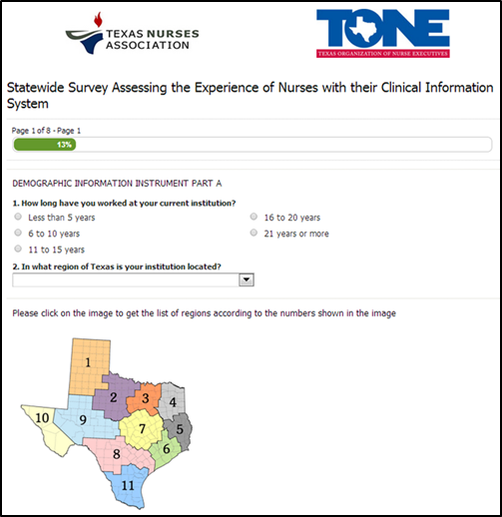
First page of the TNA/TONE state wide online survey
© Texas Nurses Association, 2015

Slide 7
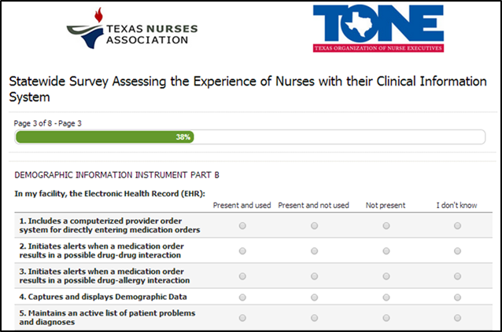
Demographic information about EHR functionality (5 of 24 items)
Meaningful Use Maturity-Sensitive Index for Nursing*
© Texas Nurses Association, 2015
(*McBride & Tietze, 2015)

Slide 8
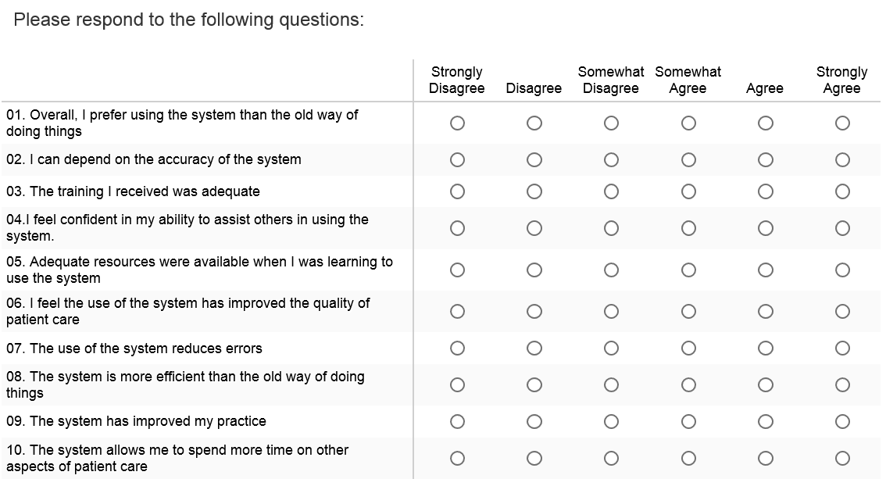
Clinical Information System Implementation Evaluation Scale (CISIES)
© Texas Nurses Association, 2015

Slide 9
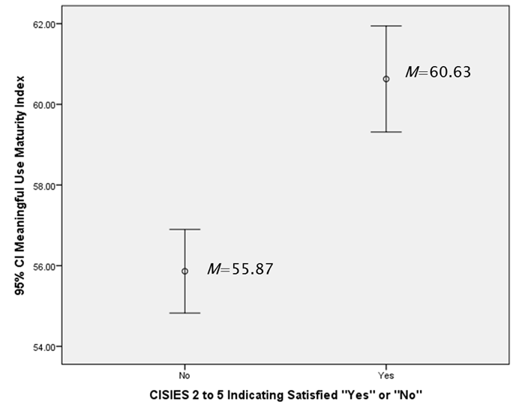
CISIES Distribution: How satisfied are nurses in Texas with EHRs?
Differences in Satisfaction with EHRs related to MU maturity.
< 0.5 CISIES Indicates Dissatisfaction
0.5-1.99 Indicates Neutral or Not Completely Satisfied
2-5 Indicates Satisfied
The MUMSI was calculated for all respondents based on 24 questions related to MU. The index score mean =56.53, median=59, range 0-72 (highest score possible).
Gugerty, B., Maranda, M., Rook, D. (2006). The Clinical Information System Implementations Evaluation Scale, pp. 621-625. In H. A. Parks, P. Murray, &
C. Delaney (Eds.) Consumer-centered computer-supported care for healthy people. Landsdale, PA: IOS Press.
© Texas Nurses Association, 2015
9
Notes:
Overall the CISIES score indicate Texas has a large proportion of nurses with satisfaction scores of CISIES ranging from 2-5. Figure 7 presents the distribution of the overall CISIES scores noting what constitutes satisfied (2-5), neutral or not completely satisfied (0.5-1.99), and dissatisfaction (0.5). The mean score of 1.04 presents opportunity to “move the needle” of overall satisfaction to the majority of Texas nurses indicating satisfaction. The satisfaction category of 2-5 CISIES scores was converted to a dichotomous variable for further analyses to address the specific research questions.
The MUMSI was calculated for all respondents based on 24 questions relating to the maturity of the EHR related to MU. The index score had a mean of 56.53, median score of 59 min score of 0 and maximum score of 72 (highest score possible). Differences in EHRs related to maturity and satisfaction.
There is a statistically significant difference in those that indicate satisfaction “Yes” or “No” from a CISIES of (2-5 score) and the mean score of the MUMSI. Figure 8 examines the difference with 95% CI and mean comparisons between the two groups indicating significant differences in the MUMSI (t(606) = 5.60, p < .001.

Slide 10
Varimax Rotation CISIES & EHR Path Diagram: Measuring 3 Distinct areas
MUMSI
Nurses are 2.8 X more likely to be satisfied when drug-drug and allergy alerts are not present (OR 2.815, 95% CI 1.591, 4.981 p<.001)
CDS
When alerts are present for clinical decisions and standards nurses are 2.76 X more likely to be satisfied compared to nurses who indicate the functionality is not present (OR 2.758, 95% CI 1.666, 4.566)
Associated with
dissatisfaction
CISIES
© Texas Nurses Association, 2015
Notes:
clinical decision support for alerts for clinical decisions and standards are significantly associated with nursing satisfaction with nurses 2.76 times more likely to be satisfied when these functions are present and used in the EHR when compared to nurses who indicate the functionality is not present (OR 2.758, 95% CI 1.666, 4.566) However, alerts associated with drug- allergy alerts are not as positive, with nurses 2.8 times more likely to be satisfied when these alerts are not present (OR 2.815, 95% CI 1.591, 4.981 p<.001). Additionally, notable is that drug-drug interaction has similar findings with nurses 2.3 times more likely to be satisfied when this function is not present compared to present and used (OR 2.298, 95% CI 1.348, 3.916, p=.002)

Slide 11
Qualitative Data of EHR Study
Major and Minor Themes
System design/usability
Interoperability
Patient safety and quality
Documentation/legality
Time
Nurse-patient time reduced/inefficient
Support
IT, administrative, competency
Workflow
Med administration, work-arounds
Distress
Aggravation, voice not heard
Communication
Reduced consultation among clinicians
McBride, S., Tietze, M., Hanley, M. A., & Thomas, L. (2017). Statewide study to assess nurses' experiences with
meaningful use-based electronic health records. CIN: Computers, Informatics, Nursing, 35(1), 18-28.

Slide 12
Not only nursing . . . Ehr use satisfaction affects most health professionals

Slide 13
Survey on HIT Safety
Published by AHRQ March 2018

Slide 14
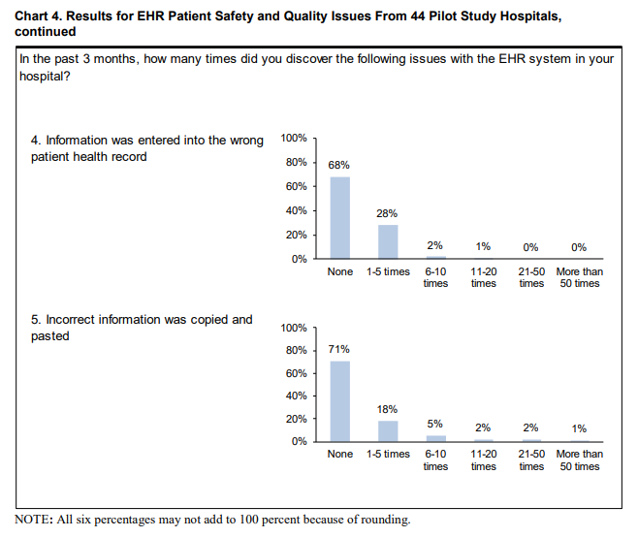

Slide 15
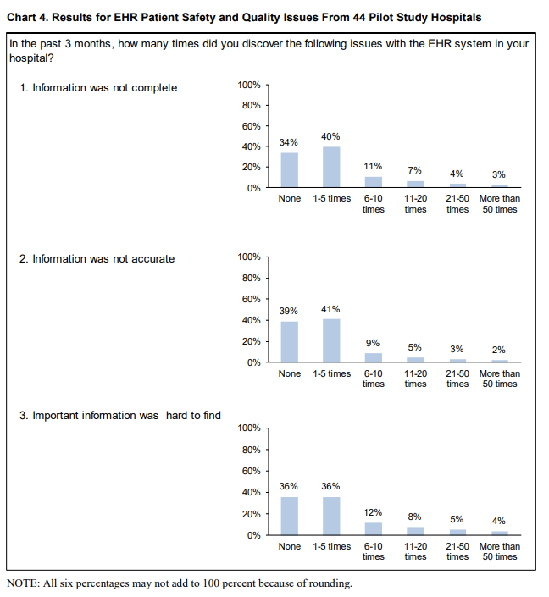

Slide 16
Joint Commission Sentinel Event Alert
March 2015
Suggested that health care organizations should work on:
Their safety culture by focusing on increasing collective mindfulness to identify, report, analyze and reduce health IT-related adverse events
Implementing a “methodological approach to health IT process improvement” that includes proactively assessing patient safety risks
Ensuring multidisciplinary leadership, support, and oversight of the planning, implementation and evaluation of health IT projects.
Sittig (2017)

Slide 17
Ethical Decision Making Process
Ethical decision-making refers to the process of evaluating and choosing among alternatives in a manner consistent with ethical principles. In making ethical decisions, it is necessary to perceive and eliminate unethical options and select the best ethical alternative.
The process of making ethical decisions requires:
Commitment: The desire to do the right thing regardless of the cost
Consciousness: The awareness to act consistently and apply moral convictions to daily behavior
Competency: The ability to collect and evaluate information, develop alternatives, and foresee potential consequences and risks
https://blink.ucsd.edu/finance/accountability/ethics/process.html

Slide 18
Four Component Model
Ethical Sensitivity
Ethical Motivation
Ethical Action
Ethical Judgement
Rest, J. R. (1986). Moral development: Advances in research and theory. New York: Praiger. Retrieved from
http://catalog.hathitrust.org/Record/000441705

Slide 19
Ethical Sensitivity
Ability to recognize to recognize an ethical problem, moral implications of our decisions and how actions affect others (Milliken, 2016)
Its development depends on an understanding of the ethical nature of the role as an obligation of the nursing profession (Milliken & Grace, 2017)
Reflecting on the Case:
Nancy recognized that adhering to the EHR-triggered CDS guideline might result in a poor outcome. She may have also been aware of her accountability in the situation as stated in the ANA Code of Ethics for Nurses with Interpretive Statements, “Systems and technologies that assist in clinical practice are adjunct to, not replacements for, the nurse’s knowledge and skill” (American Nurses Association [ANA], 2015, p.16; hereafter referred to as Code of Ethics).
Having practiced in the ED for ten years, Nancy may be respected by her nursing peers and physician colleagues and may question how her actions could potentially affect those professional relationships.

Slide 20
Ethical Judgement
Ability to reason through several courses of actions and making the right decision when forced with an ethical dilemma.
Deliberate process reflecting knowledge of ethical principles, theories and codes.
Reflecting on the Case:
Recognizing the potential harm of following the sepsis guidelines in a patient with suspected pulmonary edema, Nancy decides to share her concerns with the physician.

Slide 21
Ethical motivation
The bridge between decision-making and action.
All nurses want to be ethical and live in a manner consistent with their personal and professional values.
They may recognize an ethical issue and be aware of their role-associated obligations
Personal and/or institutional barriers may impede their motivation to act. (Robichaux, 2017)
Reflecting on the Case:
Nancy is motivated to question the physician’s decision to follow the sepsis quality metric and not write an order in the EHR for slow intravenous fluid administration. She verbally reports this information to the receiving ICU nurse and hopes “for the best outcome” for the patient.

Slide 22
Ethical action
Acting on ethical intent with moral courage
Moral courage can be “learned, practiced, and mentored” (Hawkins & Morse, 2014, p. 268).
When moral courage and ethical action are thwarted by constraints outside the nurse's control, moral distress can result.
Moral distress results when nurses "know the right thing to do while being in a situation in which it is nearly impossible to do it." (Jameton, 2017, p. 617).
Reflecting on the Case:
The stress felt by Nancy in the presented ED case scenario is an example of this type of moral distress. Specific themes reflected in the case scenario and noted by Wolf and colleagues’ (2016) qualitative investigation relate to moral distress due to overemphasis on documentation, tasks, and metrics at the expense of patient care, as well as role conflicts resulting from hierarchical decision making.

Slide 23
Moral Intent
Moral intent reflects an authority’s degree of commitment to the moral course of action
Distinction between awareness, judgement, and intent is important
Unethical people know what they do is wrong and do not care.
A driver of moral intent is moral identity
The degree to which a person sees themselves as a “moral person”
Strong moral identity increases ethical behaviors because failing to act morally triggers a strong sense of guilt

Slide 24
Code of Ethics, Nursing Scope and Standards and Legal Implications
The Code of Ethics states:
“Patients’ rights are the primary factor in any decisions regarding personal information, whether from or about the patient.
These rights of privacy and confidentiality pertain to all information in any manner that is communicated or transmitted” (ANA, 2015, p. 10).
Nurses are aware of this ethical obligation in relation to the EHR, but they may be less familiar with additional ethical issues inherent in its use and development.

Slide 25
Code of Ethics, Nursing Scope and Standards and Legal Implications
The Scope and Standards of Nursing Practice (ANA, 2015) establishes the standard of practice for registered nurses in the United States, noting:
“Nurses must document relevant data accurately and in a manner accessible to the interprofessional team” (ANA, 2015, p. 54).
Documentation in the nursing record must follow principles of “factuality, accuracy, completeness, timeliness, organization, and compliance” (ANA, 2015, p. 270).
Documentation must be clear and accurate to provide a basis for the contribution of nurses to patient outcomes and the viability of healthcare organizations (ANA, 2015).

Slide 26
A Call to Action
Support:
Healthcare organizations must have structures in place at the unit, management, and administrative levels to facilitate effective use of EHRs in nursing practice.
Culture of Safety: Originated outside of health care associated with high reliability organizations (AHRQ, 2017)
Non-punitive environment committed to safety at all levels
Nurse managers and executives have a particular obligation to ensure that direct care nurses are empowered to identify and engage in ethical situations associated with EHRs.
Interprofessional ethical imperative to:
Address EHR usability issues and related ethical considerations that result in clinical teams experiencing moral distress
AHRQ, 2017. Culture of Safety. Retrieved from https://psnet.ahrq.gov/primers/primer/5

Slide 27
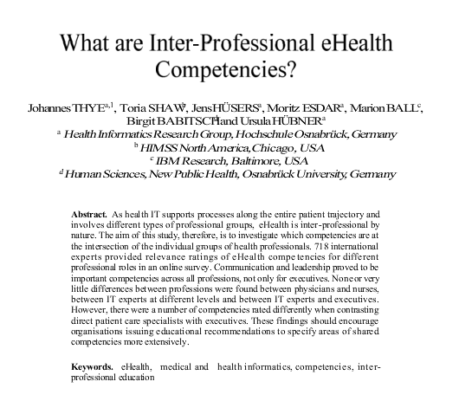
TIGER Global Study

Slide 28
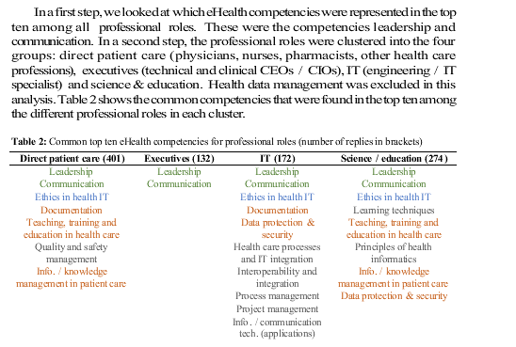
TIGER Global Study (Cont.)

Slide 29
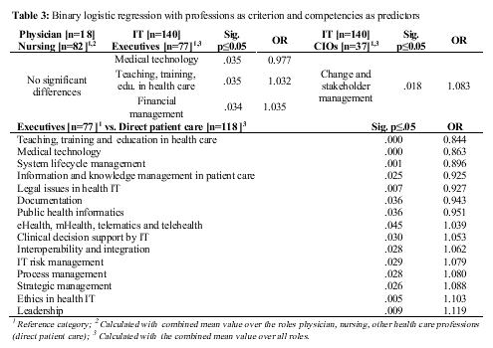
TIGER Global Study (Cont.)

Slide 30
Steps to address documentation burden

Slide 31
Death and Documentation
“In this world nothing can be said to be certain, except death and taxes.”
Benjamin Franklin, November 13, 1789.
In healthcare nothing can be said to be certain, except death and documentation. Joni Padden, May 2018. ☺

Slide 32
Florence Nightingale
Nursing Pledge segments
‘I will abstain from whatever is deleterious and mischievous . . .’
‘I will do all in my power to maintain and elevate the standard of my profession . . .’
‘With loyalty I will endeavor to aid the physician in his work, and devote myself to the welfare of those committed to my care.’

Slide 33
Good Intentions
Goal: Improve CAUTI numbers by hardwiring best practices through required documentation.
Intervention: Create hard-stop documentation to show compliance with two RN review of necessity and maintenance of sterile technique
Outcomes:
CAUTI rate unchanged
Workarounds to requirements established
Documentation burden increased (so did dissatisfaction)
‘I will abstain from whatever is deleterious and mischievous . . .’

Slide 34
Better Intentions
Situation: Line days count needed for CAUTI and CLABSI
Background: ‘7am Rows’ used to provide day count for indwelling urethral catheter, central line, ventilator in use
Assessment: Very inaccurate numbers, had been developed due to nuances in required reporting. Increased the documentation burden.
Recommendation: Changed to line days count by insertion/removal documentation, used rules to stop counts at discharge, used tools to help clean up legacy documentation, rewarded good documentation with less work going forward. Used new reporting logic rules to manage nuances instead of making bedside nurses do extra work.
‘I will do all in my power to maintain and elevate the standard of my profession . . .’

Slide 35
Food for thought
Data: Knowing how many tomatoes you have
Knowledge: Aware tomatoes are considered a fruit
Wisdom: Not putting them in a fruit salad
Philosophy: Wondering if ketchup is really a smoothie
Informatics: Statistical analysis of use of tomatoes to improve outcomes
Predictive Analytics: Using documentation about tomatoes to predict how likely the patient will enjoy spaghetti sauce
Documentation burden: Doing a checklist to show how many tomatoes you have

Slide 36
Best Intention
What problem are you trying to solve? Reduce documentation burden and improve clinician ability to identify infection to help reduce the risk of missing sepsis
Assess: Manual Sepsis screening tool doubled the amount of documentation needed by the nurse. Screening tool was based on a legacy paper based screening tool. Tool was ineffective at identifying risk for sepsis and significantly increased the documentation burden for the nursing staff.
Plan: Develop a predictive analytic tool to identify risk of infection based on clinical documentation (not screening questions or documentation for the sake of reporting)
Intervention: Predictive tool and clinical decision support tools deployed to replace the legacy sepsis screening process
Evaluation: Improved ability to identify risk of infection (and therefore risk of sepsis) and significantly decreased documentation burden
‘With loyalty I will endeavor to aid the physician in his work, and devote myself to the welfare of those committed to my care.’

Slide 37
Road paved with good intentions – Consent for DNR/Limited DNR State Law
April 1, 2018 – New Texas State law requiring informed consent before a physician can make a patient a DNR/Limited DNR status
Rules for the law not published until late April
Law contradicts itself and makes it very difficult to follow the legal requirements during a very emotional process
Increases the documentation burden by requiring specific language in the consent, having unclear inclusions and exclusions to when a consent is recommended
Still in the feedback timeframe for this new law – being opposed by the Texas Hospital Association

Slide 38
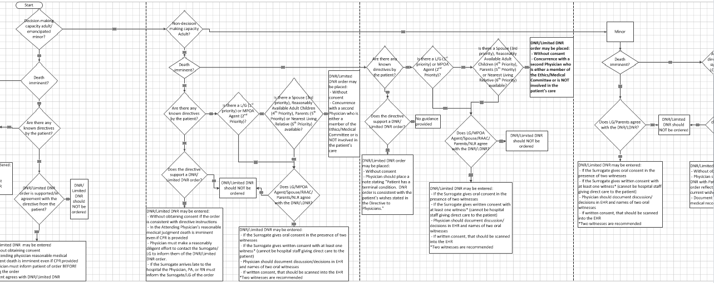
DNR Logic Algorithm Attempt
Original logic map

Slide 39
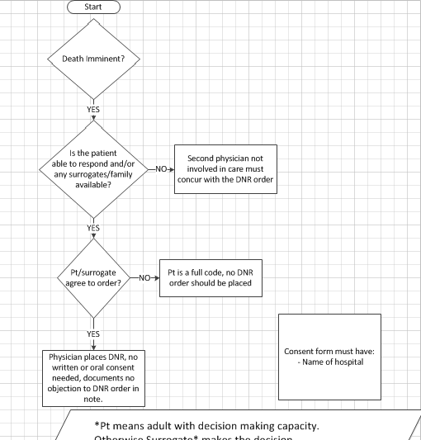
DNR Simplified
DNR Logic Algorithm Attempt
Until the details of the law are settled:
The safest course is to obtain consent for DNR
There is still leeway for the physician if no one is available to make a decision
This is an example of documentation burden that is difficult to overcome due to regulatory reasons.

Slide 40
Informatics Definition
Informatics – Helping you figure out a problem you did not know you had then solve it in a way you do not understand. ☺

Slide 41
References
McBride, S., Tietze, M., Robichaux, C., Stokes, L., & Weber, E. (2018). Identifying and addressing ethical issues with use of electronic health records. Online Journal of Issues in Nursing, 23(1), 1-4. doi:10.3912/OJIN.Vol23No01Man05
McBride, S., Tietze, M., Hanley, M. A., & Thomas, L. (2017). Statewide study to assess nurses' experiences with meaningful use-based electronic health records. CIN: Computers, Informatics, Nursing, 35(1), 18-28. doi:10.1097/CIN.0000000000000290
Sittig, D. F., & Singh, H. (2017). Toward more proactive approaches to safety in the electronic health record era. The Joint Commission Journal on Quality and Patient Safety, 43(10), 540-547. doi:10.1016/j.jcjq.2017.06.005
Sorra, J., Famolaro, T., Yount, N., Caporaso, A., Zebrak, K., & Dodson, T. (2018). Pilot study results from the 2017 AHRQ surveys on patient safety culture health IT patient safety supplemental item set for hospitals. (1 No. 1). Washington, DC: Department of Health and Human Services. Retrieved from Pilot Study Results From the 2017 AHRQ Surveys on Patient Safety Culture (SOPSTM) Health Information Technology Patient Safety Supplemental Item Set for Hospitals

