Slide 1
The Nurse Informaticist Collaborating with Nursing Leadership: Improving Hand-off Communication and Patient Experience
Presented by Cynthia Wilson BSN, RN-BC

Slide 2
Objectives
The participant will be able to verbalize the need for strong communication between the Nurse Informaticist and Nursing Leadership in order to improve the patient experience.
The participant will be able to recognize areas for improved communication between the Nurse Informaticist and Nursing Leadership in their facility.
The participant will be able to apply concepts learned regarding communication between the Nurse Informaticist and Nursing Leadership in their workplace.

Slide 3
The Clinical Informaticist will utilize strategies through technology communication during hand-off, streamlining best practice across the patient care continuum and improve patient outcomes.
.

Slide 4
McGonigle, 2012
McGonigle (2012)

Slide 5
Nursing Informatics - ANA
Nursing informatics (NI) is the specialty that integrates nursing science with multiple information management and analytical sciences to identify, define, manage, and communicate data, information, knowledge, and wisdom in nursing practice. NI supports nurses, consumers, patients, the interprofessional healthcare team, and other stakeholders in their decision-making in all roles and settings to achieve desired outcomes. This support is accomplished through the use of information structures, information processes, and information technology
Nursing Informatics Scope and Standards, 2nd Ed Standards

Slide 6
Nursing Informatics - AMIA
Nursing Informatics is the "science and practice (that) integrates nursing, its information and knowledge, with information and communication technologies to promote the health of people, families, and communities worldwide." (adapted from IMIA Special Interest Group on Nursing Informatics 2009). The application of nursing informatics knowledge is empowering for all healthcare practitioners in achieving patient centered care.

Slide 7
Nursing Informatics - AMIA
Nurse informaticians work as developers of communication and information technologies, educators, researchers, chief nursing officers, chief information officers, software engineers, implementation consultants, policy developers, and business owners, to advance healthcare. Core areas of work include:
Concept representation and standards to support evidence-based practice, research, and education
Data and communication standards to build an interoperable national data infrastructure
Research methodologies to disseminate new knowledge into practice
Information presentation and retrieval approaches to support safe patient centered care
Information and communication technologies to address inter-professional work flow needs across all care venues
Vision and management for the development, design, and implementation of communication and information technology
Definition of healthcare policy to advance the public’s health
AMIA’s Nursing Informatics Working Group serves as the United States’ representative to the International Medical Informatics Association (IMIA) Nursing Informatics Special Interest Group
https://www.amia.org/programs/working-groups/nursing-informatics

Slide 8
The Nurse Informaticist and Nursing Leadership
Implementing Technology to Improve Patient Outcomes
Vital Signs Monitoring
Bar Coded Medication Administration
Patient Throughput
Sepsis Dashboard
Advanced Clinicals Board

Slide 9
Vital Signs Monitoring
Welch Allen monitors
Talk to Meditech
Save time for nursing
Vital Signs auto-populate into Meditech
More time for the nurse to spend time with patient
Easy access to vital signs for hand-off communication

Slide 10
Bar Coded Medication Administration
Greater than 98% meds and patients scanned
Improved patient safety
Improved patient experience
Improved hand-off communication

Slide 11
How We Improved BCMA
All 12 facilities with scanning rate of greater than 98%
Weekly reports of individual and unit scanning rates
Unit rounding by Senior Clinical Analyst
Worked directly with Unit Directors and Nursing Leadership
Holding individuals accountable for their own scanning

Slide 12
Patient Throughput
Improved patient throughput ED to Discharge
Decreased ED hold times
Decreased Length of Stay
Improved patient experience
Improved hand-off communication
Barrier Rounds

Slide 13
Advanced Clinicals Board

Slide 14
Sepsis Dashboard
Improved patient safety
Decreased mortality
Improved patient experience
Improved hand-off communication

Slide 15
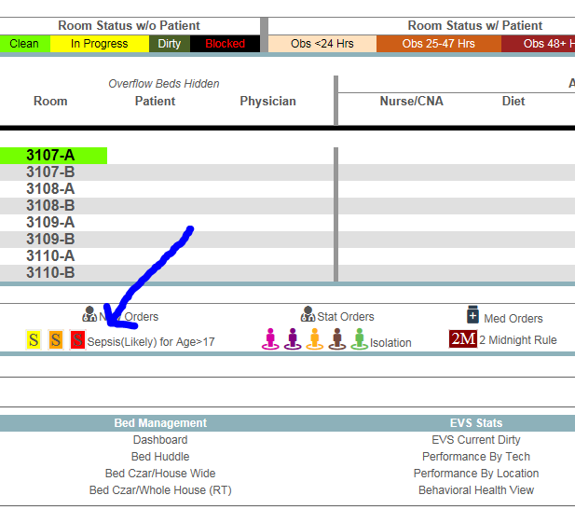

Slide 16
The Nurse Informaticist and the Bedside Nurse
Improved Communication During Hand-off Improves the Patient Experience
Working directly with the bedside nurse to improve workflows and processes
Improving communication and the patient experience

Slide 17
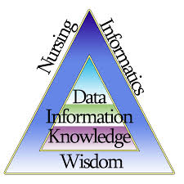

Slide 18
Using the foundations of Nursing Informatics to improve the patient experience
Decreased Length of Stay
Improved Mortality
Improved Patient Safety
Decreased Medication Errors
Barrier Rounds (Barriers to Discharge)

Slide 19
Why Do We Need to Keep Nursing Leadership Need in the Know
According to Nickitas and Kerfoot (2012) Nursing Leadership must remain in the know (regarding IT and Clinical IT) in order to take the data received about the nursing care of the patient and “synthesize, interpret and manage the data into measurable outcomes”
This synthetization is the epitome of the nursing informatics model of Data, Information, Knowledge and Wisdom
By using this process we are able to improve hand-off communication and improve the patient experience

Slide 20
How We Make This Work in the Gulf Coast Division
Nursing Leadership is very supportive of the relationship between the Senior Clinical Analysts and the nursing staff at the facilities
The Senior Clinical Analysts are the boots on the ground and the liaison between the bedside nurse and the IT world
Nursing Leadership holds the bedside nurses accountable to the set standards
Regular meetings where data and information is shared between nursing leadership and the Senior Clinical Analyst

Slide 21
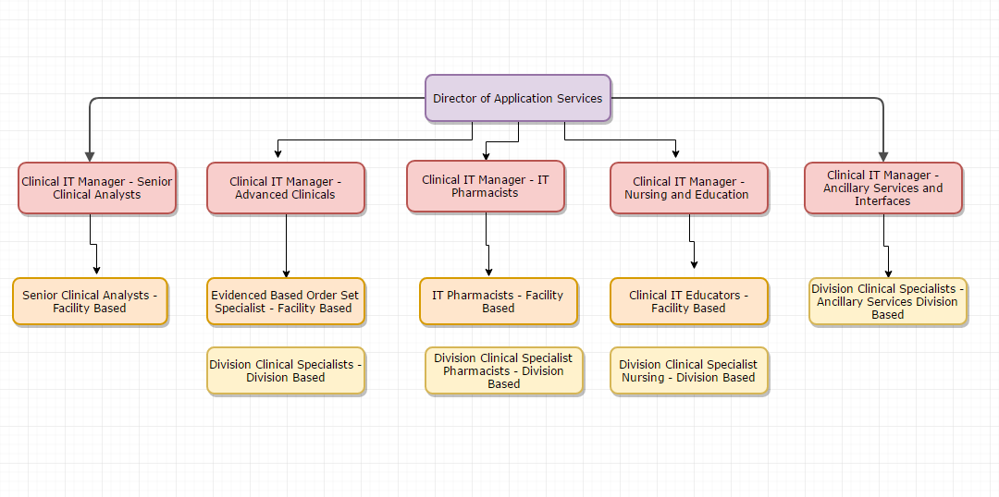
Informatics Reporting Structure

Slide 22
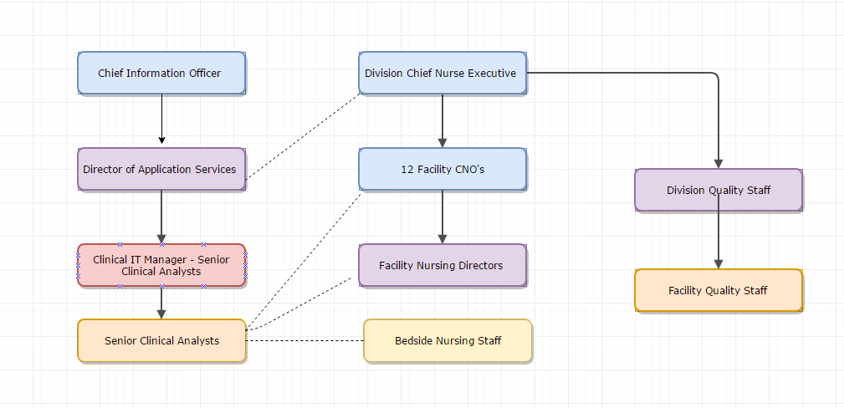
IT and Nursing Leadership Dotted Line Reporting

Slide 23
Questions

Slide 24
References
ANA. (2015). Nursing Informatics Scope and Standards of Practice (2nd ed). Silver Springs, MD. Nursesbooks.org.
Mattison, M. (2012, December 13). Q & A with Informatics Nurse Dee McGonigle. The Chamberlain Blog. Retrieved from http://www.chamberlain.edu/blog/q-a-with-informatics-nurse-dee-mcgonigle
Nickitas, D. M. and Kerfoot, K. (2010). Nursing Informatics: Why nurse leaders need to stay informed. Nursing Economics 28(3). Retrieved from https://www.nursingeconomics.net/necfiles/news/MJ_10_Nickitas.pdf
Nursing Informatics. (n.d.). American Medical Informatics Association. Retrieved from https://www.amia.org/programs/working-groups/nursing-informatics
Saba, V. K. and McCormick, K. A. (2015). Essentials of Nursing Informatics (6th ed). United States. McGraw-Hill.

