Slide 1
ANIA - HOUSTON
Business Meeting
June 9, 2017

Slide 2
Agenda
10 mins National & Texas Chapters
05 mins Committees & Meetings
10 mins Website
05 mins Membership
05 mins Treasurer Report
60 mins Presentation

Slide 3
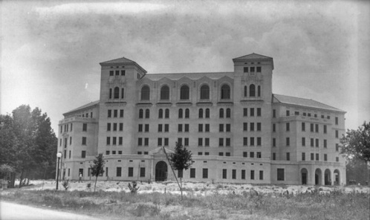
Hermann Hospital (1925)

Slide 4
National

Slide 5
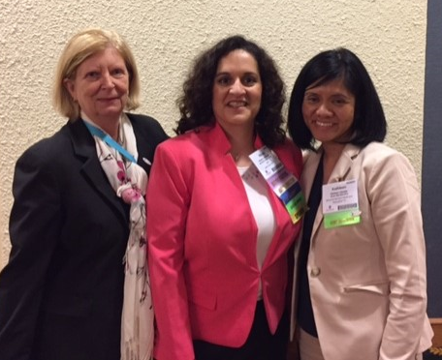
Central Region Nicole Mohiuddin, MS, RN-BC, CPHIMS
ANIA Mission: To advance nursing informatics through education, research, and practice in all roles and settings.
ANIA Vision: To be the organization of choice to advance nursing informatics.

Slide 6
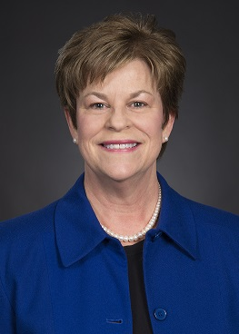
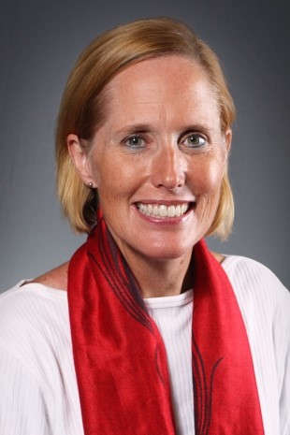
ANIA - Texas
Dallas Fort Worth Chapter
Donna Montgomery, DNP, RN-BC
Vice President, Nursing Informatics & Clinical Excellence - North Texas
South Texas ANIA (Austin through Corpus Christi)
Katherine Taylor Pearson, DNP, MSN, RN-BC, CNE, MA, CPHIMS
Nursing Director of the Frank Tejeda VA clinic

Slide 7
ANIA – Texas Chapters
Dallas Forth Worth
South Texas
Houston
None

Slide 8
ANIA - Houston
Created in Fall 2015
770
773
774
775
776
778
758 (Palestine)
759 (Lufkin)
779 (Victoria)

Slide 9
ANIA Conference: Call for Abstracts
Call for Oral Presentation Abstracts - open until June 30, 2017
Call for Poster Presentation Abstracts - open until December 15, 2017

Slide 10
Committees

Slide 11
Committees
Planning: Coordinating educational meetings
Johnathan Gecomo, CHI Baylor St. Luke’s Medical Center
Tina Coshatt, HCA
Nominating: Coordinating Officer elections
Adrian Bituin, North Cypress Medical Center
Our email address: HoustonANIAChapter@gmail.com

Slide 12
2017 Meetings
Fridays, 8:30 – 11:00 am at Memorial Hermann - TMC
September 8th – Dr. Susan McBride
November 3rd (Annual)
Hardeep Singh, MD MPH, Chief, Health Policy, Quality and Informatics Program, Houston Veterans Affairs Health Services Research Center of Innovation, Michael E. DeBakey Veterans Affairs Medical Center and Baylor College of Medicine
Poster Presentations

Slide 13
Website Update www.ania.org
Regina Wysocki

Slide 14
Features
Digest sent to your email
Register direct on the website
Discussions
Archive

Slide 15
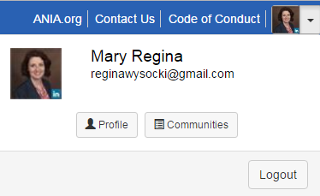
How do I set up my Community Profile?
https://community.ania.org/home/orientation

Slide 16
ANIA Connect

Slide 17
Membership Report
Regina Wysocki

Slide 18
Attendees
Currently at 104 members
2 new members since our last meeting in April 2017
44 members when chapter started in Fall 2015

Slide 19
Attendance

Slide 20
Treasurer Report

Slide 21
Treasurer Report
Current at $694.26

Slide 22
Questions

Slide 23
Presentation

Slide 24
Texas Nurses Association
Notice of requirements for successful completion
Attendance of entire activity
Completion/Submission of the evaluation form
Conflicts of interest
Please be advised the committee members and presenters have disclosed no influencing financial relationships related to the planning or implementation of this CNE activity
Sponsorship / Commercial support
There is no commercial support or sponsorship related to this educational activity.
Reporting of Perceived Bias:
Bias is defined by the American Nurses Credentialing Center’s Commission on Accreditation (ANCC COA) as preferential influence that causes a distortion of opinion or of facts. Commercial bias may occur when a CNE activity promotes one or more product(s) (drugs, devices, services, software, hardware, etc.). This definition is not all inclusive and participants may use their own interpretation in deciding if a presentation is biased.
The ANCC COA is interested in the opinions and perceptions of participants at approved CNE activities, especially in the presence of actual or perceived bias in continuing education. Therefore, ANCC invites participants to access their “ANCC Accreditation Feedback Line” to report any noted bias or conflict of interest in the education activity. The toll free number is 1(866) 262-9730.
“[Memorial Hermann-Texas Medical Center] is an approved provider of continuing nursing education by the Texas Nurses Association – Approver, an accredited approver by the American Nurses Credentialing Center’s Commission on Accreditation.”

Slide 25
The Nurse Informaticist Collaborating with Nursing Leadership: Improving Hand-off Communication and Patient Experience
Presented by Cynthia Wilson BSN, RN-BC

