Slide 1
Leading Through Change
Brandi Cannon PT, MS
Health System Director, Clinical Informatics
Baylor Scott & White Health

Slide 2
Learning Objectives: Leading Through Change
After participating in this session, attendees should be able to:
Recognize when change is impacting themselves and the team(s) they lead.
Describe three leadership strategies to support team members during times of significant change.

Slide 6
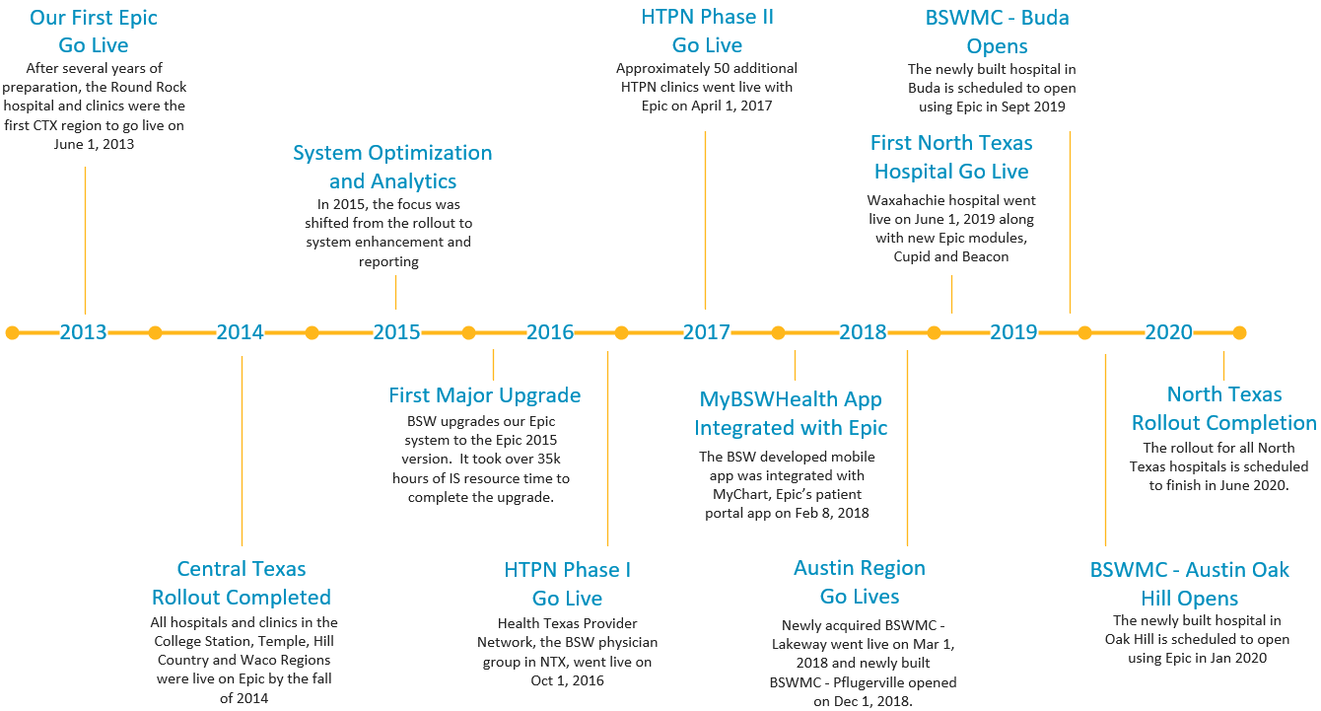

Slide 7
Decision Point
How you deal with change has a big impact on your leadership legacy. What do you want people to say about your leadership?
Anyone can lead during steady predictable times when established structures are known and can be followed. True leaders emerge during times of transformational change when there is nothing more than a vision.

Slide 8
Keys to Success
Emphasize the Big Idea, the Vision
Commit to Self-Care
Put People First
Embrace Emotions
Attitude of Patient Persistence
Focus On Communication

Slide 9
Emphasize the Big Idea
Visibility to Mission or Vision
Tie Key Milestones and Activities Back
Wash, Rinse, Repeat

Slide 10
Look After Yourself
You cannot pour from an empty cup. You must fill your cup first.
Commit to Self Care

Slide 11
Put People First
People > Process > Outcomes

Slide 12
Embrace Emotions

Slide 13
Focus on Communication

Slide 14
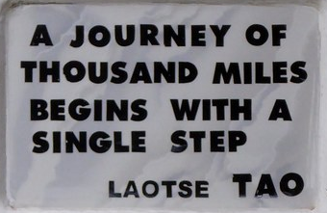
Patient Persistence

Slide 15
References
Cardinal, R. (2012). 5 strategies for leading through change. Retrieved from https://leadersinheels.com/career/5-strategies-for-leading-through-change/
Leading through change conflicts. (2019). MIT Sloan Management Review, 60(3), 1-23
Mayberry, M. (2015). When leading through change, adopt these 4 strategies. Retrieved from http://mattmayberryonline.com/when-leading-through-change-adopt-these-4-strategies/
Root III, G. N. (2019). The five top qualities needed for an effective leader to facilitate change in an organization; Retrieved from https://smallbusiness.chron.com/five-top-qualities-needed-effective-leader-facilitate-change-organization-5.html

Slide 16
Thank You!
What Questions
Do You Have?

