Slide 1
MH-CURETM
Mobilizing Clinicians by Modernizing Communications

Slide 2
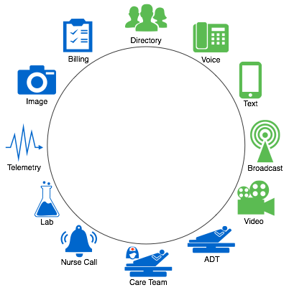
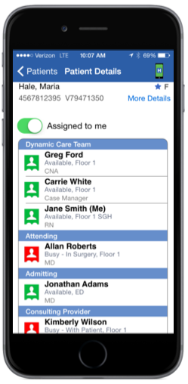
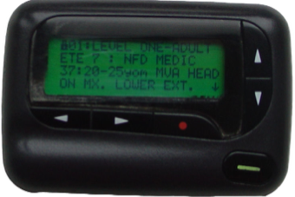
Mobilizing Clinicians…
Directory
Voice
Nurse Call
…by Modernizing Communications
Notes:
Over 90% of US hospitals rely on a WiFi phone. These "Talk Only" devices are just that. -- Talk Only, you can make and receive calls. Because the extensions are physical, the phone numbers for the nurses and assistants carrying them changes every >< shift. MH-CURE mobilizes clinicians by modernizing communications. >< The key to mobility with MH-CURE, whether talking or texting, is knowing who and what you want to communicate about. This again, is made possible through the dynamic care team.

Slide 3
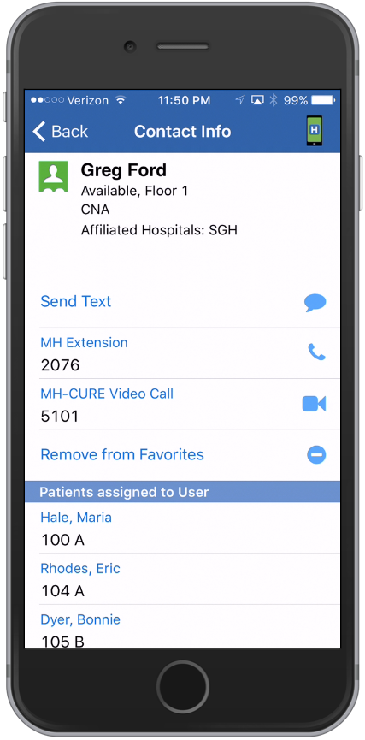
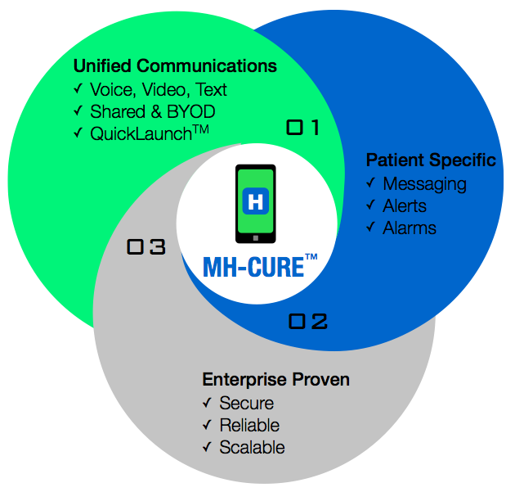
3 Differentiators
Notes:
Over 90% of US hospitals rely on a WiFi phone. These "Talk Only" devices are just that. -- Talk Only, you can make and receive calls. Because the extensions are physical, the phone numbers for the nurses and assistants carrying them changes every >< shift. MH-CURE mobilizes clinicians by modernizing communications. >< The key to mobility with MH-CURE, whether talking or texting, is knowing who and what you want to communicate about. This again, is made possible through the dynamic care team.

Slide 4
iMobile Project
Desired | Impact
Secure, Scalable & Reliable (3) Regional Data Centers Multi-Hospital Support | 6 Sites, 2 RDC’s Live NOW 19 Sites by Jan. 46 More in 2016 6 Minute Reduction “Time to Treat” 9 Minute Reduce “Stroke to CT Scan” 1st Hospital has Highest HCAHPS
Roll-out Contract Signed September 2013:
Licenses for
175 hospitals

Slide 5
Thank You
Mobile Heartbeat
Adam Maguire
Director of Sales Support
(619) 916-8717
adam.maguire@mobileheartbeat.com
www.mobileheartbeat.com

