Slide 1
Legislative Update and the Power of Advocacy
LIZ JOHNSON, MS, FCHIME, FHIMSS, CPHIMS, RN-BC
Chief Information Officer, Acute Care Hospitals & Applied Clinical Informatics
Tenet Healthcare

Slide 2
Conflict of Interest Disclosure
LIZ JOHNSON, MS, FCHIME, FHIMSS, CPHIMS, RN-BC
has no real or apparent
conflicts of interest to report.

Slide 3
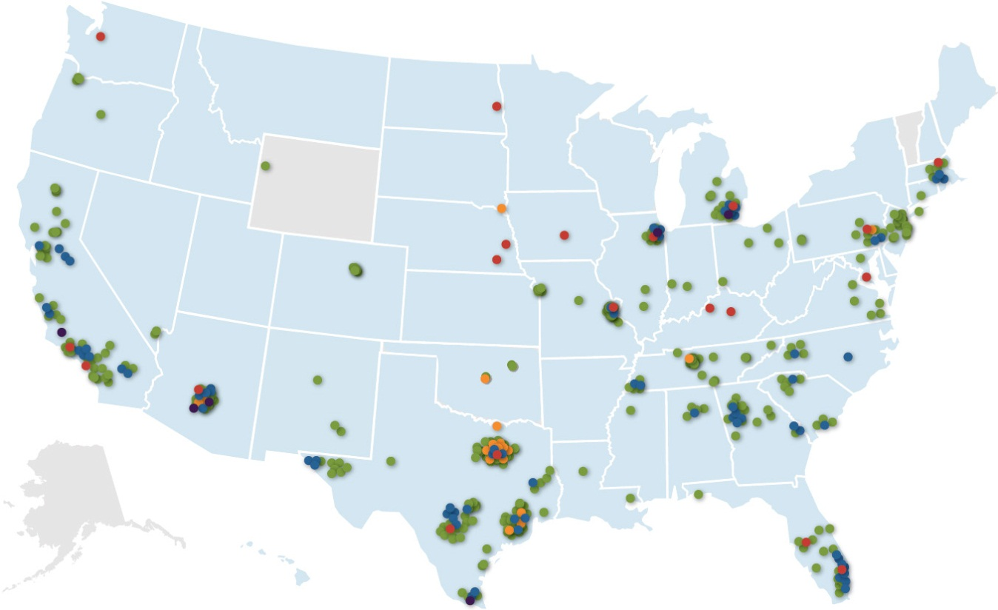
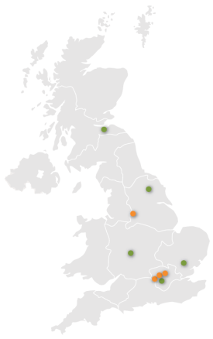
Tenet Healthcare Today
80
acute care
hospitals
18
short-stay
surgical hospitals
400+
outpatient
facilities
6
health plans
50+
health system
partners
16
accountable care
organizations
Hospitals
125,000+
Short-Stay Surgical Hospitals
employees
Outpatient Facilities
20 million
Health Plans
annual patient encounters
Conifer Health Solutions Client Service Centers
48
Operating in
states and the United Kingdom
Conifer Client Locations
3

Slide 4
ADVOCACY
…….the act or process of supporting a cause or proposal : the act or process of advocating something

Slide 5
What does my being a nurse have to do with advocacy?
Part of the American Nurses Association's dedication to patient safety and nursing quality comes in the form of advocacy. By creating initiatives that raise awareness both among legislators and the general public, ANA is able to encourage legislation on important issues such as safe patient handling and patients' rights.
(2015 the American Nurses Association, Inc. All rights reserved)
5

Slide 6
First, let’s recall how a law is born:
6

Slide 7
Now that we have a law, what happens next?
Federal agencies regulate areas of health IT based on laws passed by Congress.
ARRA
7

Slide 8
Where is all the action occurring for Health IT advocacy and how can you get involved?
Federal Agencies
CMS – Centers for Medicare and Medicaid
ONC – Office of the National Coordinator
FDA – Food and Drug Administration
AHRQ – Agency for Healthcare Research and Quality
HIT Policy Committee
HIT Standards Committee
NIST - National Institute of Standards and Technology
HRSA – Health Resources and Services Administration
FCC – Federal Communications Commission
OCR – Office of Civil Rights
Congressional Entities
Senate Appropriations
Senate Finance Committee
Senate Health, Education, Labor & Pensions Committee
Senate Special Committee on Aging
House Appropriations Committee
House Energy and Commerce Committee
House Ways and Means Committee
Join a federal advisory committee
Email or call agency staff
Write a letter to your member of Congress
Participate in an agency town hall
Host a local site visit with a state rep
8

Slide 9
Examples of Public Policy in Motion Right Now:
Patient Identity Matching
Cybersecurity in Healthcare
Meaningful Use
Patient Safety & Regulatory Oversight
Quality Measurement
Telemedicine / Telehealth
ICD-10
Interoperability
9

Slide 10
PATIENT IDENTIFICATION
Have the political winds shifted on a patient identifier?

Slide 11
Patient Identification Congressional Activity
21st Century Cures Act – H.R. 6 – Passed House on July 10th
“(H) an individual should have the right to be confident that the data in the electronic health record of the individual pertains to such individual; and
(I) the right described in subparagraph (H) will promote safety and care coordination for individuals.”
June 10th HELP Hearing – “Health Information Exchange: A Path Towards Improving the Quality and Value of Health Care for Patients”
Sen. Elizabeth Warren (D-MA) references 2012 CHIME study, Rand study on adverse events due to patient mismatches
Do you who your patient is, is the treatment the right
treatment…. Without a patient identifier that is universal
Informaticists are key subject matter experts.
11

Slide 12
CYBERSECURITY IN HEALTHCARE
95 million patient records breached, and growing

Slide 13
Cybersecurity Congressional Activity
Focus of Cybersecurity Legislative Proposals:
Robust national information sharing network
Standardized breach reporting
Targeted liability protections
Notable Legislation:
Senate: Cyber Information Sharing Act of 2015 (CISA) - Burr (R-N.C.) & Feinstein (D-Calif.) ,
Cleared Select Committee on Intelligence 14-1 (3/17/15)
House passed two information sharing bills in 2015
HR 1560 (4/22/15) & HR 1731 (4/23/15)
Office of Personnel Management says 5.6 million fingerprints stolen in cyberattack, five times as many as previously thought
Washington Post, Wednesday September 23rd.

Slide 14
MEANINGFUL USE
1,000+ pages of regulation in 2015

Slide 15
MU Proposed Rules in 2015
March 30 – Meaningful Use Stage 3 (CMS)
Response deadline: May 29, 2015
March 30 – 2015 Certification (ONC)
Response deadline: May 29, 2015
April 15 – 2015-2017 Modifications Rule (CMS)
Response deadline: June 15, 2015
…….still waiting for finalized rules

Slide 16
MU Modifications Proposed Rule
Begins in 2015, effective through 2017
Modifies Stage 2 objectives & measures
Exclusions available for Stage 1 providers & some Stage 2 providers in 2015 ONLY (ex. eRx)
“Continuous” 90-day reporting period for all in 2015
In 2016, 1st time participants would have an EHR reporting period of any continuous 90-days; all returning providers have full-year
In 2017, 1st time participants would have a full-year reporting period, as do all returning providers

Slide 17
First Year of Participation | Stage of Meaningful Use
 | 2015 | 2016 | 2017 | 2018
2011 | Modified Stage 2 | Modified Stage 2 | Modified Stage 2 or Stage 3 | Stage 3
2012 | Modified Stage 2 | Modified Stage 2 | Modified Stage 2 or Stage 3 | Stage 3
2013 | Modified Stage 2 | Modified Stage 2 | Modified Stage 2 or Stage 3 | Stage 3
2014 | Modified Stage 2* | Modified Stage 2 | Modified Stage 2 or Stage 3 | Stage 3
2015 | Modified Stage 2* | Modified Stage 2 | Modified Stage 2 or Stage 3 | Stage 3
2016 | N/A | Modified Stage 2 | Modified Stage 2 or Stage 3 | Stage 3
Modified Stage 2* = limited exclusions and alternative measures available to providers scheduled to demonstrate Stage 1 in 2015.
17

Slide 18
MU Stage 3 Design
Program Design
Mandatory 2018
Optional in 2017
Single Definition
Regardless of historic participation
Final Stage of MU
Last, but not least
Ongoing requirements
EHs / CAHs move to Calendar Year in 2017

Slide 19
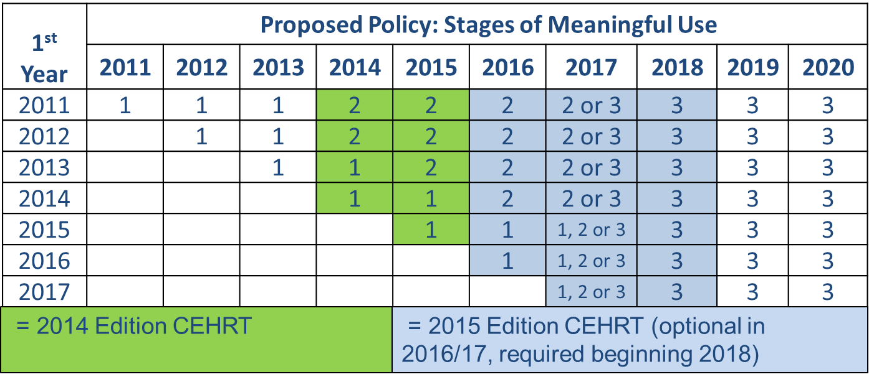
Timeline Proposed in MU3 Rule
20

Slide 20
Congress and MU
Sen. Alexander (R-TN) says providers are “Terrified” of Stage 3
Repeated references to delaying MU 3/ 2015 CERT Rulemaking by CMS & ONC
Sen. Cassidy (R-LA)
Rumored Interoperability & MU bill in the works
Rep. Ellmers (R-NC)
90-day reporting in 2015 or “Flex-IT Act” (H.R. 270)
FLEX-IT 2 Act of 2015 (H.R. 3309)
Rep. King (R-IA)
Proposed Amendment eliminated penalties for EP beginning 1/1/15
Rumored bill with same premise expected this fall
Rep. Price (R-GA)
In W&M Hearing says CMS moving on Stage 3 without metrics showing Stage 2 success
AMA Town Hall
21

Slide 21
FLEX-IT 2 Act (H.R. 3309)
1. Pausing Meaningful Use (MU) Rulemaking.
Until 2017 OR MIPS Final Rules OR 75% of EPs and EHs successful in MU 2
2. Removing the Pass-Fail Approach of the Medicare and Medicaid Meaningful Use Program
Implement the MU incentives and penalties in a linear manner
3. Aligning Quality Reporting in the Medicare and Medicaid Meaningful Use Program
Deems EPs for PQRS, EHs for IQR
4. Expanding the Hardship Exception to the Medicare EHR Payment Adjustments
Ex: Technological difficulties (e.g., cyber-attack), Change in certified EHR vendor, Technology is not interoperable
5. Promoting Interoperability through EHR Certification Process
Secretary to first test certification standards, criteria, with end-users for a 1 -year period before proposing adoption.
6. Improving the Timing of the Adoption of More Stringent Measures of Meaningful Use under the Medicare and Medicaid Meaningful Use Program.
Requires MU objectives/measures not be changed or modified for a three year period
7. Three-month EHR Reporting Periods for the Medicare and Medicaid EHR Incentive Payment Programs.
90-day reporting annually
8. Providing Eligible Professionals and Eligible Hospitals the Option to Meet a More Advanced Stage of Meaningful Use
22

Slide 23
PATIENT SAFETY AND REGULATORY OVERSIGHT
Food and Drug Administration Safety Innovation Act (FDASIA)

Slide 24
FDASIA
3 year old Act
The Food and Drug Administration Safety Innovation Act (FDASIA) Workgroup was charged with providing expert input on issues and concepts identified by the Food and Drug Administration (FDA), Office of the National Coordinator for Health IT (ONC), and the Federal Communications Commission (FCC) to inform the development of a report on an appropriate, risk-based regulatory framework pertaining to health information technology including mobile medical applications that promotes innovation, protects patient safety, and avoids regulatory duplication.
The FDASIA Workgroup built on prior work such as the Institute of Medicine (IOM) report, Health IT and Patient Safety: Building Safer Systems for Better Care and ONC's Health IT Patient Safety Action and Surveillance Plan; FDA's mobile medical applications guidance and Medical Device Data Systems Rule; FCC's National Broadband plan and other relevant work. Specifically the three agencies sought input on issues relevant to the report, which included:
Types of risk that may be posed by health IT that impact patient safety, the likelihood that these risks will be realized, and the impact of these considerations on a risk-based approach;
Factors or approaches that could be included in a risk-based regulatory approach for health IT to promote innovation and protect patient safety; and
Approaches to avoid duplicative or overlapping regulatory requirements.
22

Slide 25
Telehealth
Reimbursement Parity, Licensure, Remote Monitoring

Slide 26
Telehealth Legislative Proposals
Proposals to expand the use of telehealth services are complicated by the COST of such proposals in a very budget conscious Congress.
CBO released a blog outlining their justification for viewing the expansion of telehealth in federal programs increase or decrease government spending
Common Themes:
Expand Medicare reimbursement for telehealth services
Remove cross-state licensure barriers
Include telehealth/remote monitoring in Alternative Payment programs

Slide 27
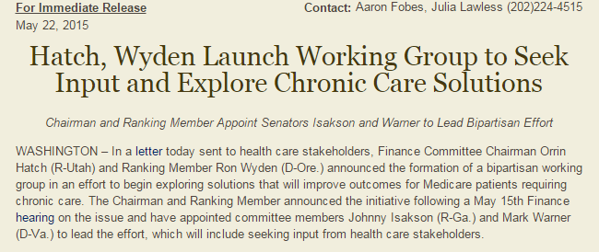
Telehealth Legislative Proposals
Senate Activity:
Senate Committee on Commerce, Science and Transportation Hearing
Senate Finance Chronic Care Working Group
“Ideas to effectively use or improve the use of telehealth and remote monitoring technology”
Schatz, Wicker, Thune Draft
Evaluating how telehealth can be incorporated into alternative payment models
Telehealth Enhancement Act (Awaiting Wicker & Cochran in Senate, H.R. 2066 in House)
Extend Medicare coverage for telehealth services provided in rural America, moving toward parity payment and improved Medicare reimbursements
Notes:
Schatz, Wicker, Thune - a program to assist doctors in establishing telemedicine or remote monitoring programs under Medicare's new Merit-Based Incentive Payment System, which was created when Congress repealed the flawed Sustainable Growth Rate (SGR) reimbursement structure for physicians. The bill also includes a directive for Medicare to reimburse telemedicine in new models such as accountable care organizations (ACOs) and bundled payments. The draft also includes a mandate that Medicare pay for remote monitoring of patients with chronic conditions for up to 90 days, provided certain conditions are met. A patient's home would be considered an "originating site" and federally qualified health centers would be acceptable "distant sites." The bill does not open up telemedicine payments in the broader fee-for-service Medicare program, except for home kidney dialysis treatments.

Slide 28
Telehealth Legislative Proposals
House Activity:
Bipartisan Telemedicine Member Working Group
21st Century Cures
TELEmedicine for MEDicare Act of 2015 or “TELE-MED” Act (H.R. 3018 & S. 1778)
Removes the barriers posed by licensure laws to the utilization of telehealth services by allowing Medicare physicians to treat Medicare patients across state boarders
Medicare Telehealth Parity Act of 2015 (H.R. 2948)
Proposes changes to Medicare telehealth payment methodologies and expands coverage not only to residents of rural areas, but urban areas as well through a phased approach
Notes:
21st Century Cures Language:
1. MedPAC would be obligated to collect data on services involved in telehealth treatments and in cases where payments are not provided
2. CMS report on: Whose care would be improved by expanding telehealth services; current activities related to the adoption/use of telehealth services; “high volume procedure[sic] codes or diagnostics” best suited for to telehealth; Identifying barriers to the expansion of telehealth

Slide 29
Quality Measurement
IPPS 2016

Slide 30
IPPS 2016 Final Rule - Summary of Findings
Hospitals now required to electronically submit clinical quality measures in CY 2016 /FY 2018 determination year
Select a minimum of 4 eCQMs from the list of 28
Reduced from 16 in the proposed rule
Report at least one quarter of data
Q3 or Q4 of CY 2016 by February 28, 2017
Reduced from 2 quarters in the proposed rule
Selections may fall under any domain
Not required to cross 3 domains
Hospitals must be certified either to the CEHRT 2014 or 2015 Edition
Must submit using QDRA I format
Must use most recently published measure specifications (June 2015)
30

Slide 31
IPPS 2016 Final - Summary of Findings
Hospitals now required to electronically submit clinical quality measures in CY 2016 /FY 2018 determination year
Electronic submission of 4 measures in IQR program will count for eCQM submission in EHR Incentive Program (dual credit)
Electronic measures will not be publicly reported
CMS expanding Extraordinary Circumstances Extensions/Exemptions including, but are not limited to:
Infrastructure challenges (hospitals must demonstrate that they are in an area without sufficient internet access or face insurmountable barriers to obtaining infrastructure)
unforeseen circumstances, such as vendor issues outside of the hospital’s control (including a vendor product losing certification).
No change in zero denominator and case threshold exemption polices for eCQMs reporting in the Hospital IQR Program
31

Slide 32
ICD-10

Slide 33
ICD-10 It’s Time to Go Live: T- 5 days
Struck by Orca: ICD-10 Illustrated Paperback – 2014
by Niko Skievaski (Editor)

Slide 34
Interoperability
What are we doing to fix the “Problem?”

Slide 35
Interoperability Roadmap
ONC Interoperability Roadmap, Version 1.0 released January 30
Primary outcome sought within 3 years
The Roadmap seeks to “enable a majority of individuals and providers across the care continuum to send, receive, find and use a common set of electronic clinical information at the nationwide level by the end of 2017.”
Four primary strategies:
establish a coordinated governance framework and process for nationwide health IT interoperability;
improve technical standards and implementation guidance for sharing and using a common clinical data set;
enhance incentives for sharing electronic health information according to common technical standards, starting with a common clinical data set; and
clarify privacy and security requirements that enable interoperability.

Slide 36
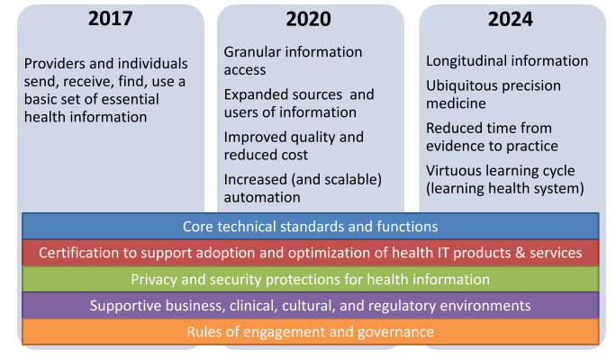
Roadmap Overview
Source: Connecting Health and Care for the Nation: A 10-Year Vision to Achieve and Interoperable Health IT Infrastructure
36

Slide 37
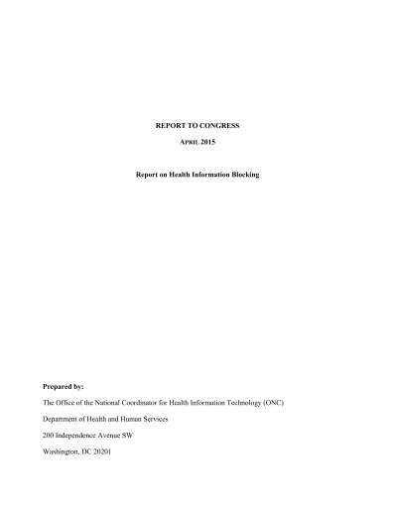
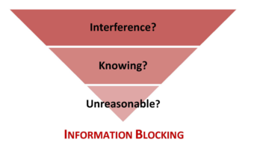
Information Blocking
Information blocking occurs when persons or entities knowingly and unreasonably interfere with the exchange or use of electronic health information.
Report to Congress:
A Report on Health Information Blocking
Released: April 10, 2015
37
Notes:
The Consolidated and Further Continuing Appropriations Act, 20151 was signed by the President on
December 16, 2014. An explanatory statement2 accompanying the Act and agreed to by the House of
Representatives and the Senate provides in pertinent part:
Information Blocking.--The Office of the National Coordinator for Health Information
Technology (ONC) is urged to use its certification program judiciously in order to ensure
certified electronic health record technology (CEHRT) provides value to eligible hospitals,
eligible providers and taxpayers. ONC should use its authority to certify only those products that
clearly meet current meaningful use program standards and that do not block health information
exchange. ONC should take steps to decertify products that proactively block the sharing of
information because those practices frustrate congressional intent, devalue taxpayer investments
in CEHRT, and make CEHRT less valuable and more burdensome for eligible hospitals and
eligible providers to use. The agreement requests a detailed report from ONC no later than 90
days after enactment of this act regarding the extent of the information blocking problem,
including an estimate of the number of vendors or eligible hospitals or providers who block
information. This detailed report should also include a comprehensive strategy on how to address
the information blocking issue.

Slide 38
Legislation to Watch
House
21st Century Cures Initiative – Sec. 3001- Interoperability
Senate
Senate HELP Health IT Working Group
Notes:
Congress is working together on a nonpartisan issue that will have a profound effect on the lives of all Americans. H.R. 6, the 21st Century Cures Act, will bring our health care innovation infrastructure into the 21st Century, delivering hope for patients and loved ones and providing necessary resources to researchers to continue their efforts to uncover the next generation of cures and treatments.
In the 21st century, health care innovation is happening at lightning speed. From the mapping of the human genome to the rise of personalized medicines that are linked to advances in molecular medicine, we have seen constant breakthroughs that are changing the face of disease treatment, management, and cures. Health research is moving quickly, but the federal drug and device approval apparatus is in many ways the relic of another era. We have dedicated scientists and bold leaders at agencies like the NIH and the FDA, but when our laws don’t keep pace with innovation, we all lose.
If we want to save more lives and keep this country the leader in medical innovation, we have to make sure there’s not a major gap between the science of cures and the way we regulate these therapies.
That is why, for the first time ever, we in Congress have taken a comprehensive look at what steps we can take to accelerate the pace of cures in America. We have looked at the full arc of this process – from the discovery of clues in basic science, to streamlining the drug and device development process, to unleashing the power of digital medicine and social media at the treatment delivery phase. We took our time, listening to the experts who know best. We’ve been working with patients, patient advocates, researchers, and innovators in the health care system to learn more about how to close the gaps between advances in scientific knowledge about cures and the regulatory policies created to save more lives.
For over a year now, members have taken this important conversation back home to districts all across the country, and now it's time to take those ideas and bring them to life.
On May 21, 2015, the committee voted 51-0 to advance the 21st Century Cures Act, a bill to help modernize and personalize health care, encourage greater innovation, support research, and streamline the system. As this nonpartisan legislation makes its way to the president’s desk we encourage you to stay up to date with the effort here and on social

Slide 39
Information Blocking According to Congress
Language From the House-Passed 21st Century Cures Act (H.R. 6)
Information Blocking: Information blocking is defined to include any technical, business, or organizational practices that an actor knows, or should know, prevents or materially discourages access to, exchange, or use of health information.
Exceptions: Information blocking excludes any practice required by law, or that the Secretary identifies as necessary to:
protect patient safety;
maintain privacy or security of health information; or
promote competition and consumer welfare.
Liability: An individual or entity is not considered to have engaged in information blocking where they were aware of the act or practice of information blocking, but did not have the ability to control the act or practice of information blocking.
Enforcement: Compliance with interoperability criteria and standards is required for:
vendors of health information technology offered for use by a provider participating in Medicare or Medicaid;
health information systems;
hospitals; and
healthcare providers.
Non-compliance will be punishable by decertification and civil monetary penalties.
39

Slide 40
Senate Health, Education, Labor & Pensions (HELP) Committee Health IT Working Group or “HITWG”
Chairman Lamar Alexander (R-TN) and Ranking Member Patty Murray (D-WA) announced a bipartisan commitment to health IT in April
The goals of this Senate HELP committee working group are to help identify ways that Congress and the administration can work together to:
• help doctors and hospitals improve quality of care and patient safety;
• facilitate information exchange between different electronic record vendors and different health professionals, referred to as “interoperability”;
• empower patients to engage in their own healthcare through convenient, user-friendly access to their personal health information;
• leverage health information technology capabilities to improve patient safety; and
• protect patient privacy and security of health information.
The workgroup has met with numerous stakeholders regularly over the last several months
The Committee has held five hearings on health IT thus far in 2015, two more are forthcoming
Legislation and Administration Recommendations may result from Committee’s efforts
40

Slide 41
41

Slide 42
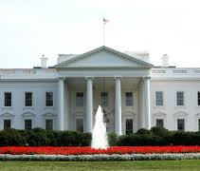
Be Aware, Be Engaged, Be Powerful
‘The White House’
By stepping up and out,
You become part of the decision making..
Part of determining the solutions.

Slide 43
Contact Information
LIZ JOHNSON, MS, FCHIME, FHIMSS, CPHIMS, RN-BC
Chief Information Officer, Acute Care Hospitals & Applied Clinical Informatics
Tenet Healthcare
1445 Ross Avenue
Suite 1400
Dallas, Texas 75202
o 469-893-2039 f 469-893-3039
c 817-312-8160
e-mail: liz.johnson@tenethealth.com
Admin: angela.elsasser@tenethealth.com

