Slide 1
Southern California Annual Conference
San Bernardino, California
January 26, 2024

Slide 2
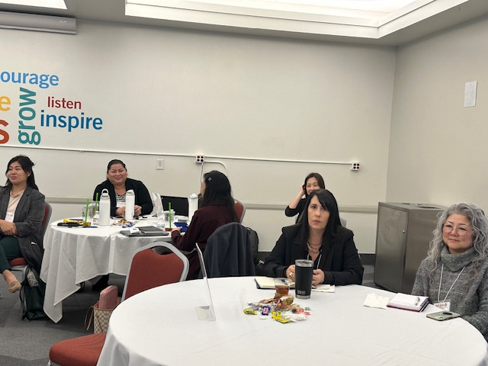
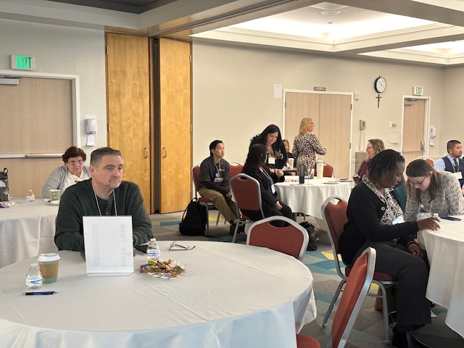
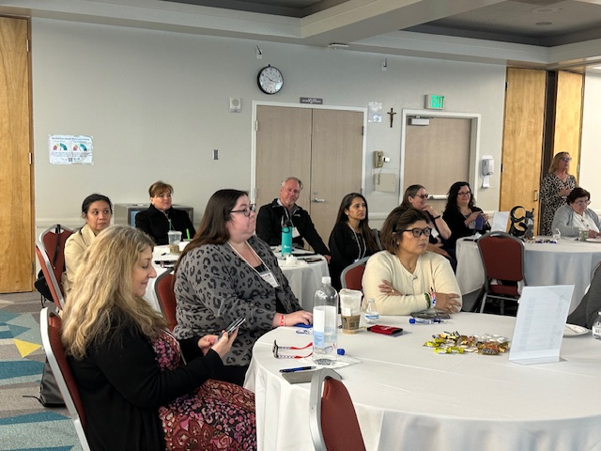
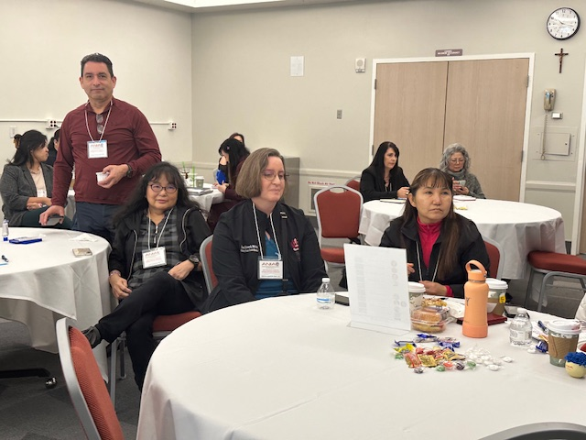
Some of the attendees……

Slide 3
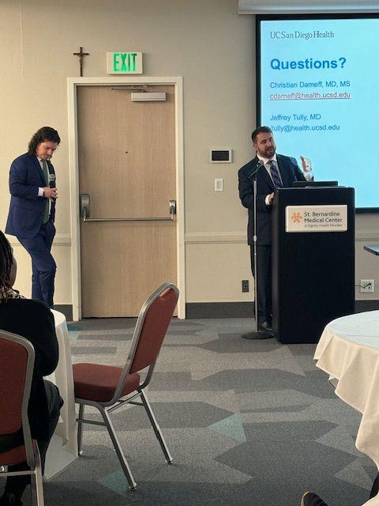
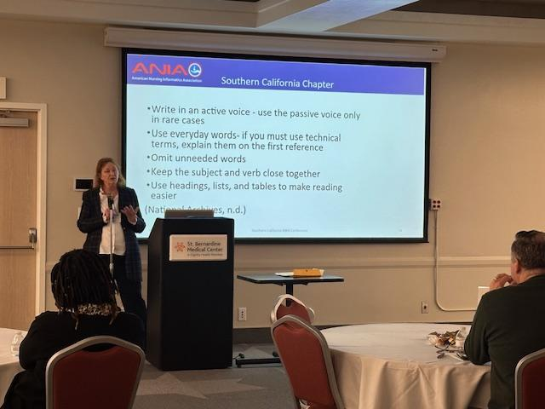
Speakers

Slide 4
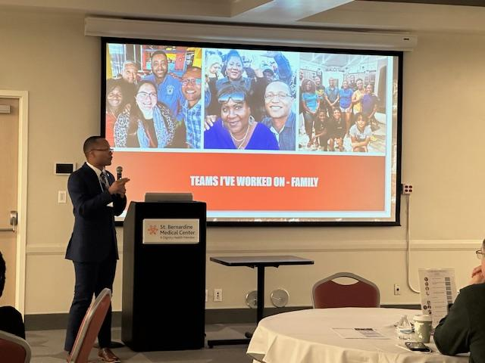
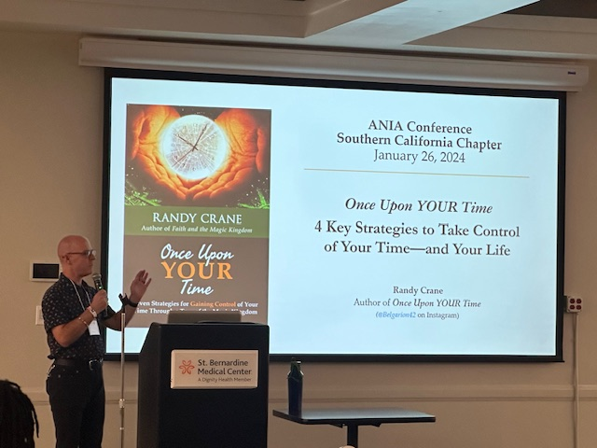
More Speakers….

Slide 5
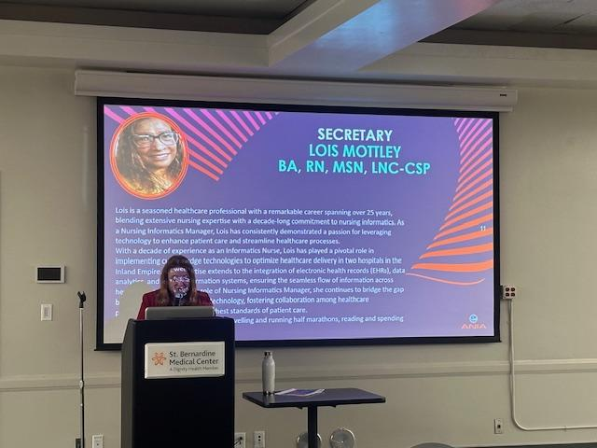
O
Our President Karen Pope introducing the current and new board members during our annual meeting

Slide 6
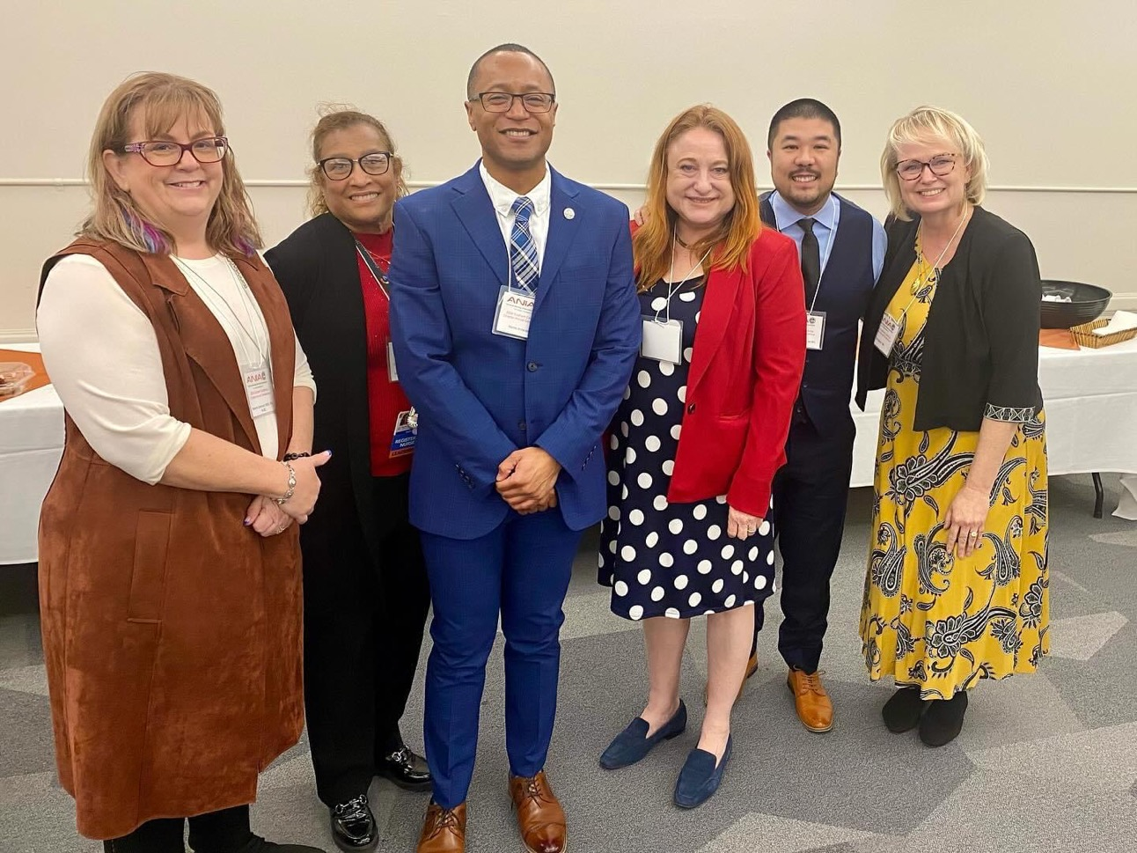
Group Photo(LtoR):
Melanie Sorenson-Vice President, Lois Mottley- Secretary, Morris (one of our speakers), Karen Pope- President, Jimmy Phan- Treasurer, and Amy Bacon- Education Director

