Slide 1
Care Connect UCLA
Change Communication

Slide 2
Disclaimer
I do not have any financial conflicts to disclose.
I am not promoting any product, though device & software vendors will be mentioned.
This presentation is not meant to offer medical, legal, accounting, regulatory compliance, reimbursement advice, and is not intended to establish a standard of care.

Slide 3
Questions to Consider for Change Communication Strategies
Why
What
Who
How
When

Slide 4
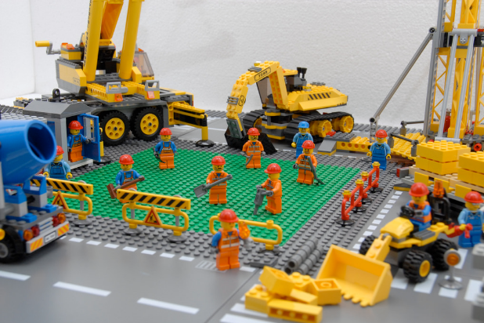
Why is Change Communication Necessary?
Ongoing system optimization and enhancements require ongoing end user education.

Slide 5
Why is Change Communication Necessary
Even the best systems are not effective if users don’t understand them!

Slide 6
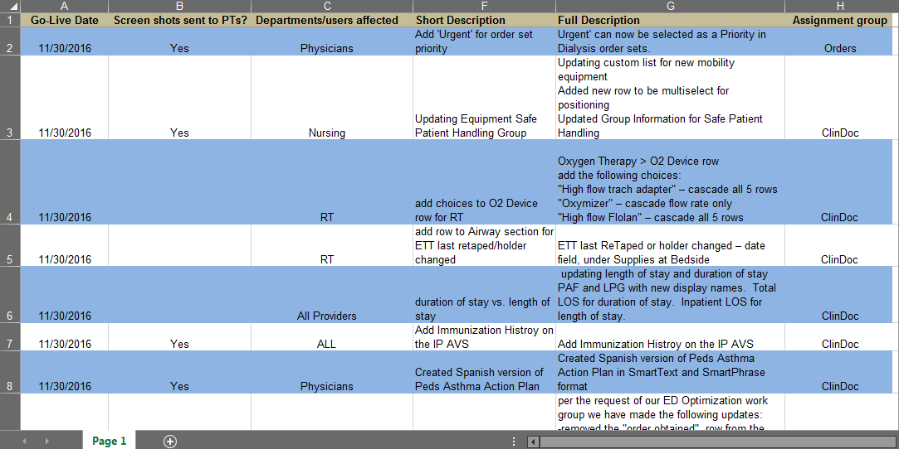
What Needs to be Communicated?
Application coordinator sends out Optimization spreadsheet on regular basis to trainers.

Slide 7
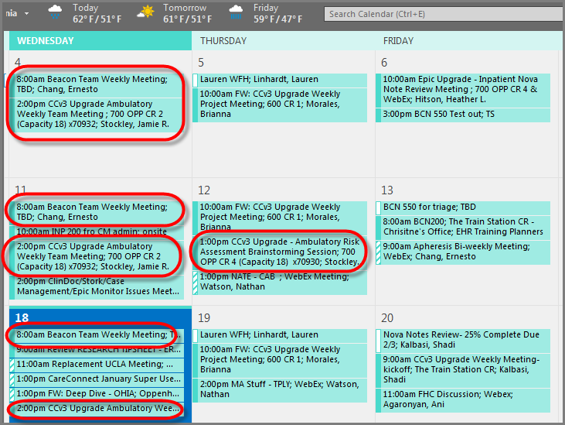
What Needs to be Communicated
Trainers are integrated into the build team’s regular meetings and Business Owner’s calls and rounding, so they are aware of new build and any issues end users are experiencing.

Slide 8
Who?
Who is your target audience for the Change Communication?
All Users
Example: Change to Patient Lookup
2. Role-Based
Example: all Inpatient Case Managers
Small subset of users in a particular role
Example: 15 Oncologists have patients receiving a specific medication that Pharmacy is switching out to a new formulation

Slide 9
How?
How will you get the information out? Consider how extensive the change is. You may use 1 or more of these methods.
Email
Email sent to all users
Role or Application specific newsletters or Updates, emailed out to managers or distribution list of users supplied by managers
Email to individual users, if small subset
2. Department Meetings/ Huddles
3. Webinars

Slide 10
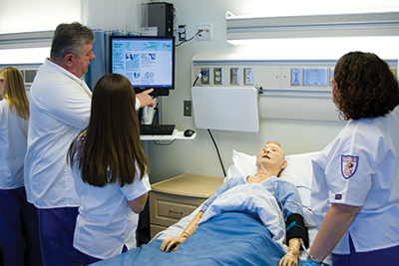
How will you get the information out?
Mobile Skills Labs
Staffed by Trainers or SuperUsers
5. Floor Support (allows for 1:1 training)
Allows you to test how the build fits into existing workflows and bring suggestions back to build team/managers from end users on front line.
Allows you to re-inforce other training points with users so they can use the system optimally.
Builds strong relationships with end users

Slide 11
Update Example

Slide 12
Update Archives
Archived Updates are available on the website

Slide 13
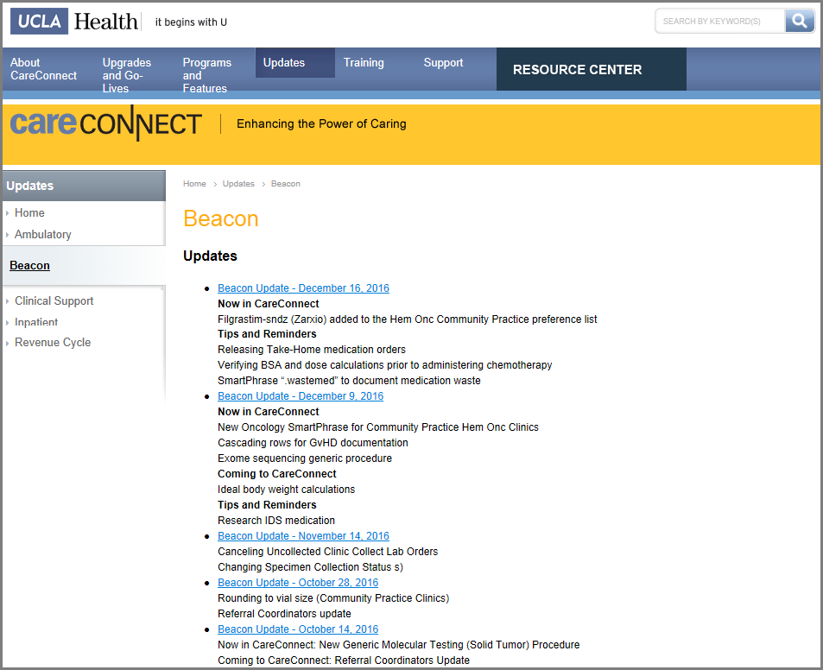
Archive Example

Slide 14
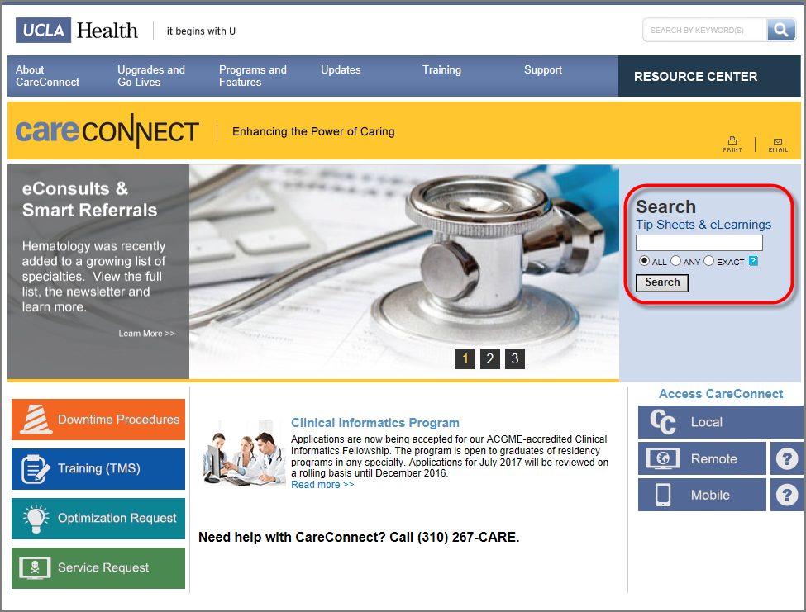
How will you get the information out?
CareConnect Website allows staff to search for training materials.

Slide 15
How will you get the information out?
Stand Alone Learning Home Dashboards
Can be accessed by users while in the system to check for updates and review training material.

Slide 16
How will you get the information out?
Example of Training Resource component added to existing Dashboard for Role

Slide 17
When should Updates go out?
Updates are emailed regularly based on a Change Communication Calendar
Advantages:
Users feel secure that new build will appear on a regular schedule and not take them by surprise.
Users learn to expect to receive advance communication about the new build on a regular schedule and are not overwhelmed by numerous emails at varying times.
The calendar provides clear guidelines for when trainers will send communication drafts to the build team and when the application coordinators should finish reviewing them.

Slide 18
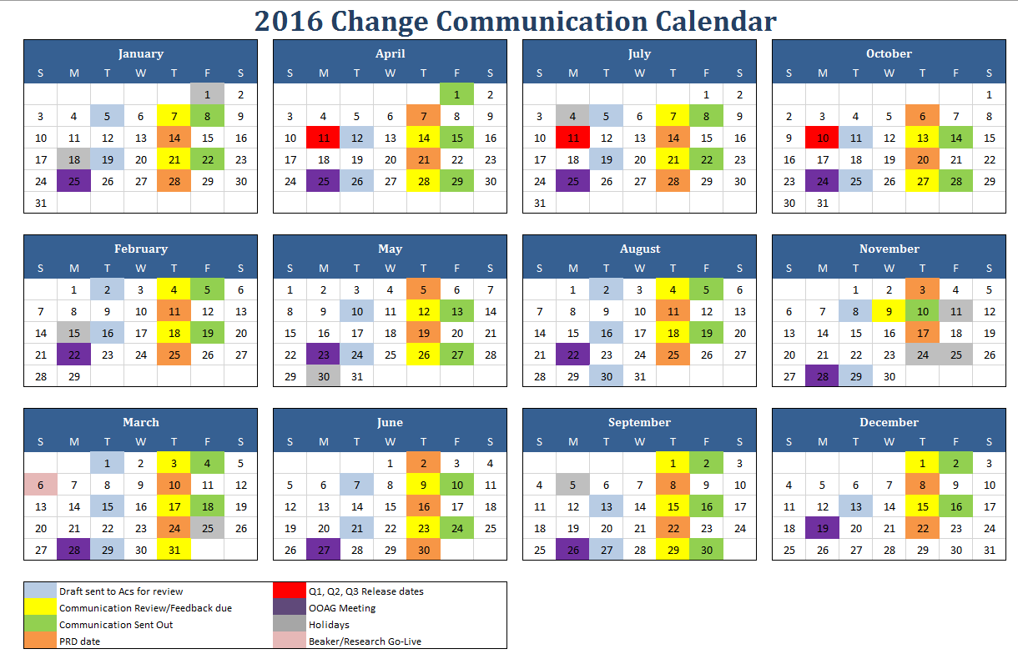
Change Communication Calendar

Slide 19
When?
For more extensive changes, such as Upgrades/New Modules:
Consider the number of people who require training
Don’t forget weekend and night staff
Training methods may also include:
Classroom training, Super-User training, eLearnings
Training done too early may be forgotten
Provide for practice in the Training Playground
Prepare Triage Staff to deal with callers

Slide 20
Questions?
?

Slide 21
Lauren Linhardt RN CPN
Principal Trainer
IP Ancillary/Beacon
llinhardt@mednet.ucla.edu

