Slide 1
UCLA Health Downtime Procedures Overview
Presented By:
Angela Amucha, BSN, RN-BC, Nurse Informaticist

Slide 2
Objectives
Types of Outages
Devices
Recovery
Drills
Role of the Nurse Informaticist

Slide 3
Priorities During the Downtime
Continue to Provide Patient Care
Access Patient Information
Documentation During the Downtime
Recovery After the Downtime is Over

Slide 4
Types of Outages
EMR: The application is not accessible from the desktop icon.
Network: The data network is down, and the site is unable to access any clinical applications.
Power: All power has been lost to the site making computer systems inaccessible.

Slide 5
Downtime Devices
Computer
Local Printer
Uninterruptible Power Supply (UPS)

Slide 6
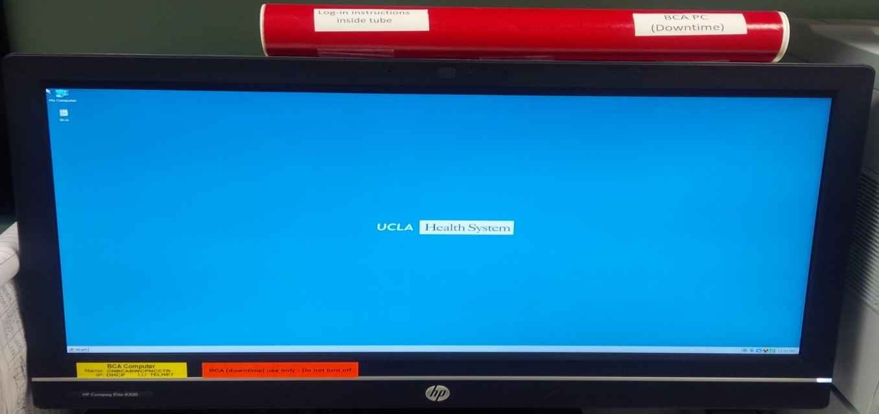
BCA Computer
Identified by a Red Tube and Yellow Tag
Required to always be on to receive downtime reports
Logged in at all times with a generic user account

Slide 7
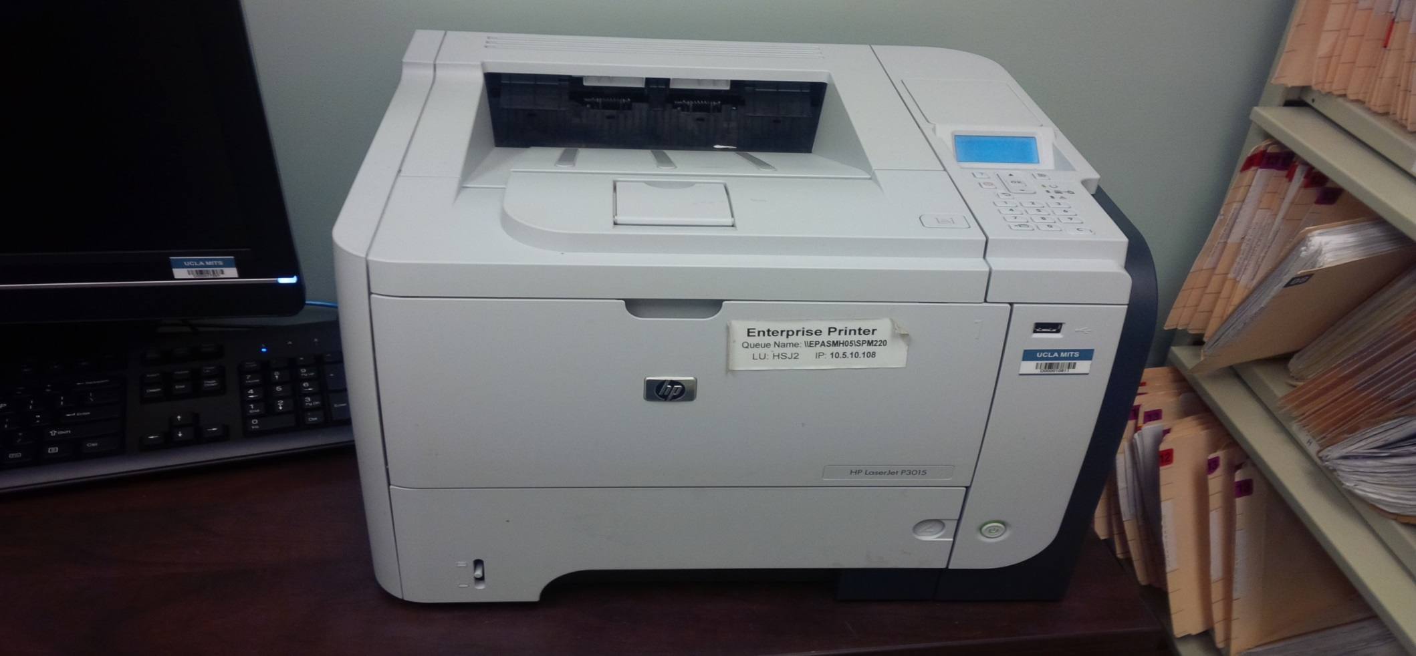
Printer
Printer is connected locally to the workstation
Printer is connected to the Uninterruptable Power Supply (UPS) for availability during a power outage

Slide 8
Uninterruptable Power Source (UPS)
Battery back-up dedicated to providing power to the BCA PC and Printer in the event of a power outage
UPS provides up to 1 hour of backup power once building/floor power goes out

Slide 9
Downtime Screen
The Desktop screen will turn RED

Slide 10
Reports and Recovery

Slide 11
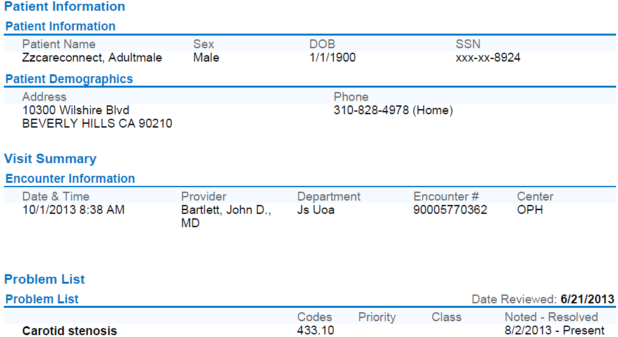
Ambulatory Reports
Two report types are copied to the local workstation daily:
Downtime DAR (Department Appointments): Contains 2 days' worth of scheduling information
Clinical Summary: One per patient snapshot of all scheduled patients for the next 2 days;
Summary includes:
Demographics
Visit Summary
Problem List
Allergies
Patient History
Immunizations
Medication List
The Last Visit information.

Slide 12
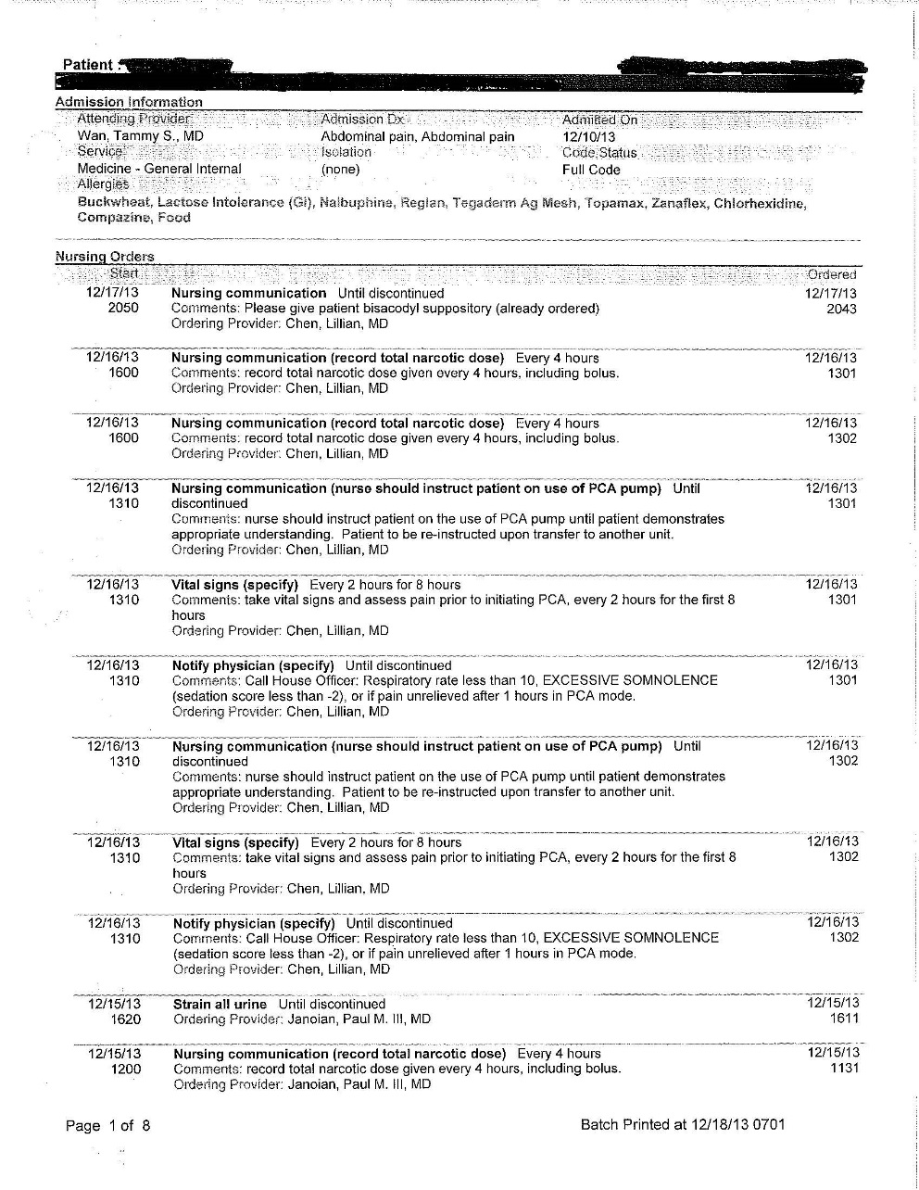
Inpatient Downtime Reports
Generated at scheduled intervals
Current as of last update
Contain information needed during a downtime
Patient Summary (vital signs, intake and output, notes)
Medication Administration Record (MAR)
Orders
Census
Schedules
Preference Cards
Appointments

Slide 13
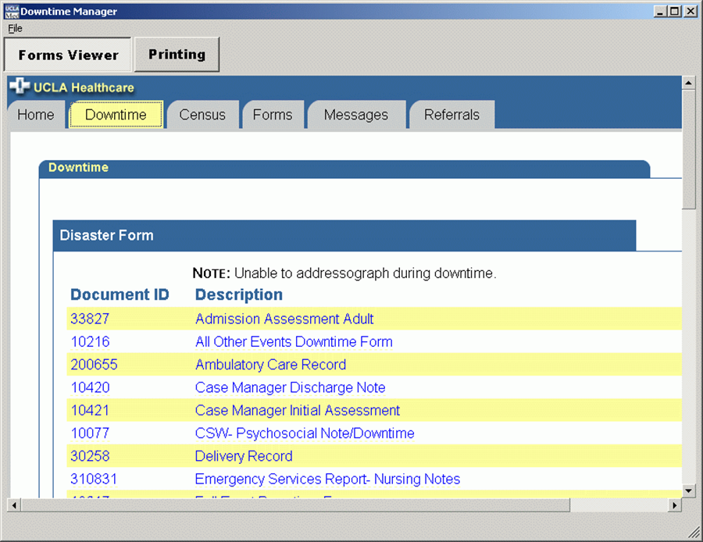
Downtime Forms
Forms are available through our electronic forms application

Slide 14
Recovery Documentation - Ambulatory
Front Office
Patient Demographics
Insurance
Preferred Pharmacy
Signed Forms
Telephone Encounter
Appointments
Back Office
Reason for Visit
Vital Signs
Allergies
Current Medications
In clinic Medication Administration
Immunizations
Charges
Provider
Diagnosis
Brief Progress Note
Medication Orders
Charges

Slide 15
Recovery Documentation - Inpatient
All Medications
Any Orders Not Yet Completed
Most Recent Vital Signs
Total I&O During Downtime
Allergies

Slide 16
BCA Drill Exercise

Slide 17
Drills
Inpatient (Day & Night Shift) and Ambulatory (Multiple Days) drills conducted twice a year
Led by our Disaster Recovery Lead, Lead Nurse and Nurse Informaticist
Clinics participate via WebEx and Inpatient units send a Lead Nurse/Supervisor to receive instructions in an auditorium setting

Slide 18
Exercise Objectives
Locate Your BCA PC
Log-in
Print One Report
Log-off Downtime computer
Locate your Downtime Binder & Printed Forms
Complete Feedback Form
- Survey Monkey: Ambulatory Clinics
- Paper submissions: Inpatient

Slide 19
Incentive for Ambulatory Clinics
3 Clinics who complete the drill and complete the survey entered into a drawing for a Pizza Party

Slide 20
Role of the Nurse Informaticist
Communication
Drill Support
Policy Review
More Support……..
Super Nurse

