Slide 1
Applying the 5 Rights of CDS in the Real World: It’s Messy
Dr. Lasi McArthur, DNP, RN-BC
Systems Analyst
Notes:
Greeting, name, role
Set the stage
Applying the 5 rights of CDS in the real world is messy. It’s not clear-cut. Electronic health record analysts walk a tightrope between filling requests from end-users, following established practices, being innovative, and making sense out of chaos.

Slide 2
At the conclusion of this activity, participants will be able to …
LIST
DEVELOP
APPRAISE
This Photo by Unknown Author is licensed under CC BY
Notes:
At the conclusion of this activity, participants will be able to list the 5 rights of clinical decision support.
At the conclusion of this activity, participants will be able to develop interventions that follow the 5 rights of clinical decision support.
At the conclusion of this activity, participants will be able to appraise a proposal for the 5 rights of clinical decision support.

Slide 3
What is Clinical Decision Support?
“Clinical decision support (CDS) provides clinicians, staff, patients or other individuals with knowledge and person-specific information, intelligently filtered or presented at appropriate times, to enhance health and health care.”
ONC, 2018
Notes:
What is CDS and what are the 5 rights?
Office of the National Coordinator for Health Information Technology
CDS: “Clinical decision support (CDS) provides clinicians, staff, patients or other individuals with knowledge and person-specific information, intelligently filtered or presented at appropriate times, to enhance health and health care.”

Slide 4
What is Clinical Decision Support? A bridge to evidence-based practice.
clinicians, staff, patients or other individuals
knowledge and person-specific information
intelligently filtered
presented at appropriate times
to enhance health and health care
ONC, 2018
Bates, 2003
Notes:
What is CDS and what are the 5 rights?
CDS: “Clinical decision support (CDS) provides clinicians, staff, patients or other individuals with knowledge and person-specific information, intelligently filtered or presented at appropriate times, to enhance health and health care.”
Clinicians: physicians, nurses, dieticians, physical therapists…
Staff: nursing assistants, schedulers who are scheduling diagnostic tests from written orders…
Patients: patients can benefit from CDS? How are we going to show CDS to them?
Other individuals:
Person-specific information: specific to the patient, specific to the role of the care-er
Intelligently filtered: filtered to show under certain clinical situations
Presented at appropriate times: don’t hinder staff from accessing vital patient information
Enhance health and health care: maybe lay off the “staff reminders”? The point of CDS is to be a supportive structure between research and application of that evidence to practice. In other words, CDS is a bridge to evidence-based practice (EBP).

Slide 5
CDS Examples
Alerts
Documentation
Floating windows
In-line warnings
Audible alarms
Text messages
Structured forms
Required fields
Single-select lists
Checklists
Orders
Information Display
Grouped orders
Single-select choice lists
Default doses
Built-in calculators
Hyperlinks to references
Abnormal flag indicators
Dashboards
AHRQ, n.d.
Notes:
The Agency for Healthcare Research and Quality provides an overview of CDS.
Examples of CDS
Alerts: floating windows, in-line warnings, audible alarms, text messages
Orders: grouped orders, single-select choice lists, default doses, built-in calculators
Documentation: structured forms, required fields, single-select lists, checklists
Information Display: hyperlinks to references, abnormal flag indicators, dashboards
You will notice an overlap of human-computer interaction, data display, etc., with clinical decision support. To provide good CDS, we must consider usability and visualization principles.

Slide 6
The 5 Rights
Information
Person
Format
Channel
Time
AHRQ, n.d.
Notes:
The Agency for Healthcare Research and Quality states that the five rights of clinical decision support are to:
Get the right information
To the right person
In the right format (alert, order set, reference information)
Through the right channel (EHR, intranet site, text message)
At the right time in the workflow
Simple, logical, direct
Why is applying it messy? It’s messy because…
Sometimes defining the right person or format or time is difficult
Well-meaning people bring pre-cooked solutions to analysts

Slide 7
Right
Channel
Information
Wrong
Format
Person
Time
Notes:
A pre-cooked solution may include:
The right information
Through the right channel (EHR, intranet site, text message)
But at the wrong time in the workflow
Showing it to the wrong person
In the wrong format (alert, order set, reference information)
One or two “wrongs” can lead to a failed intervention.

Slide 8
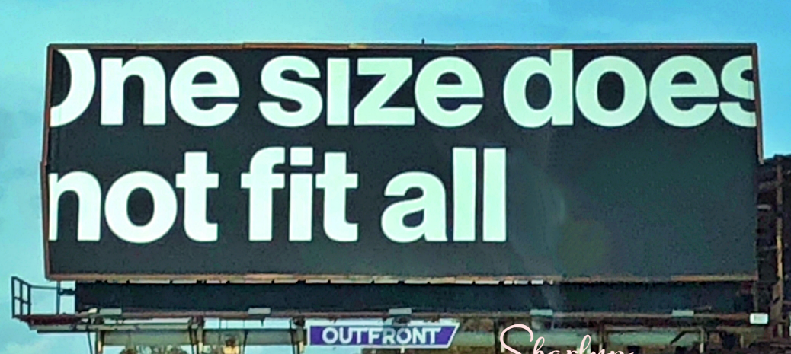
Functional Constraints
Scope Questions
Where’s the Evidence?
Idealized Goals
Resource Limitations
This Photo by Unknown Author is licensed under CC BY-NC-ND
Notes:
In addition to well-meaning proposals, there are other limitations to consider.
Functional constraints
What can the hardware and software do?
Scope questions
Who has the scope to sign orders from an alert prompt?
Who has the scope to utilize clinical judgement?
Where’s the evidence?
Is the solution evidence-based?
Does the literature support the presented solution?
Who makes that determination?
Idealized goals
Pre-cooked solutions sometimes come with goals that are not attainable.
Every patient should be screened 100% of the time for the Ebola virus and there should be no way to skirt the screening.
Target to audience.
Focus on timing—screen once per office visit or hospital admission. Do not screen when transferring units or going to radiology or phlebotomy.
Different follow-throughs for providers versus nursing versus ancillary staff.
Resource limitations
How many hours?
Time required for meeting with stakeholders, testing, revising, testing again
Is there approval to spend resources (time/analyst) on the request?

Slide 9
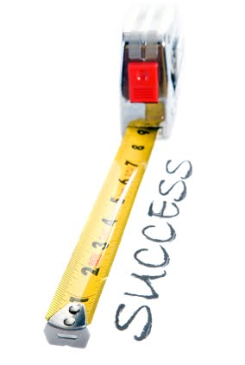
Strategies
What are you trying to change?
Who has the ability to make an impact?
How will you know that it’s working?
Bates, 2003
This Photo by Unknown Author is licensed under CC BY-NC
Notes:
What action are you really trying to change? Sometimes it’s easier to target an intervention to staff who may not have much say in what goes into the EHR, instead of targeting the users that have the power to make most impact most efficiently.
In 2003, Bates et al composed an article titled: Ten commandments for effective clinical decision support: Making the practice of evidence-based medicine a reality. They state that clinical decision support should fit into the workflow (p. 525).
2. “Anticipate needs and deliver in real time.”
3. Make it easy to “do the right thing” (p. 525).
6. “Changing direction is easier than stopping.” Instead of changing a clinical decision after it’s already been made by interrupting the workflow with a popup, how can you guide the clinician to the best decision earlier in the process?
7. “Simple interventions work best.” Are clinicians more likely to apply evidence that they have to go out to a journal repository, search, analyze, summarize, then apply at the bedside? Or is it something that can be integrated into an order set or plan of care for a medical condition?
Who in the organization could really make an impact? Consider the best audience. Physicians, pharmacists, nurses, registered dieticians?
9. “Monitor impact, get feedback, and respond.” At what point would you consider the CDS intervention a success? How will you know that it’s working?

Slide 10
Appraise a Proposal
The Proposal
We want to add a hard stop to nursing to be sure that heart failure patients are discharged from hospital with an ACE/ARB, aspirin, and statin.
This Photo by Unknown Author is licensed under CC BY-NC
Notes:
Proposal
We want to add a hard stop to nursing to be sure that heart failure patients are discharged from hospital with an ACE/ARB, aspirin, and statin.

Slide 11
Appraise a Proposal: 5 Rights
Information: heart failure patients must be on an ACE/ARB, aspirin, and statin.
Person: nursing.
Format: hard stop...
Channel: electronic health record.
Time: at discharge.
This Photo by Unknown Author is licensed under CC BY-SA
Notes:
Proposal
We want to add a hard stop to nursing to be sure that heart failure patients are discharged from hospital with an ACE/ARB, aspirin, and statin.

Slide 12
Appraise a Proposal: Apply What You Know
Information: heart failure requires special medication management.
Time: close to discharge, or maybe earlier in the encounter?
Person: prescribing providers, clinical pharmacists, specialized heart failure nurse?
Channel: electronic health record.
Format: order set?
inline alert? popup alert? checklist?

Slide 13
Hitting the Target
Success!
No mess!
Chaos has been subverted.
Informatics Nurse
This Photo by Unknown Author is licensed under CC BY-SA
Notes:
Let’s say that you’ve made it through the mess of functional constraints, scope questions, the requestors provided evidence for the intervention, and leadership has approved for time to be spent on implementation. You’ve also worked through the idealized goals of the requestors, and they have agreed that it doesn’t make sense to make a hard-stop to screen every patient in the health system, every time, for Ebola. It also doesn’t make sense to hold up hospital discharges due to medication mismanagement, and tie up nurses on pages and phone calls with providers to order new prescriptions or document why they didn’t order them.
You feel good! Success!
But we’re not done yet. Now’s the tedious part. Watch and wait.

Slide 14
Quality Improvement
Act
Plan & Do
Study
Notes:
After getting all the ducks in a row and implementing a well-planned, thoughtful, CDS intervention, it’s time to gather feedback.
The PDSA cycle for continuous improvement efforts is easy to remember and easy to follow. It is similar to what we learned for the nursing process, ADPIE: assess, diagnose, plan, intervene, evaluate.
In the perfect world, every new popup alert, order set, or other intervention is monitored for impact, feedback is obtained, and revisions are made as needed (Bates, et al, 2003, p. 528).
This can be difficult to do every time—think *resource limitations*--but it is worthy of our time.

Slide 15
Impact
Alerts
How often triggered?
Which departments affected?
Orders
Order sets being used?
Complaints about single-select options?
Documentation
Structured forms being filled out?
Is the intended behavior changing?
Information Display
Are the hyperlinks working?
Is anyone clicking on them?
Notes:
When in the “study” part of a PDSA cycle, the impact of the intervention should be assessed. Make sure we didn’t create a mess by overlooking some aspect of the workflow or decision-making.
How often is the intervention being triggered? For example, is the new order set being utilized? Is the popup alert firing? Which departments are affected? Continue to evaluate after intervening—plan do study act should be a continuous process, not a “once and done”.

Slide 16
Recap
Clinical decision support (CDS) is…
5 rights of CDS
information
person
format
channel
time
Considerations
Strategies for success
This Photo by Unknown Author is licensed under CC BY-SA
Notes:
“Clinical decision support (CDS) provides clinicians, staff, patients or other individuals with knowledge and person-specific information, intelligently filtered or presented at appropriate times, to enhance health and health care.” It provides a bridge from research to application at bedside, i.e. EBP.
5 rights of CDS
Get the right information
To the right person
In the right format
Through the right channel
At the right time in the workflow
Considerations: functional constraints, scope questions, what’s the evidence say, resources
What are you trying to change? Who can make an impact? How will you know it’s working?

Slide 17
Questions to Ponder
How do you vet CDS requests?
Are you applying the 5 rights?
How do you evaluate CDS interventions?
What does the future hold?
Silverman, 2019
Notes:
Questions to ponder
How does your organization vet CDS requests?
Are you applying the 5 rights?
How does your organization monitor CDS interventions after initial implementation?
What does the future hold in the field of clinical decision support?
Let’s talk about the role of nurses… As technological advances are made in interoperability and sharing of information, we should see CDS become more patient-centered. Better yet, we should see CDS become more intertwined in the medical record. We should see “smarter” CDS, that is less interruptive and more imperceptible, with more of a soft glove approach. A couple weeks ago I read an essay in the New York Times (Silverman, 2019) by a physician discussing how an EHR can have a very accusing voice—”you haven’t signed this note”, “you are deficient.” I see that partly as an opportunity for vendors and health informaticists to collaborate on better EHR designs, but I also see it as a testimony to how nurses, THE coordinators of care, have not been engaged enough as EHRs have been developed and deployed across the world. We need to do better. We need to bring a strong, hearty, collaborative voice to the table, like we nurses are good at doing when advocating for patients. Let’s do the same for the EHR—let’s advocate for better, so we can better care for our patients.

Slide 18
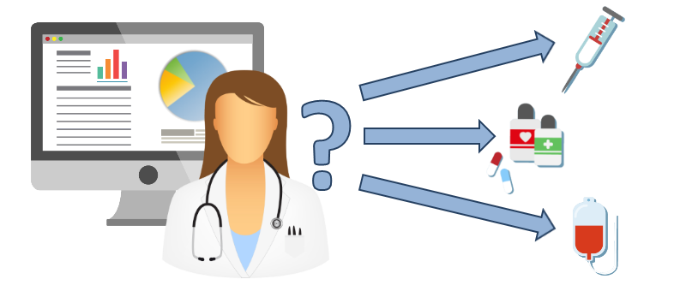
Conclusion
Notes:
In conclusion, CDS is a tool that should be used thoughtfully by considering the 5 rights. Interventions should be reviewed for appropriateness and effectiveness at routine intervals. We should make it easy for clinicians to do the right thing. As informatics nurse professionals, it’s our duty to staff and patients that we provide technology that is safe, efficient, and effective. Thank you.

Slide 19
References
Agency for Healthcare Research and Quality (AHRQ). (n.d.). Overview of CDS five rights. Retrieved July 8, 2019, from https://healthit.ahrq.gov/ahrq-funded-projects/current-health-it-priorities/clinical-decision-support-cds/chapter-1-approaching-clinical-decision/
Bates, D. W., Kuperman, G. J., Wang, S., Gandhi, T., Kittler, A., Volk, L., … Middleton, B. (2003). Ten commandments for effective clinical decision support: Making the practice of evidence-based medicine a reality. Journal of the American Medical Informatics Association: JAMIA, 10(6), 523–530. doi:10.1197/jamia.M1370
Office of the National Coordinator for Health Information Technology (ONC). (2018). Clinical decision support. Retrieved September 22, 2019, from https://www.healthit.gov/topic/safety/clinical-decision-support
Silverman, E. (2019). Our hospital’s new software frets about my ‘deficiencies.’ The New York Times. Retrieved November 3, 2019, from https://www.nytimes.com/2019/11/01/health/epic-electronic-health-records.html

