Slide 1
The Clinical Informatics Leader: A Behavioral Analysis
Clinical Informatics: It’s Our Time!
2014 Clinical Informatics Academy
Sponsored by DFW ANIA Chapter
October 10-11, 2014
Dorothy DuSold, MA, CPHIMS
Senior Director Adoption & Sustainment
Tenet Healthcare

Slide 2
Conflict of Interest Disclosure
Dorothy DuSold, MA, CPHIMS
has no real or apparent
conflicts of interest to report.

Slide 3
Session Objectives
Learn why behavioral profiling for clinical informatics leaders was a need at Tenet
Learn how Tenet developed the behavioral profile
Learn what makes up the behavioral DNA of effective Tenet clinical informatics leaders
Learn ways to use the behavioral profile

Slide 4
Why Behavioral Profiling?
Session Objective #1

Slide 5
Tenet Spans 16 States in Many Settings
Michigan
Connecticut (LOI)
8 Hospitals
9 Outpatient
ProCare
4 Hospitals
California
Massachusetts
12 Hospitals
36 Outpatient
Golden State Health Plan
Illinois
Tennessee
3 Hospitals
4 Outpatient
4 Hospitals
4 Outpatient
Chicago Health Plan
2 Hospitals
6 Outpatient
Pennsylvania
2 Hospitals
3 Outpatient
Missouri
2 Hospitals
3 Outpatient
N. Carolina
2 Hospitals
4 Outpatient
Arizona
6 Hospitals
4 Outpatient
Abrazo Advantage Health Plan
S. Carolina
5 Hospitals
10 Outpatient
New Mexico
Georgia
2 Outpatient
5 Hospitals
15 Outpatient
Texas
Alabama
Florida
1 Hospital
5 Outpatient
10 Hospitals
28 Outpatient
19 Hospitals
63 Outpatient
Valley Baptist Health Plan
Mississippi
80 Hospitals
1 Outpatient
197 Outpatient Centers
6 Health Plans

Slide 6
Clinical Informatics Structure at Tenet
Three levels of Clinical Informatics (CI)
National Clinical Informatics
Managing Director
Regional
Clinical Informatics
Director
Regional
Clinical Informatics
Director
Regional
Clinical Informatics
Director
Regional
Clinical Informatics
Director
Hospital
Clinical Informatics
Director¹
Hospital
Clinical Informatics
Director¹
Hospital
Clinical Informatics
Director¹
Hospital
Clinical Informatics
Director¹
¹Direct report to hospital Chief Nursing Officer

Slide 7
Clinical Informatics Role at Tenet
Hospital director-level position
Strategic to the successful adoption and sustainment of the EHR
Primary role is to serve as a change agent
Must be able to move people out of their comfort zones and challenge the status quo
Promotes health system-wide standards, not automation of hospital-specific practices
Represents all departments, not just nursing
Must be influential, articulate, credible, respected, fair-minded

Slide 8
The Cause for Action
Identify the right individuals to fill the role
Improve CI effectiveness
Evolve the organization’s perception of the role
Reduce turnover
Enhance the organization’s ability to promote standardization, implement rapid changes, and develop the culture needed to sustain the EHR environment

Slide 9
How Was the Profile Developed?
Session Objective #2

Slide 10
Step 1: Identify the population
30 Tenet-employed clinical informatics leaders from hospitals in 12 states (subset of group pictured below)
Over 6 months tenure in the position

Slide 11
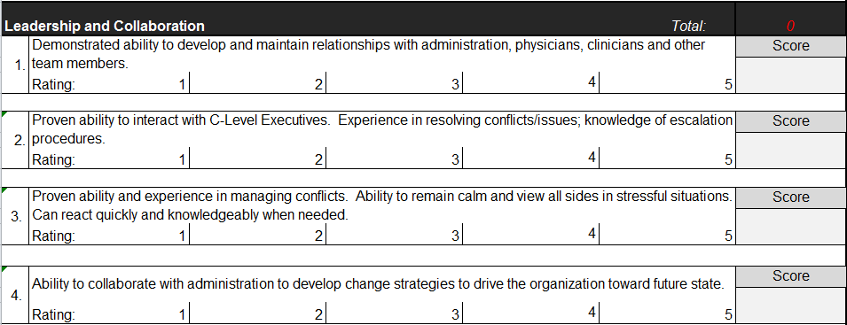
Step #2: Assess the population (1 of 2)
CI population completed an assessment used as part of hiring process for leaders
CI Skills assessment
Managers rated CIs on the Tenet CI Skills Assessment Tool
Measures “user”, “modifier”, “innovator” competencies
Assessment Areas:
Experience and background
Leadership and collaboration
Effective communication
Change management
Organizational readiness
Value realization
Work ethic and integrity

Slide 12
Step #2: Assess the population (2 of 2)
Behavioral assessment
Assessment firm interviewed managers to identify the traits they considered important to the CIs effectiveness
An assessment was completed by the manager of each CI to rate the CIs on these traits
Forced ranking
CI population was ranked from highest to lowest performer based on the skills and behavioral assessments

Slide 13
Step #3: Develop the Behavioral Profile
The assessment firm performed analysis of all data to determine the behavioral DNA of our top performers
General assessment results for each CI
Manager assessment results for each CI
Forced ranking
Analyzed 38 attributes
Determined most predictive attributes for position fit and assigned weights
Identified 8 significant attributes

Slide 14
What is the Behavioral DNA of Successful CI Leaders?
Session Objective #3

Slide 15
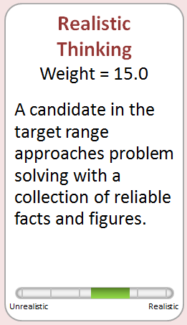
Interpretation
Behavioral attribute identified as relevant to the effective CI leader
Weight: Degree of relevance of the attribute
Note: Above 4 is relevant; 15 is an extremely high weight
Continuum: The ideal placement and range on the scale of behavioral extremes
Description of the successful behavior

Slide 16
#1 – Realistic Thinking
Effective Clinical Informatics Leaders:
Make decisions based on reliable facts but also considers other factors such as
The organization’s capacity to deal with change
Environmental constraints
Clinical system functionality
Resource capabilities
Competing initiatives and priorities

Slide 17
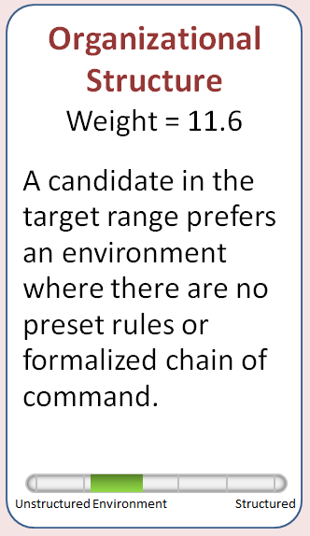
#2 – Organizational Structure
Effective Clinical Informatics Leaders:
Can exert influence at all levels of the organization
C-Suite
Department directors and physician department chairs
Managers and supervisors
Super users
End users
Do not need a rigid structure

Slide 18
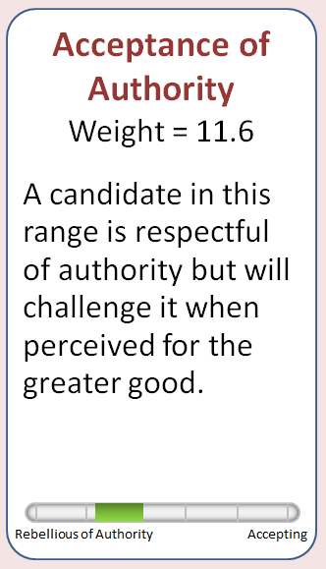
#3 – Acceptance of Authority
Effective Clinical Informatics Leaders:
Will respectfully challenge the status quo when perceived for the better good
Will support a clinical system standard but must believe in it (using realistic thinking!)
This is hard when supporting standards across a large organization

Slide 19
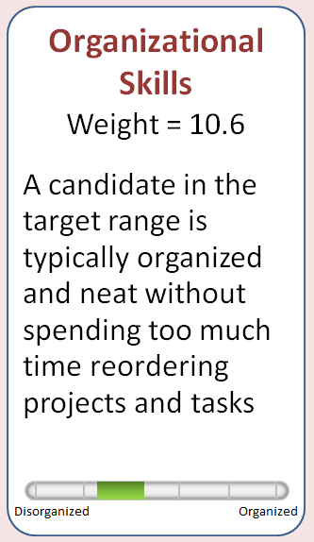
#4 – Organizational Skills
Effective Clinical Informatics Leaders:
Can make organization out of disorganization; leaves detailed organizational tasks to others
Helps others see the big picture and directs them to do the minutia to follow through on what needs to be done
Delegates effectively to others

Slide 20
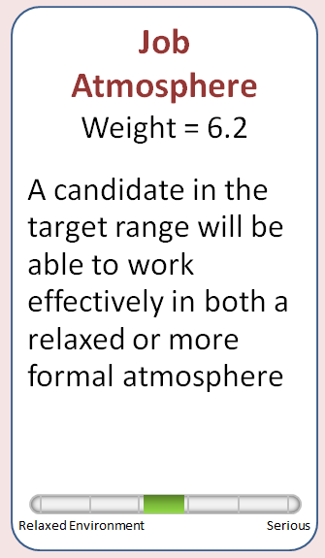
#5 – Job Atmosphere
Effective Clinical Informatics Leaders:
Are effective in both informal (i.e. the break room) and formal (the board room) settings
Are flexible and can adapt to a wide range of professional environments to establish a rapport with the audience

Slide 21
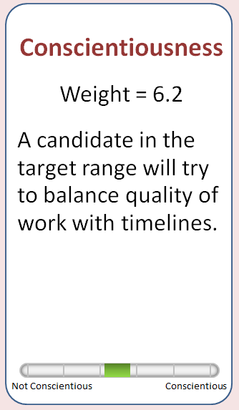
#6 – Conscientiousness
Effective Clinical Informatics Leaders:
Balance quality with timeliness
Know when “B” work is good enough
Do not sweat the small stuff
Hold others accountable

Slide 22
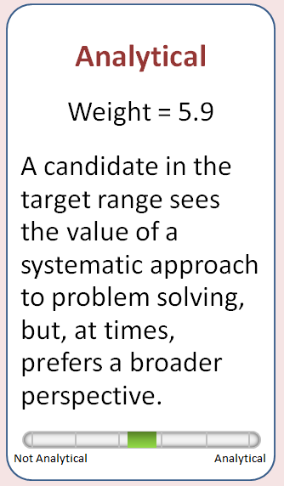
#7 – Analytical
Effective Clinical Informatics Leaders:
Analyze facts but also considers the people factors
Mid range between artists and accountants
Use data to change behavior
Do not stay behind a desk creating spreadsheets
Make end users understand how their use of the EHR produces analytics that allow comparative analysis of outcomes

Slide 23
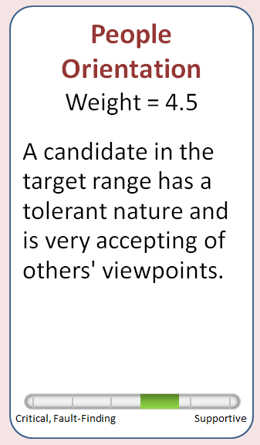
#8 – People Orientation
Effective Clinical Informatics Leaders:
Are tolerant of others’ viewpoints
Respect and encourage discussion
Are not critical, rigid, and fault-finding
Are supportive of others, yet able to drive to a decision
More outgoing in nature as opposed to being introverted

Slide 24
How Can You Use the Profile?
Session Objective #4

Slide 25
Recruiting
CI leader candidates complete the behavioral assessment during the interview process
Assessment results are compared to the CI Behavioral Profile
Behavioral profile matches are considered along with other factors in the hiring decision

Slide 26
Skills Development
Develop CI education sessions to strengthen desired characteristics and mitigate high-risk behaviors
Address behavioral skills in individual CI development plans
Provide education on interaction across different behavioral styles

Slide 27
Recap
In this session, did you:
Learn why behavioral profiling for clinical informatics leaders was a need at Tenet?
Learn how Tenet developed the behavioral profile?
Learn what makes up the behavioral DNA of effective Tenet clinical informatics leaders?
Learn ways to use the behavioral profile?

Slide 28
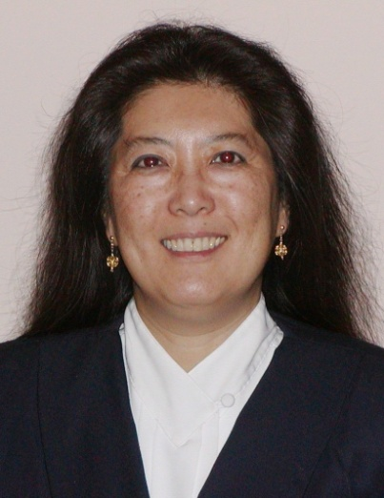
Contact Information
Dorothy DuSold, MA, CPHIMS
Senior Director Adoption & Sustainment
Tenet Healthcare
dorothy.dusold@tenethealth.com

