Slide 1
Clinical Informatics: It’s Our Time!
2014 Clinical Informatics Academy
Sponsored by DFW ANIA Chapter
October 10-11, 2014
innovation creating & sustaining
Edward Marx
SVP/CIO
Texas Health Resources

Slide 2
Conflict of Interest Disclosure
Edward Marx
Has no real or apparent conflicts of interest to report.
© 2014 HIMSS

Slide 3
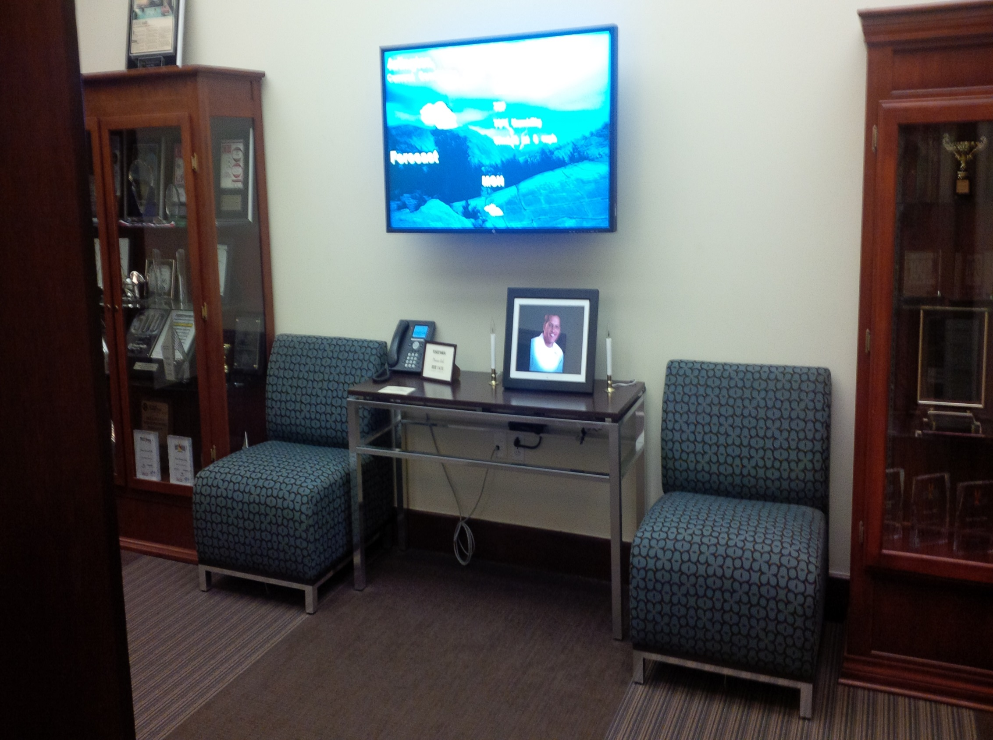
Notes:
-Texas Health Resources is the product of a brand unification that took place in 2009
-Aligning our legacy systems – Harris Methodist, Presbyterian, and Arlington Memorial into a singular regional brand.
-THR is the largest health care provider in North Texas:
22,500 employees
5,500 Physicians
3,800 beds
293 access points, including
25 hospitals in three sub-regional zones
18 outpatient facilities
2,500 other community access points

Slide 4
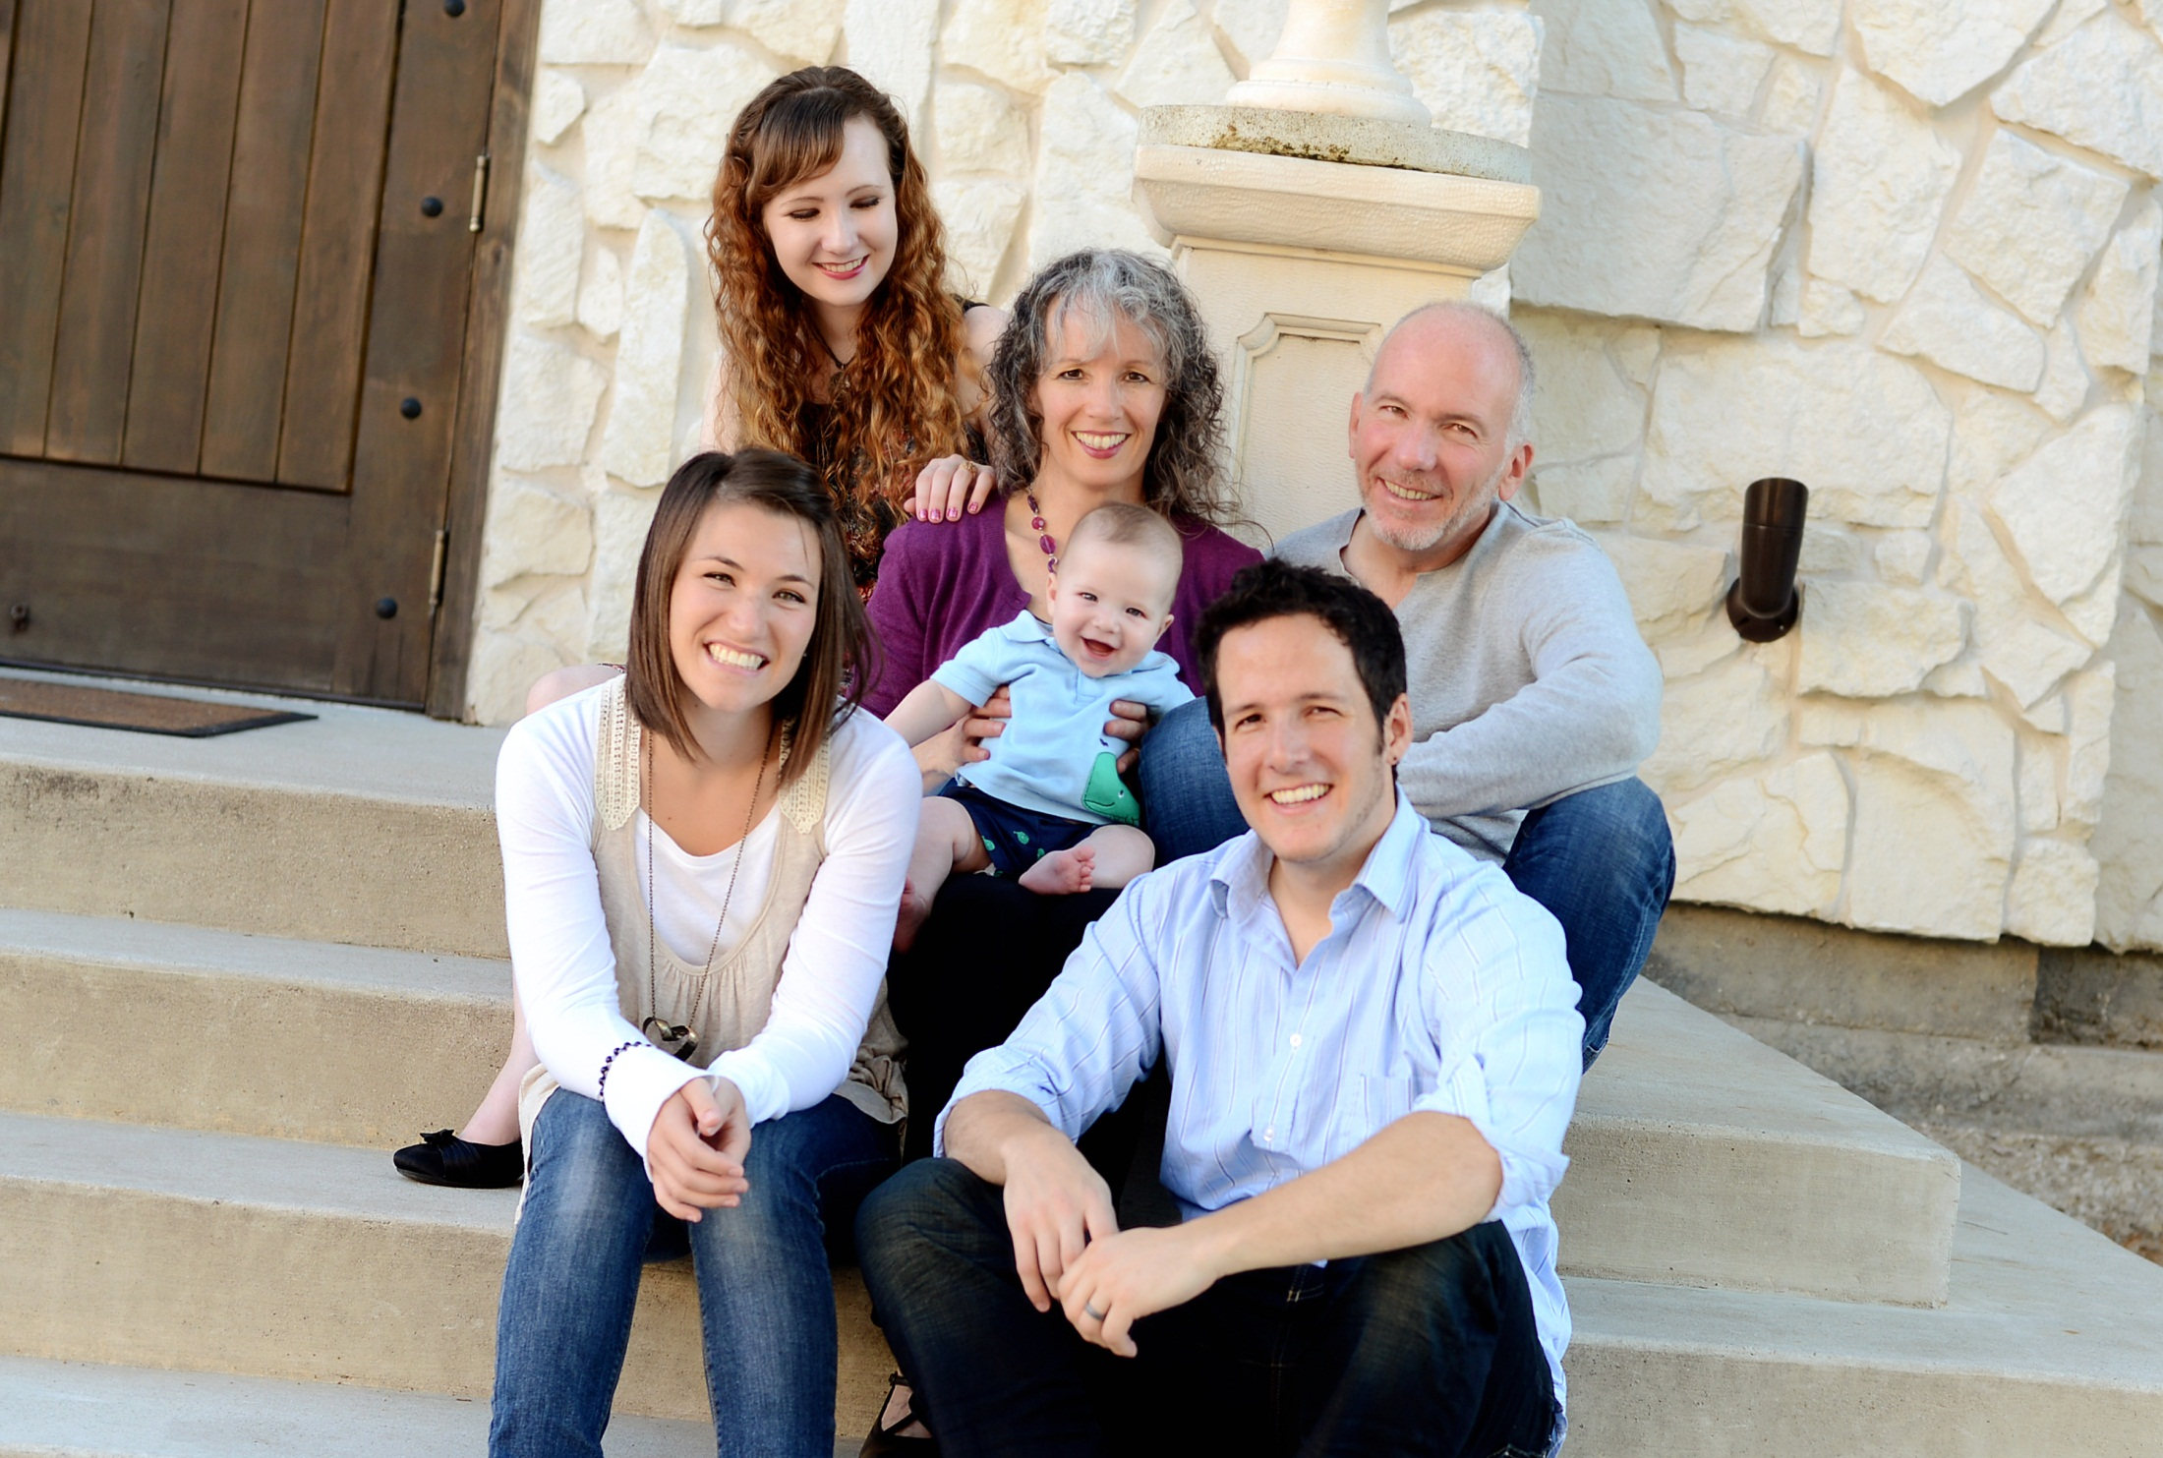
Who I am
Serve
Study
Share
Shape

Slide 5
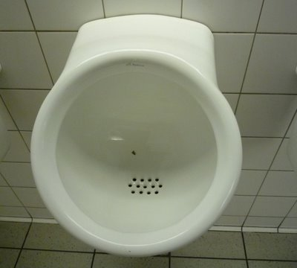

Slide 6
Learning Objectives
Defining innovation
Creating innovation
Innovation design process
Sustaining innovation
Innovation case studies
Winning with innovation
Discussion
“The future is already here, it’s just not
evenly distributed” ~Gibson, Author
Notes:
Identify examples of successful innovation case studies
Describe the present state of innovation in healthcare IT
Describe innovation as culture not project
Identify critical success factors
Identify internal & external sources for innovation inspiration
Discuss innovation as culture, not a project
Share formal & informal innovation management processes
Communicate lessons learned
Stimulate ideas to jump start innovation

Slide 7
Defining innovation

Slide 8
innovation is…
innovation…a change in method or technology; a positive, useful departure from previous ways of doing things
innovation Characteristics:
Innovation is new – new technologies, products, services, processes, business models, etc.
Innovation is a process that generates new sources of value and growth for the organization
Innovation can dramatically change the basis of competition in an industry
innovation = Invention + Execution
Notes:
Notes
Although most people writing about innovation have their own definitions of the term, they all share these characteristics:
Innovation is new
Innovation is a process that generates new sources of value and growth for the company
And innovation can dramatically change the basis of competition in an industry (“disruption”)
Grab a grapefruit

Slide 9
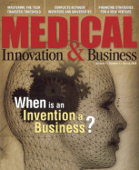
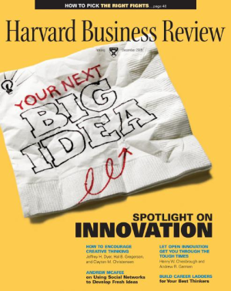
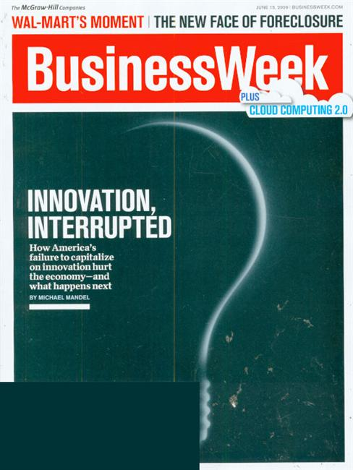
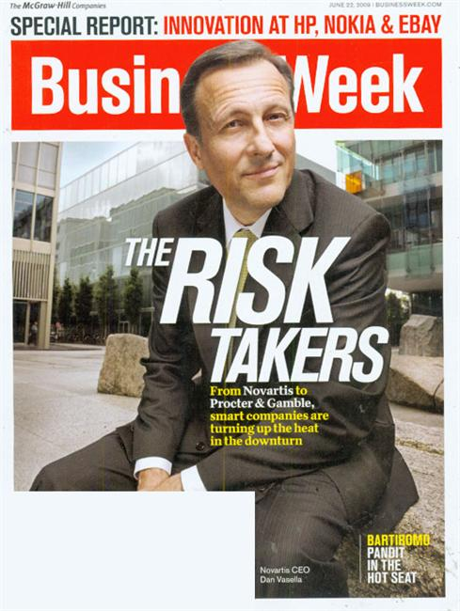
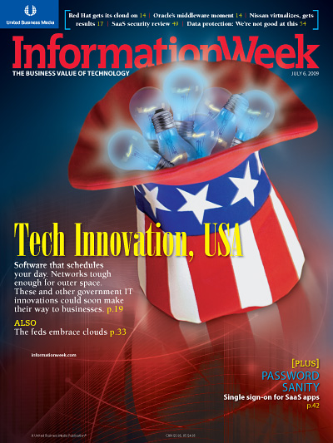
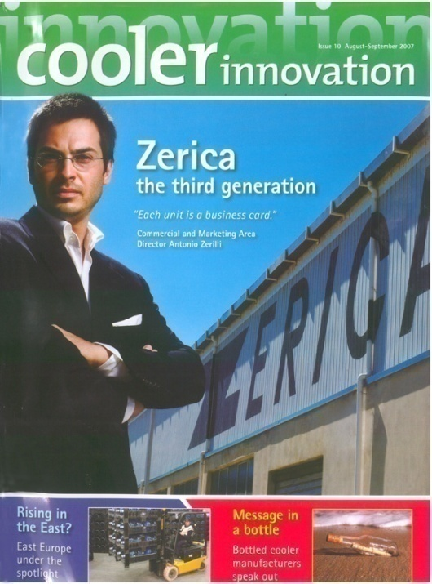
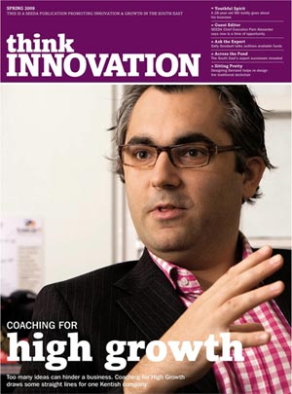
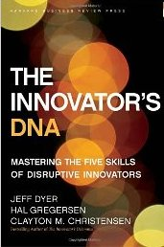
innovation is Everywhere…
Notes:
Innovation hot topic
Defined as Innovation = Invention + Execution
Everyone trying to figure out innovation (execution, culture, structure, etc)
“The first step in winning the future is encouraging American innovation.
-State of the Union (2011)
CEO Surveys…
IBM Super Second Act. How? Focus on Innovation and set it up for even brighter future.
Cant go anywhere without see, hear, taste, smell innovation yet alone define it!
Modicum of success, Why? missing primary ingredient!
But it starts with you…You want innovation, be innovative
To be innovative you must be innovative
We spend 1 Trillion per year on Innovation with little ROI (book on tape)
How

Slide 10
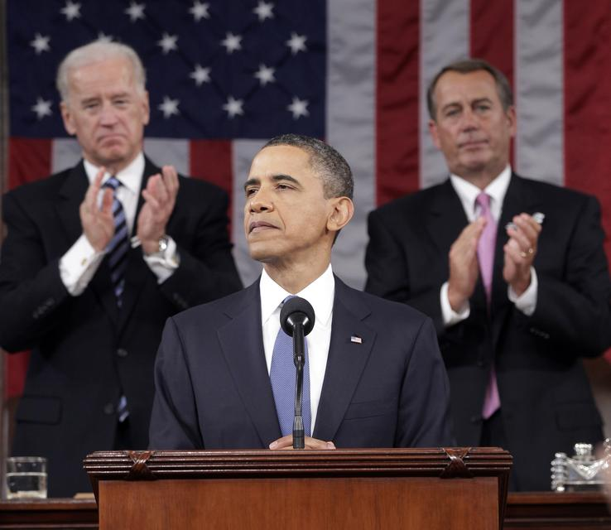
“The first step in winning the future is encouraging American innovation.”
“The world leaders in innovation will be world leaders in everything else.” ~McAlindon

Slide 11
innovation Ranking in Priority
innovative companies grow 3x faster than S&P global
Fortune 500 Survey, 2012

Slide 12
Leveraging Tech innovation *
*Information Week Survey 2013

Slide 13
innovation Evolution
Agricultural Age | Physical strength important, location based, edible output | Physical
Industrial Age | Tangible, visibly operational, transportation centric, physically useable output | Obvious
Information Age | Increasingly intangible; teamwork still largely proximity centric, work in cubes and buildings, solutions based on information quantity | Cooperative
Intelligence Age | Specificity, information and ideas changed in real time from broad range of distributed participants; communication centric | Socially Collaborative
innovation = where are you?
Source; AT&T
Notes:
19 century physical resources
20 century manufacturing
21 human potential

Slide 14
innovation & Healthcare
30 years for new scientific knowledge to become standardized in healthcare delivery.
~Crossing the Quality Chasm
Healthcare is the most dysfunctional industry and most primed for disruptive innovation.
~Wired Magazine
Disruptive business models improve quality, accessibility and affordability by changing the way hospitals and doctors work.
~Innovator’s Prescription
…save 162B through innovative technology
Notes:
Innovative companies grow 3x faster than S&P global average. ~BusinessWeek
RAND

Slide 15
Why innovation Lags
Only 20% CIOs considered innovative*
IT becomes Compliance function & cost center*
85-90% of IT spend are with vendors*
Fear of failure*
Healthcare CIOs are old school”
Not working collaboratively”
Lack of consumer demand, but rising”
be prepared to lead organization
know thyself and know thy organization
*CIO Magazine Nov 2011 “Marx
Notes:
IT reporting to CFO…became Compliance; security and audit
Only 10-15% of spend available for yourself
Regulatory oversight that is completely focussed on compliance. "It discourages risk-taking and innovation," Deane said.
Health care doesn't have the same financial reward system. Facebook isn't about to pay $1 billion for the latest hot-ticket item in imaging and informatics.
And, finally, Deane said, "Security always trumps information sharing, and so better, faster linkages are constrained because of security concerns, most of which are bogus."
One of the other big problems is that, unlike other industries, new technologies in health care are not driven by consumer demand. It's up to doctors and hospitals to decide whether to implement the latest and greatest piece of health care tech.

Slide 16
Creating innovation

Slide 17
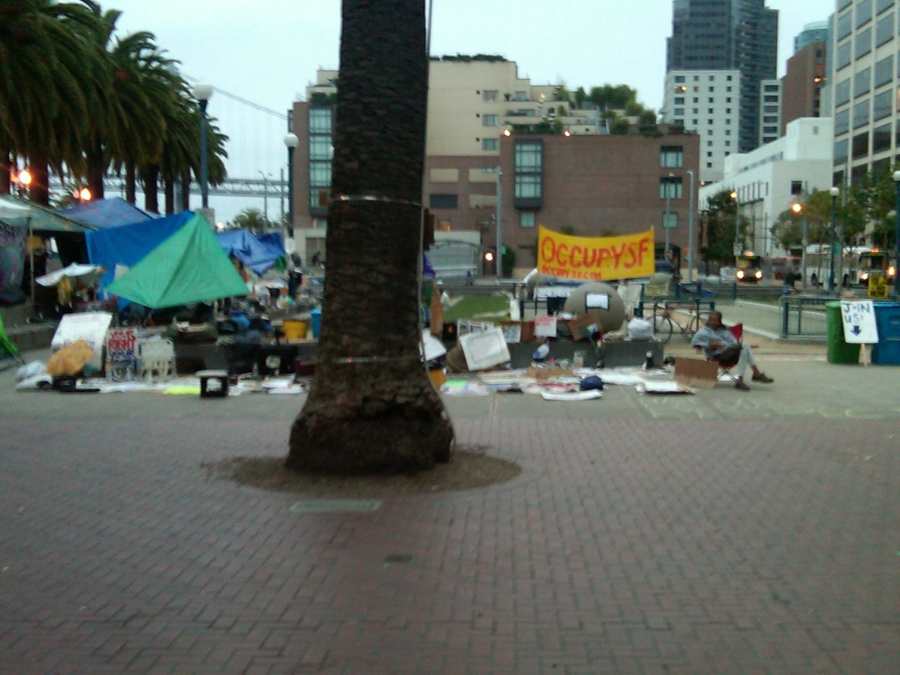
Creating innovation Culture
Ask Why? What If? Multiple Perspectives?
Encourage innovation …not optional …fund it
Must model behavior yourself
Take risks and reward failures
Book clubs & read voraciously …education
Embrace social networking & mind mapping
People mash-ups & Parties
Cross generational/cultural teams
Hire outside of norms
Occupy IT!
hire people that don’t look like you!
Notes:
Encourage Innovation
Talk about it
Showcase
Allow time
Must Model Behavior Yourself
Work
Home ironman, tango, rockband, church

Slide 18
Creating innovation Culture
Leverage vendors
Don’t outsource innovation…or hire “expert”
Staff for innovation
Enterprise architects
Business analysts
Ensure development resources
Bust routines
Create innovation Center (hospital floor of future)
Break tradition & silos …enhanced org structures
Collaboration space
to BE innovative you must BE innovative
Notes:
Cloud fear, but you don’t even do DR/BC!!!

Slide 19
Access External innovation
Benchmarking
Scanning
Partners
Advisory
Best practices
Corporate exchanges

Slide 20
do you have to get the IT team out of their cubicles?
Notes:
http://www.flickr.com/photos/ste3ve/521083416/
Attribution-ShareAlike License
Steve

Slide 21
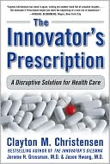
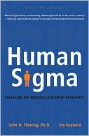
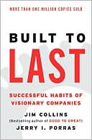
Book Studies…

Slide 22
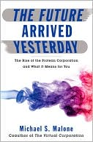
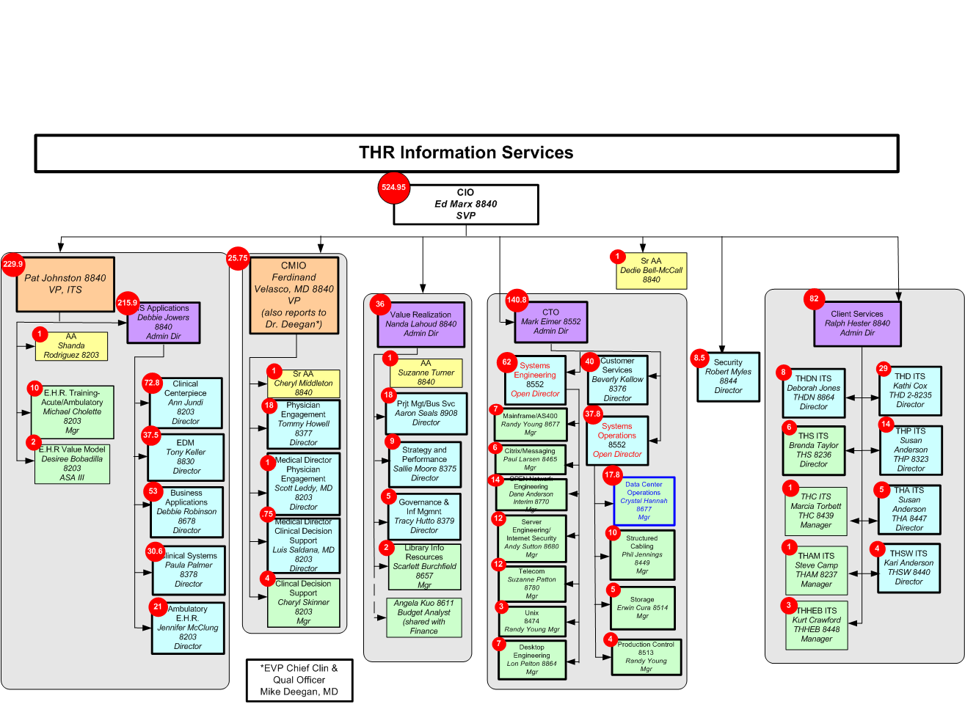
Protean Organization*
CareConnect App Support
Application Support
CORE services
TBD…
Service Desk
Optimization
TBD …
Customer Engagement
*readily assuming different shapes or forms

Slide 23
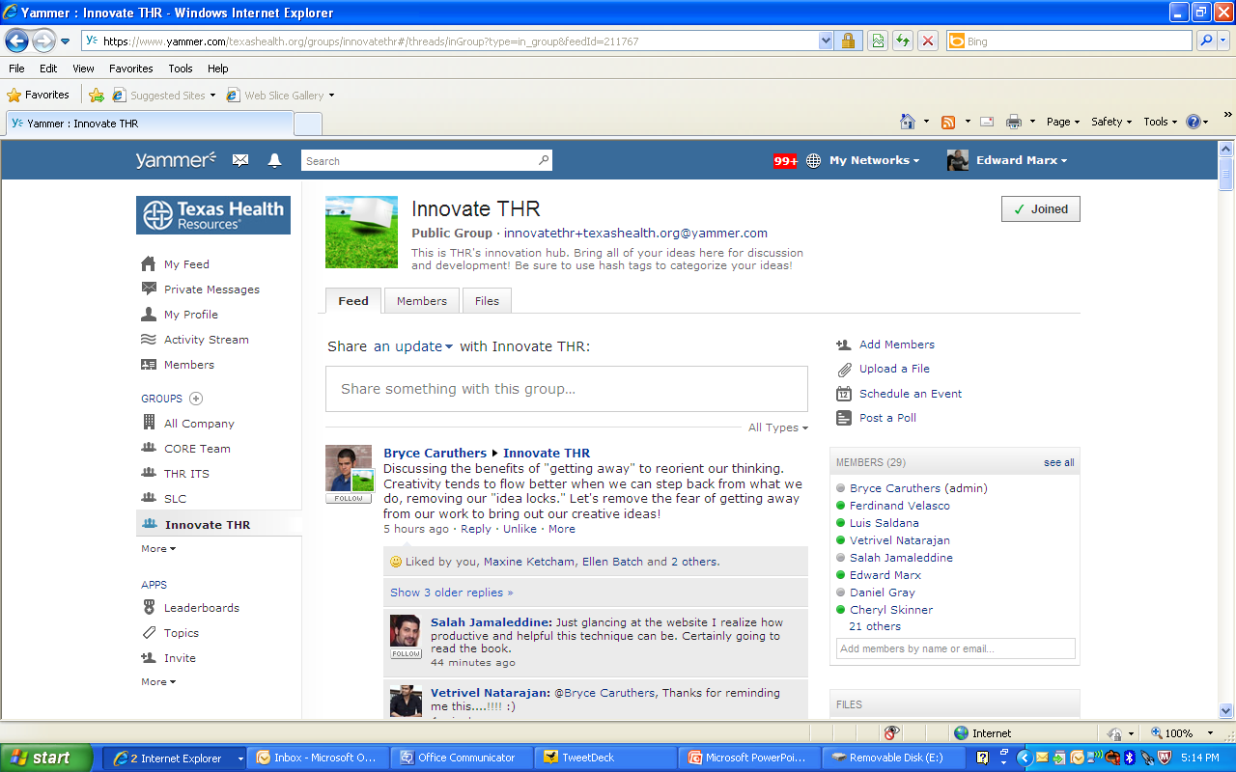
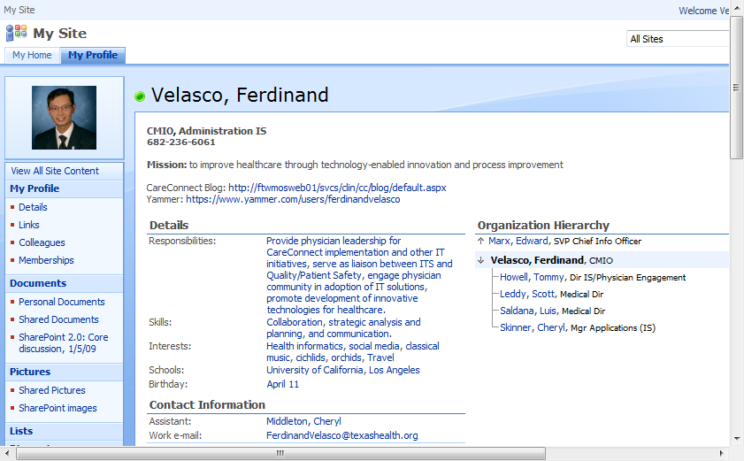
Yammer & MySites

Slide 24
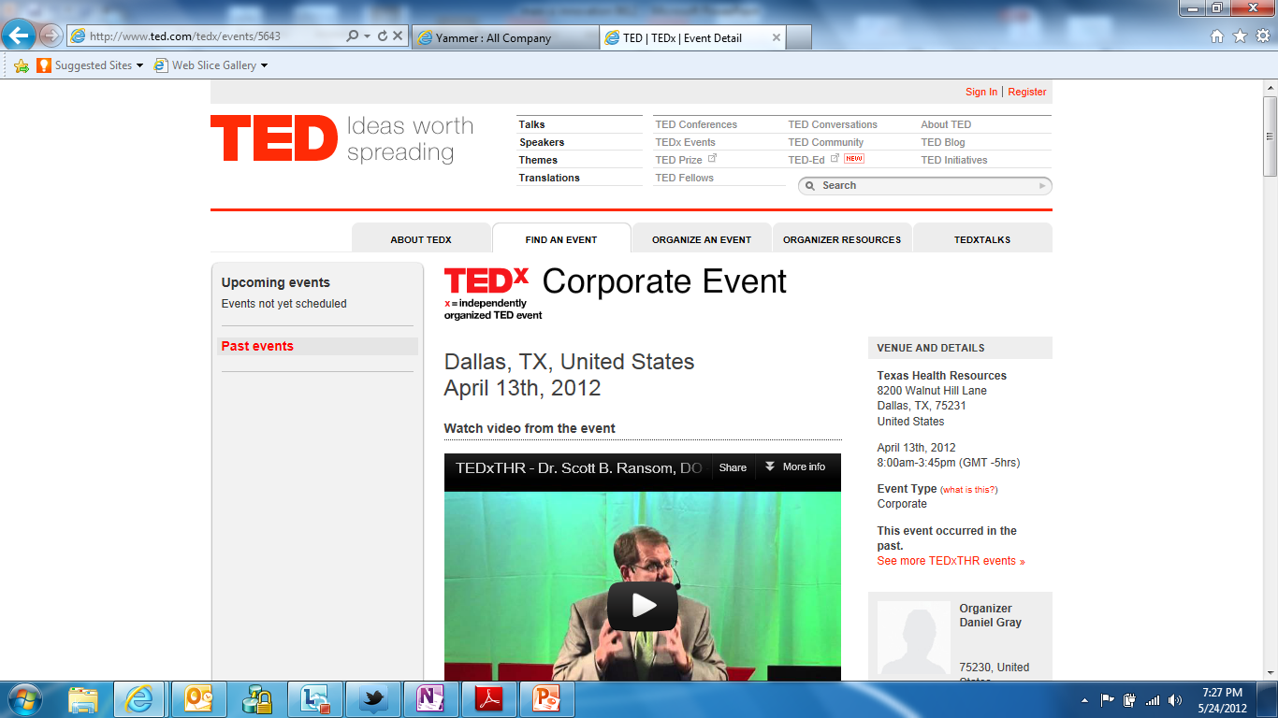

Slide 25
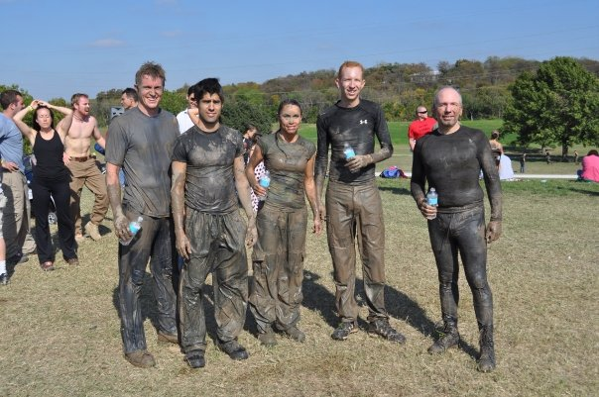
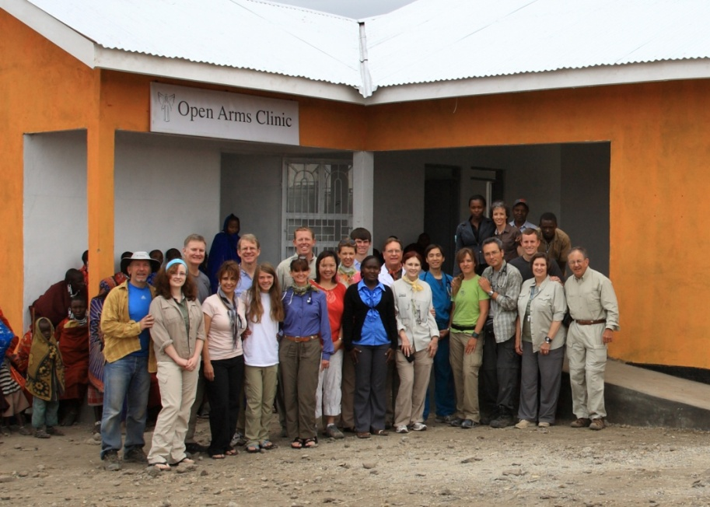
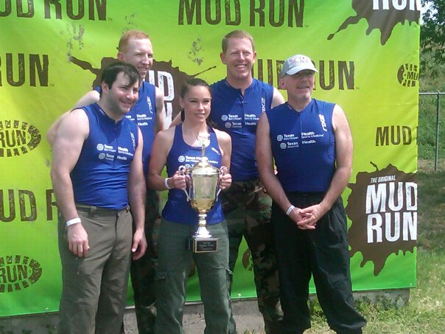
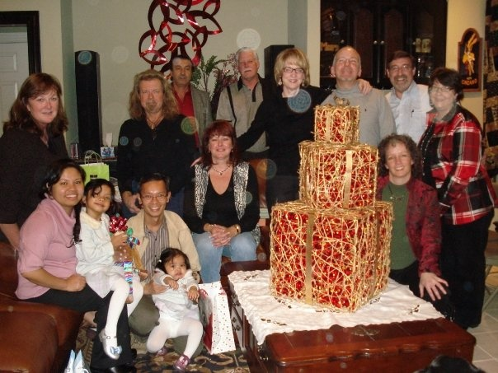
Connections & Team Building
innovation rarely happens in a conference room…

Slide 26
Creating innovation…Process
innovation collaboration
innovation council
Linkage with IT plan
Convergence with organizational strategy
Linkage with organizational uber objectives such as Baldrige, Six Sigma, Lean
Working with suppliers!
…shrinking the bench to bedside time gap

Slide 27
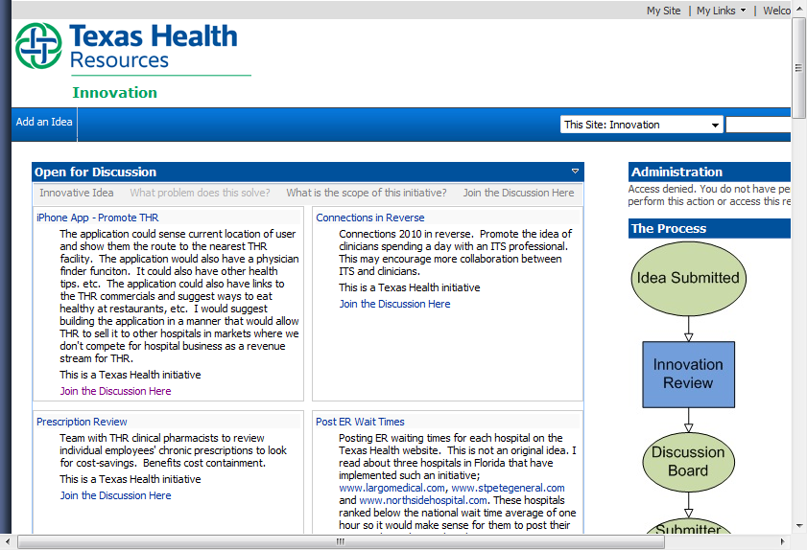
innovation Portal

Slide 28
Idea Source & Success
Idea Factor | Success-to-Failure Rate
Random events (innovators stumbled on something they were not looking for but immediately recognized its significance) | 13 times more successes than failures
Solution spotting (finding a new way of using an existing piece of technology) | 7 times more successes than failures
Market research | 4 times more successes than failures
Need spotting (actively looking for an answer to a known problem) | 2 times more successes than failures
Mental inventions (things dreamed up in the head with little reference to the outside world | 3 times more failures than successes
Trend following | 3 times more failures than successes

Slide 29
Business & IT Convergence
VALUE EQUATION
Strategy 1 | Strategy 2 | Strategy 3 | Strategy 4 | Strategy 5
A1 Advance mission, vision, values and Promise and adopt service standards A2 Align Leadership Continuity and Growth in support of strategy A3 Assure workforce alignment/ clarity with strategic direction A4 Strengthen our performance-based culture by attracting retaining and growing top performers A5 Balance workforce supply & demand | B1 Provide clear reasons and ways for THR to engage independent and employed physicians, e.g. Clinical integration initiatives Leadership opportunities Research, educational opportunities B2 Excel in being the most attractive system for all physicians to use Ease of use Good care of patients | D1 Build physician-led models of care in selected services (acute and non-acute), e.g. CV, diabetes, neuro, etc.)
4
1
C1 Fully engage physicians, nurses and other caregivers in redesigning and delivering coordinated patient care with exceptional results:
including creating supportive analytical, technical and organizational structures
including care delivery outside the acute care setting and into the care continuum
with the explicit objective of improving outcomes and lowering costs
positioned to bring innovative solutions
People
Processes
3
2
Systems

Slide 30
Sustaining innovation

Slide 31
Sustaining innovation…
Culture eats strategy everyday
Create “innovation points” & never stop!
Live by example (I mean live all of life)
Accountability (more than great ideas)
Showcase internal and external success
Align competencies
Extend networks (RadioShack, Pier1, Kimberly-Clark)

Slide 32
Accelerating innovation…
Invest (money, people, time)
Celebrate & Show and Tell
Leverage supplier partnerships
Stories, ideas, speakers
Partner on innovation
Process improvements
Hire for innovation (diversity, stretch)
Manage innovation killers (Devils & Hawks)
supplier collaboration is key to acceleration

Slide 33
Innovation case studies/tools

Slide 35
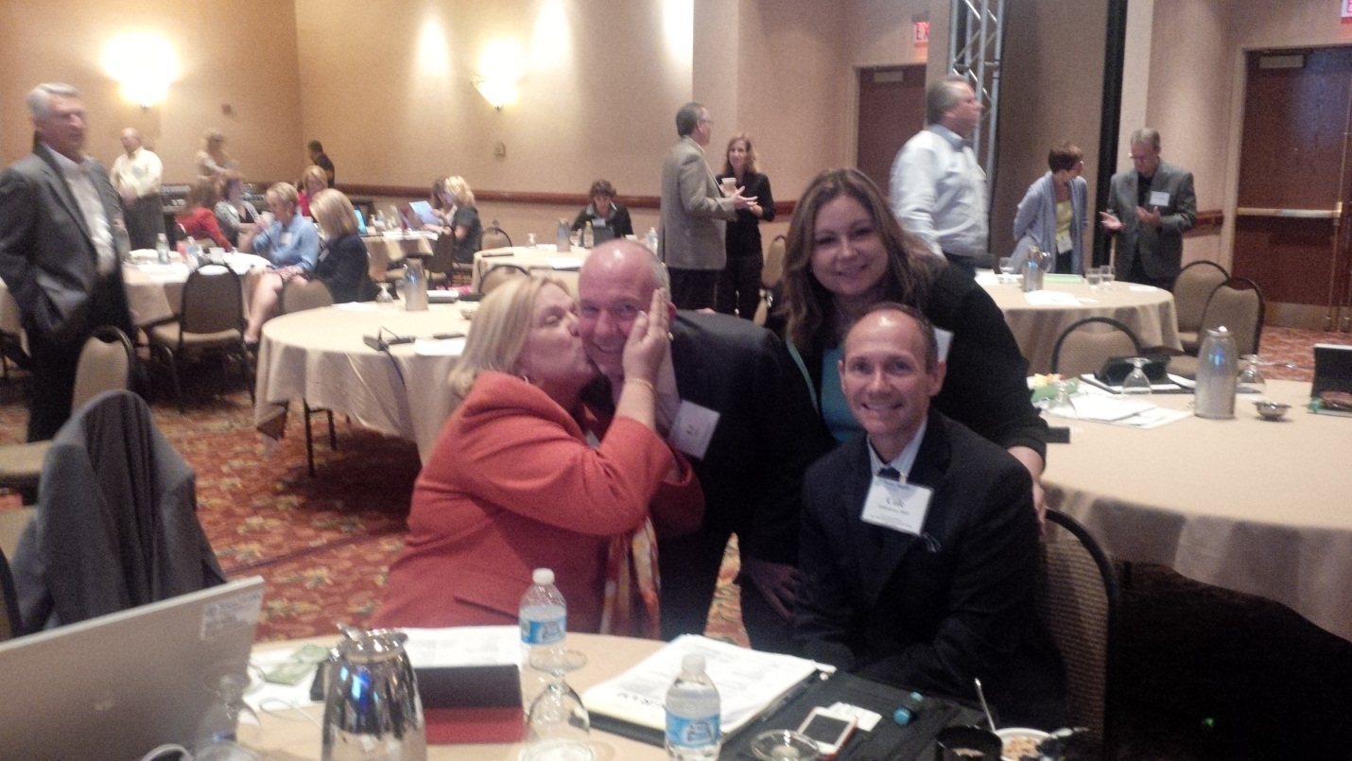
Increased
Clinician
Engagement
Press Gainey…94% Physician Very Satisfied w/IT
Notes:
Engaging clinicians.

Slide 36
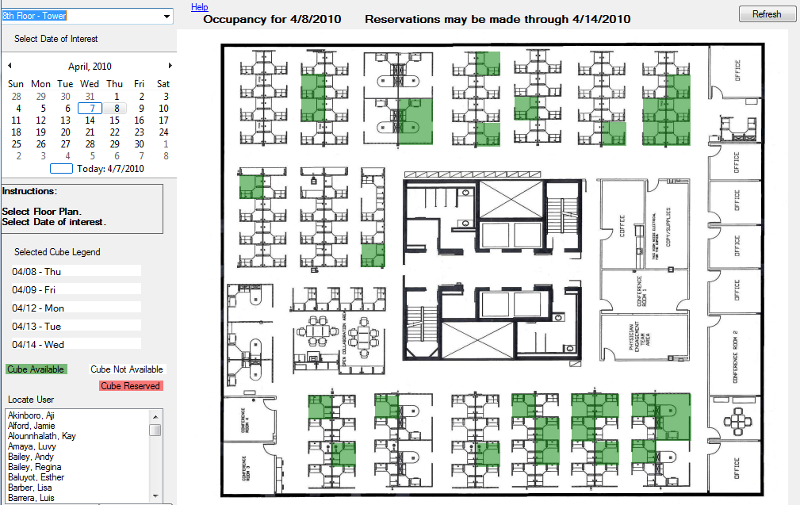
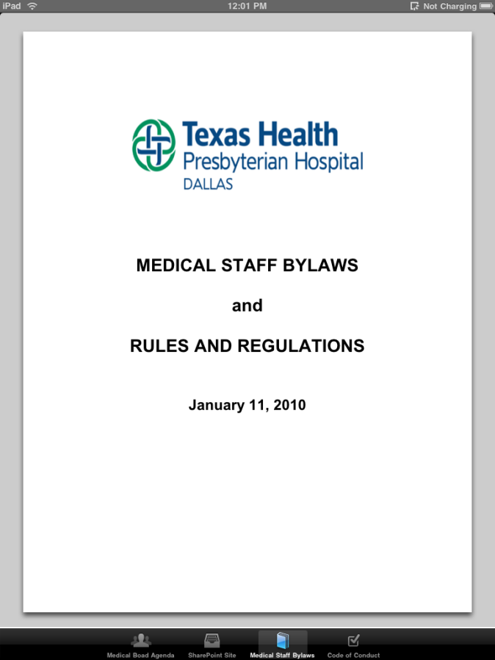
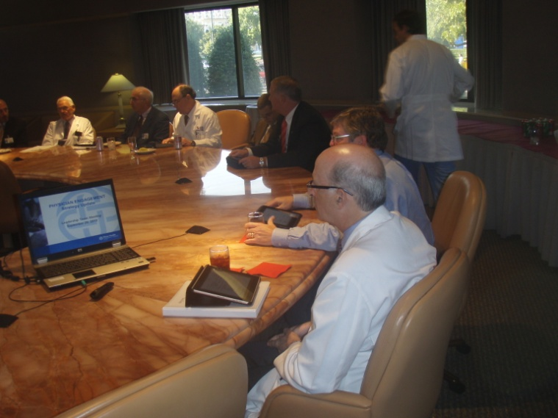
Rapid Apps Development

Slide 37
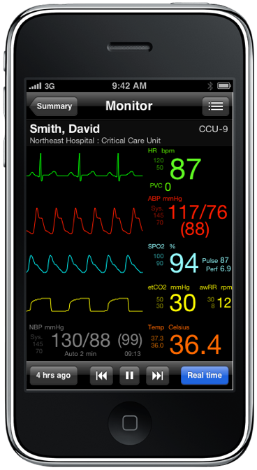
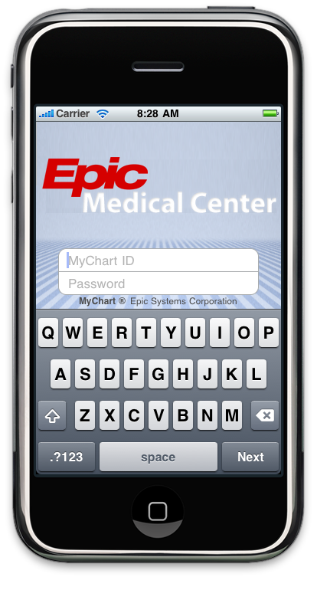
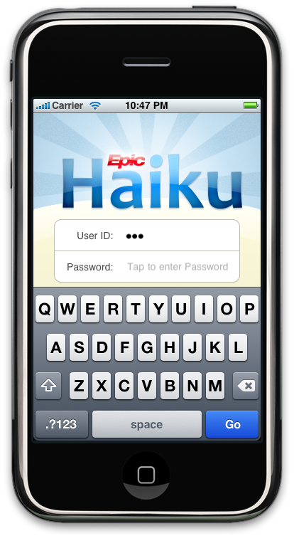
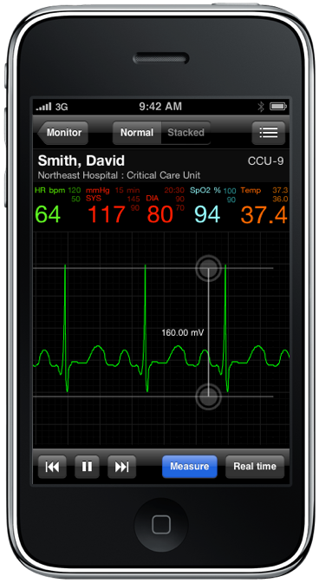
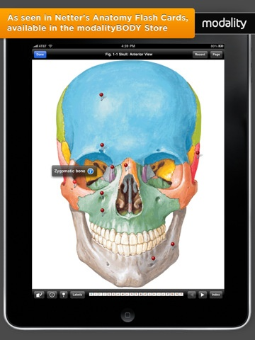
Hyper Mobility Deployment
Notes:
Furthermore, we have had a pretty major technological breakthrough that will now see our Telemetry product be much more robust. The headline is that now we will capture all alarmed events and when either the nurse on the floor or the physician is notified or called about an alarm, they can tap on that alarmed event and not only be taken to the alarmed cardiac/telemetry waveform, but they will actually be transported in time to the full scope of that moment in time.
In other words, they will see the alarmed waveform event AND all the other associated data (vitals, readings, etc.) that was occurring when the cardiac alarm occurred. At that point, they can bring the event to life by actually scrolling left and right before and beyond the event because we are now going to be dynamically storing 24 hours of waveform data on a rolling basis within this particular product.
Based on our analysis and a lot of feedback….including feedback from each of you, we see that this solution will have a pretty dramatic effect on both nurses and doctors.

Slide 38
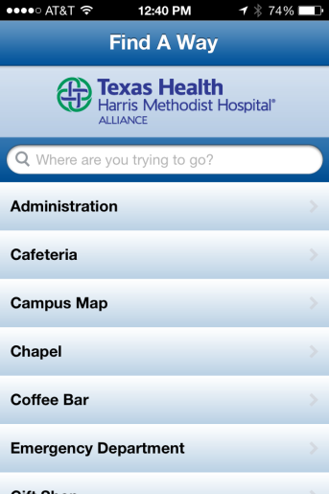
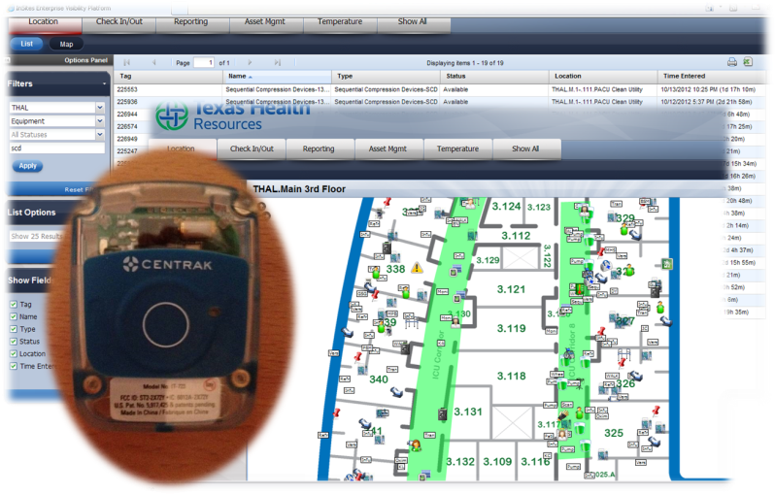
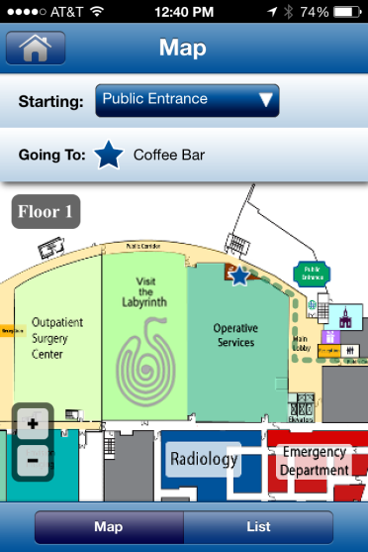
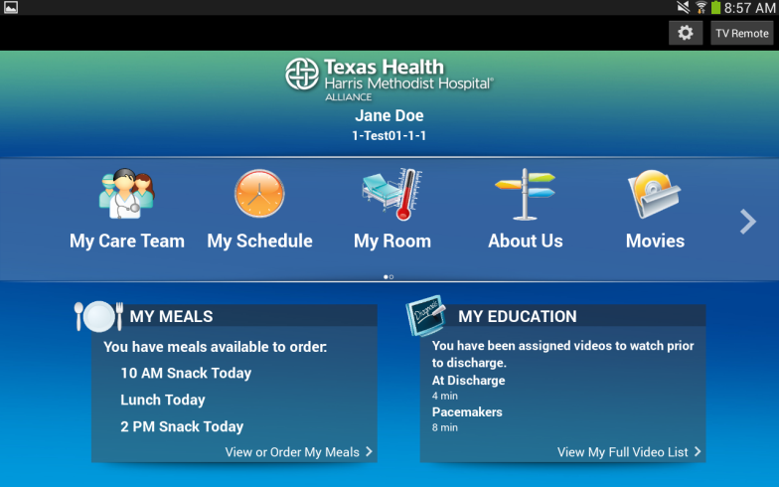
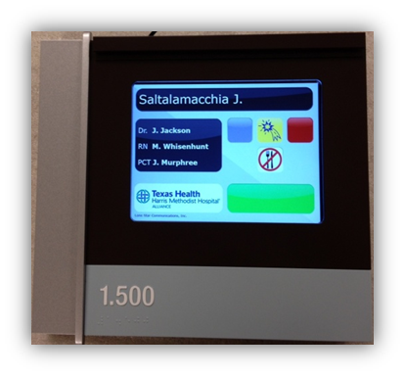
Mobile Wayfinding Apps
RTLS – Patients, Staff, Equipment
Bedside Interactive Tablet Device
Digital Signage for patient rooms
Notes:
Wayfinding ap
Created prior to opening
Includes Hospital and Professional Building
Apple & Android
RTLS
Automated workflows
Allows nurse to practice at top of her license
Integrated with Nurse Call, ADT, Vocera, Capacity Mgt System
Digital Signage
Internal idea
Worked with vendor partner to create and perfect
Completely automated
Bedside Interactive Tablet Device
Patient Education
Patient controlled temperature
Meal ordering
Patient access to PHR

Slide 39
Electronic Health Record
42% Reduction in
Medical Errors
Clinical Decision Support
Computerized Order Entry
Barcode Med Verify
Pump Integration

Slide 40
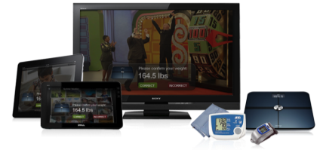
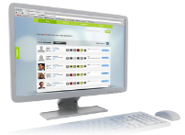
Personal Health Devices
30% Reduction in
CHF & Diabetes Readmissions
Family
with
Cloud
Computing
Easy to use
Lowest cost
3G/4G Enabled
Consumer oriented
High adoption
Highly scalable
No installation
Easily updated
Highly integrated
All inclusive
and
Consumer
Electronics
Payer
Provider

Slide 41
Training & Satisfaction

Slide 42
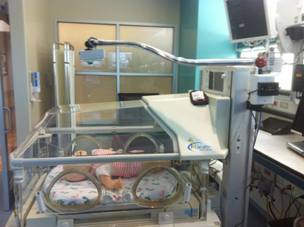
Peek A Boo
Web Browser, Apple and Blackberry devices
Video only to Friends & Family designated by Mother
Video to Mother
Audio to Crib
Provider audio and video monitoring

Slide 43
VTE Reduction
Notes:
Reducing Venous Thromboembolism using Clinical Decision Support INITIATIVE Venous Thromboembolism (VTE) is the most common preventable cause of hospital death (AHRQ 2008). Nationwide more people die from VTE than AIDS, Breast Cancer and highway fatalities combined. Clinical trials provide irrefutable evidence that thromboprophylaxis (using mechanical methods to promote venous outflow from the legs and antithrombotic drugs) reduces VTE. Currently, the Joint Commission has developed VTE prophylaxis measures, which are also a part of Meaningful Use. To help prevent hospital acquired VTE, Texas Health Resources (Texas Health) IT department embarked on a journey to gain consensus on VTE best practices by working closely with key stakeholders and end users; developed an interactive clinical decision support application using rapid application development techniques; then integrated this application into our electronic health record (EHR) to help guide our clinicians. Evidence of the success of this project is illustrated by the over 20% reduction in post-operative pulmonary embolism/deep vein thrombosis since this project's deployment. SCOPE Our mission is to improve the health of the people in the communities we serve. To help fulfill our commitment to this mission, this project's goal is the prevention of hospital acquired VTE by 1.) early identification of patients at risk and 2.) appropriate timely intervention strategies as per national guidelines and evidence based practices. TECHNOLOGY The Application. The VTE risk assessment is an independent, web-based application based on a modified Caprini Risk Assessment and built using ASP and ASPx based Web pages with a supporting MS SQL Server database. Although this is an independent, web-based application, it is tightly integrated with our EHR. In fact, our EHR treats the VTE risk assessment as an "activity" within it. When a clinician clicks the VTE risk assessment activity, a new application pop-up window that emulates HTML is opened and a routine is triggered activating complex queries to the EHR for diagnosis, procedures, lab results and other pertinent information by MRN. This information is auto-populated into the VTE risk assessment (as seen in the following image). Since the VTE risk assessment tool is interactive, the clinician can select additional risk factor. With each selection the Total Risk Assessment Score is automatically calculated and Suggested Regime modified to best meet the patient's needs. The tool also provides additional resources for clinicians such as a link to additional information about the Caprini Risk Assessment Tool and other helpful reference material. Notice the button "Send to VTE Score to EHR". By clicking this button, the clinician triggers a transmittal process for the information to be sent to our EHR via HL7 and FTP servers. The transmission process is so quick that the information appears in the EHR almost immediately. Network and Computing Infrastructure. This application is supported by a SQL database server, a web-server, and FTP server. Because the Risk Assessment Tool is accessed and populated from information within the EHR, the existing security from the EHR was used to secure this application. BENEFITS - VALUE Built using commercially available tools such as SQL server, active server pages (ASP), ASPx and HL7, the VTE risk assessment was designed, written and tested with less than 700 man-hours. The financial investment in its development was minimal. Benefits resulting from this initiative include: • a reduction of post-operative pulmonary embolism/deep vein thrombosis by over 20% since implementation and adoption of the VTE risk assessment, order sets and associated clinical decision support tools. • increased utilization of VTE prophylaxis using standardized VTE risk assessment tools and evidence-based order sets. Prior to this implementation, VTE prophylaxis could be overlooked. Now clinicians either use the order set or document the reason it wasn't used. • demonstration of a Meaningful Use component. Integrating the VTE risk assessment application with our EHR extends the use of our EHR and illustrates our ability to improve quality with health information technology, which helps us qualify for increased incentives from ARRA legislation. • improved efficiencies. Time is saved as 25% of the VTE risk assessment is auto-populated with patient data and calculations are made electronically. No longer are clinicians manually completing paper assessments and manually computing scores. It is done automatically. • enhanced collaborative information sharing and standardization of best practices. Since VTE risk assessment results are stored back into the EHR, this information is accessible by any other clinician who is treating the patient. Rather than clinicians using a variety of VTE risk assessments, now our clinicians are using a standardized, evidence-based VTE risk assessment tool.

Slide 44
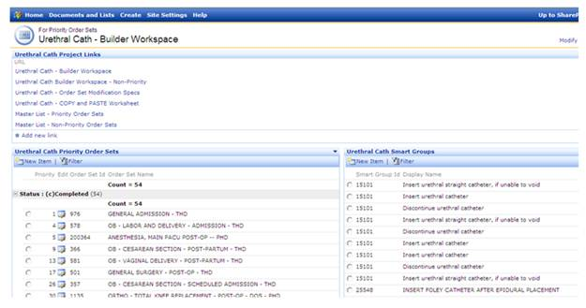
UTI Reductions
.
Notes:
1. Please describe how technology has helped you reduce catheter-associated infection. What has this system improved or enabled?
Catheter-associated urinary tract infection, a common and potentially preventable complication of hospitalization, is the most frequent healthcare-associated infection in the United States. With approximately one in every five patients admitted to an acute care hospital receiving an indwelling catheter, urinary catheter use is common. To help prevent catheter-associated urinary tract infections, Texas Health Resources’ Innovative Technology Solutions division used collaboration workgroup and social media tools to rapidly incorporate this best practice protocol by modifying and testing changes to 1,639 order sets within our electronic health record (EHR) and deploying the changes to the entire health system within three weeks of Medical Executive Board approvals.
2. What challenges did you face implementing this system?
We faced challenges in four primary areas:
Identification and modification of 1,639 order sets to include the new protocol within a short period of time with limited build resources: We used a custom search function and a “builder workspace” in our collaboration workgroup tools to increase efficiency in record identification and modification.
Communication and support of the modified protocol to a geographically dispersed workforce: Our internal social network platform enabled us to communicate with our workforce over our 16-county service area. We used the social network to engage physicians, nurses, build team and customer engagement staff throughout the project from initial design to post-implementation. We also conducted training via our Web-based training system.
Adoption of a standard protocol throughout the health system: After achieving consensus, our Medical Executive Committee approved the protocol, which was incorporated into the system EHR.
User adoption: Engaged hospital chief quality officers, chief nursing officers and project champions helped drive user adoption at their entities. End users were engaged early in the project design, development and usability testing.
3. What results have you seen? How are these measured?
Streamlined number of physician orders from eight to four orders.
Increased systemwide adoption and utilization of urethral catheter protocol by using evidence-based order sets. Prior to this implementation, urethral catheter protocol was available in only one of 14 facilities. Systemwide protocol utilization increased by 8% within four months of implementation.
Protocol compliance reduced length of urethral catheter line days from average 1.82 days to 1.35 days within first 60 days of implementation.
Enhanced collaborative information sharing and standardization of best practices since approved criteria for catheter removal has empowered nurses to make clinical decisions. Protocol compliance and timely removal of catheters are achieved on patients with indwelling catheters. This enabled us to meet the SCIP (Surgical Care Improvement Project) measure for post-operative patients and also achieve one of the Partnership for Patient objectives on reducing hospital-acquired infections related to urinary catheters

Slide 45
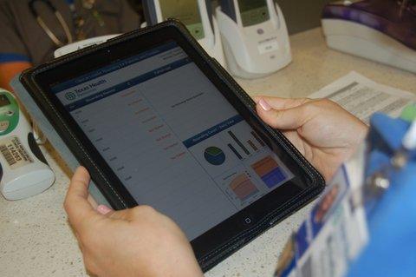
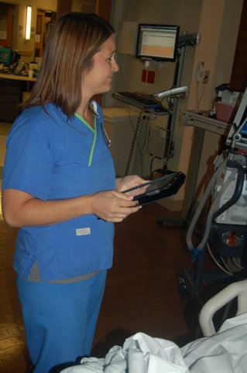
Increasing Patient Satisfaction

Slide 46
Winning with innovation

Slide 47
Critical Success Factors
Build & Develop Business Relationships
o Speak their language; build trust and mutual respect o Credibility via leadership and execution
o Bring and deliver on solutions
Encourage Innovation o Discuss innovation in every leadership message o Surround yourself with creative talent
Change Culture o Allow non-conformity & embrace self-expression o Expect/reward innovation from clinical & business leaders
Embrace Failure (non-patient care) o Advocate merits of risk & remove fear & shame of failure o Expect and celebrate reasoned failure
lead by example and innovate!
Notes:
Hire and reward for innovation
Actively participate in collaborative approaches

Slide 48
Winning with innovation
Transform Healthcare
Impact Clinical and Business Outcomes
Display Courageous Leadership
Bust Bureaucracy
Train for a Marathon not a Sprint
Don’t Surrender, it is not for Faint of Heart
Operate with Humility
how will you innovate & transform your org?

Slide 49
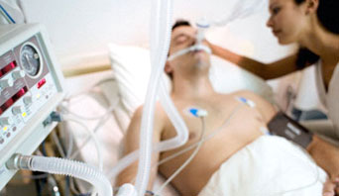
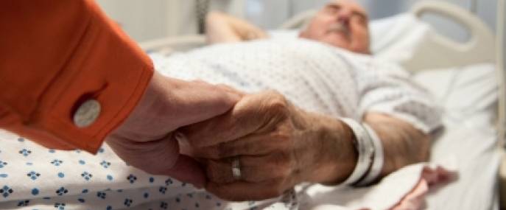
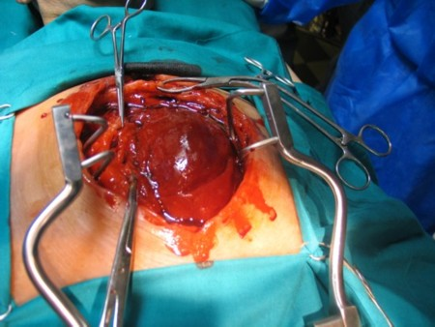
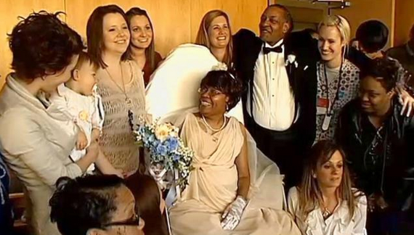

Slide 50
Open Arms Clinic…innovation

Slide 51
2013 Enterprise Award
Top Technological Innovators across America for the 13th consecutive year
Ranked 31
HIMSS EMRAM Stage 6 designation at all hospitals
13 of the past 14 years
THA, THAL, THAZ, THC, THDN, THFW, THSH, THS, THSW, THK
2nd consecutive year
Doug Hawthorne – 2008
2008 Healthcare SIG Project of the Year
Edward Marx
THAM, THD, THFW THP, & THSW
Innovator
State Advocacy Award
Semi Finalist
John E. Gall Jr. CIO of the Year Award Edward Marx
1st & 2nd place
Nanda Lahoud – 2011
Debbie Jowers – 2009
Edward Marx

Slide 53
Marx Contact
Blog http://histalk2.com/category/ed-marx/
Twitter http://twitter.com/marxists
LinkedIn www.linkedin.com/in/edwardmarx
FaceBook www.facebook.com/edwardmarx
Email edwardmarx@texashealth.org

Slide 54
Notes:
Texas Health Resources is ranked No. 62 on the 2011 InformationWeek 500 List of Top Technology Innovators Across America. Texas Health has appeared on the list for 11 consecutive years. It is the only Metroplex-based company, and the only health care system nationwide, to make the list 11 straight years. Texas Health was further recognized for innovation for using Best Practice alerts in its electronic health records to help reduce the risk of patients getting blood clots during hospital stays.

