Slide 1
The Power of Your Personal Brand
Clinical Informatics: It’s Our Time!
2014 Clinical Informatics Academy
Sponsored by DFW ANIA Chapter
October 10-11, 2014
Andrew L. Urich, J.D.
Associate Professor of Management
Director of Student Development
Eastin Center for Talent Development
Oklahoma State University
aurich@okstate.edu
www.andrewurich.com

Slide 2
Conflict of Interest Disclosure
Andrew L. Urich, J.D.
has no real or apparent
conflicts of interest to report.

Slide 3
Do You Need a Personal Brand?

Slide 4
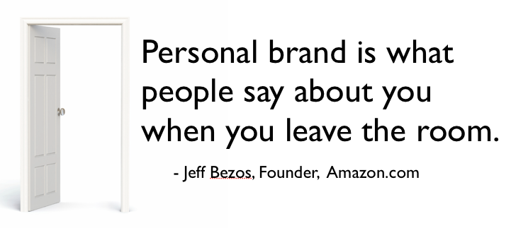
Do You Need a Personal Brand?
You already have one!

Slide 5
Idea #1 People Are Annoying
I am a hypocrite.
I play favorites.
I interpret rules in a way that benefits me.
I have been known to ignore rules that get in my way.
I like people better if they like me.

Slide 6
Idea #1 People Are Annoying
I like my ideas better just because they’re mine.
I think it’s fun to say “no” when I have the power to do so.
You cannot change how I see the world.
It is important to me to look good in the eyes of others.
I don’t even know 1/10th of 1% about anything, but I think I know everything.

Slide 7
Idea #1 People Are Annoying
I like to be “right.”
I love to say “I told you so.”
I hate to admit I’m wrong even in those rare situations when it looks like I might be.
Here’s how I make decisions: I decide what I want the answer to be – and then make up the logical reasons to support my decision.

Slide 8
Idea #2 The Facts Don’t Matter……… If No One Believes You
The FACTS don’t matter!
Politics
Marketing vs. Finance
Literally a matter of life and death.
Ability to influence is a key to success.

Slide 9
Idea #3 Arguing will get you nowhere
Is it important enough to care?
Going to Montana
Value diversity of opinion
Notes:
______________________________________________________________
______________________________________________________________
______________________________________________________________
______________________________________________________________
______________________________________________________________
______________________________________________________________
______________________________________________________________
______________________________________________________________
______________________________________________________________

Slide 10
Idea #4 Authority Is OUT – Influence Is IN
Use your PERSONAL BRAND instead of position and status.
Team building and leadership are not based on authority.
Your PERSONAL BRAND spells leadership.
The sign in PS 101
My daughter wants to go to Vegas
Authority at Tinker Air Force Base
Notes:
______________________________________________________________
______________________________________________________________
______________________________________________________________
______________________________________________________________
______________________________________________________________
______________________________________________________________
______________________________________________________________
______________________________________________________________
______________________________________________________________

Slide 11
Brand Plan Manage how you are perceived
Strategy for Success: Plan in advance!
A little preparation saves the day.
It’s not always what you do say – it’s
often what you don’t say.
Notes:
______________________________________________________________
______________________________________________________________
______________________________________________________________
______________________________________________________________
______________________________________________________________
______________________________________________________________
______________________________________________________________
______________________________________________________________
______________________________________________________________

Slide 12
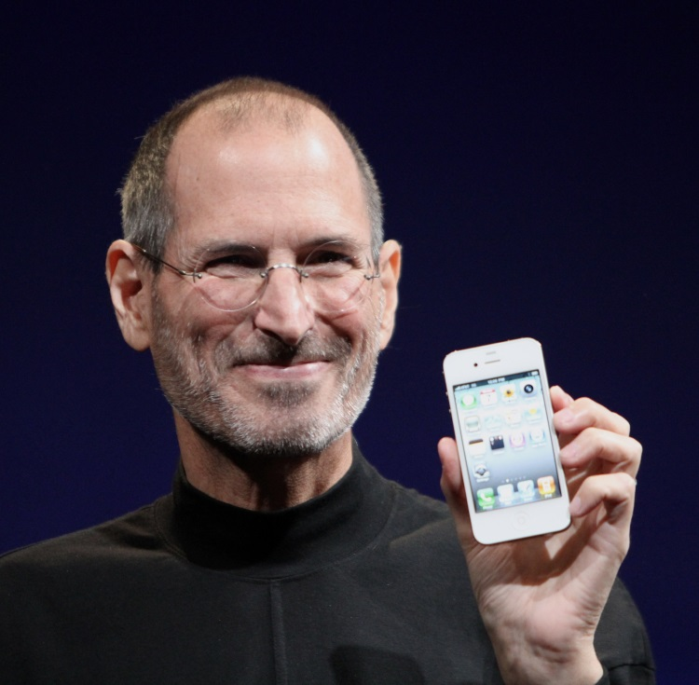
Brand Development Brand = Reputation
Define your reputation
Stakeholder focus
Promise
A brand is an identifiable entity that makes specific promises of value.
Service
Aligned with promise
A brand is an experience
Brands touch emotions. We make excuses for– and connect with our brands.

Slide 13
Valuable Brands Forbes Magazine
Apple People love their products
Google Simple, straightforward information
Coca Cola It’s an experience
IBM Strong & reliable
GE Tough, smart & efficient
Intel Branded a commodity
Positive differentiation in the sea of sameness – the key to career success.
Toyota Best built
Disney Ultimate entertainment
McDonalds Consistency
Amazon A better way to get things done
*

Slide 14
Your Brand Plan
Overcome communication blockers. (If they’re not listening– it doesn’t matter what you say)
Look for win/win opportunities (manage self-interest).
Be likeable. (Appearance, Behavior and Attitude)
Make an emotional connection. (Make them feel good about you)
Get control of information and misinformation.
(It’s not all about the facts…but facts are important)
Notes:
______________________________________________________________
______________________________________________________________
______________________________________________________________
______________________________________________________________
______________________________________________________________
______________________________________________________________
______________________________________________________________
______________________________________________________________
______________________________________________________________

Slide 15
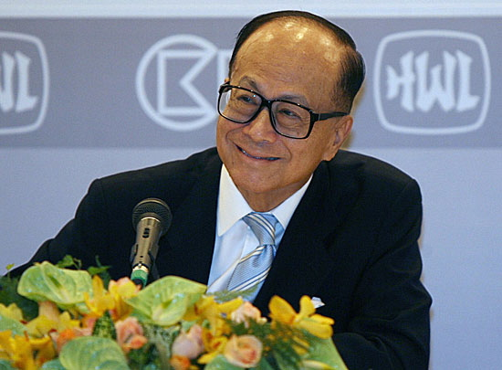
Win/Win Attitude
Ka-shing

Slide 16
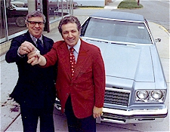
Learn to Become EVEN More Likeable We prefer to comply with the requests of people we like.
We like, trust, and believe people who like us.
Notes:
______________________________________________________________
______________________________________________________________
______________________________________________________________
______________________________________________________________
______________________________________________________________
______________________________________________________________
______________________________________________________________
______________________________________________________________
______________________________________________________________

Slide 17
Your Brand Plan
Overcome communication blockers. (If they’re not listening– it doesn’t matter what you say)
Look for win/win opportunities (manage self-interest).
Be likeable. (Appearance, Behavior and Attitude)
Make an emotional connection. (Make them feel good about you)
Get control of information and misinformation.
(It’s not all about the facts…but facts are important)
Notes:
______________________________________________________________
______________________________________________________________
______________________________________________________________
______________________________________________________________
______________________________________________________________
______________________________________________________________
______________________________________________________________
______________________________________________________________
______________________________________________________________

Slide 18
Thank You! Contact Information
Andrew L. Urich, J.D. Associate Professor of Management Director of Student Development Eastin Center for Talent Development Oklahoma State University
I Like You!
aurich@okstate.edu
www.andrewurich.com

