Slide 1
Optimization Practices: Building a Sustainable Structure to Manage Clinically Relevant Change
Johnna Moution-Donald, MSIS, BSN, RN
Joni Padden, DNP, APRN, BC, CPHIMS

Slide 2
Conflict of Interest
Neither Johnna Moution-Donald nor Joni Padden have any conflict of interest to disclose.

Slide 3
Learning Objectives
Understand the structure, composition, and goals of the Optimization process
Describe the collaboration strengths between the Optimization Team and Nursing Informatics
Utilize the principles presented to strengthen support structure for informatics systems

Slide 4
Roles
Johnna Moution-Donald, CareConnect Optimization Team/ClinDoc Builder
Joni Padden, Nursing Informatics Specialist

Slide 5
Texas Health Resources
More than 22,000 employees
25 hospitals in North Texas (19 on same instance of Epic)
22 outpatient facilities
More than 5,500 physicians with active staff privileges
Physicians Group: 500+ physicians and 200+ physician assistants and nurse practitioners
Recognition
CIO of the Year Award

Slide 6
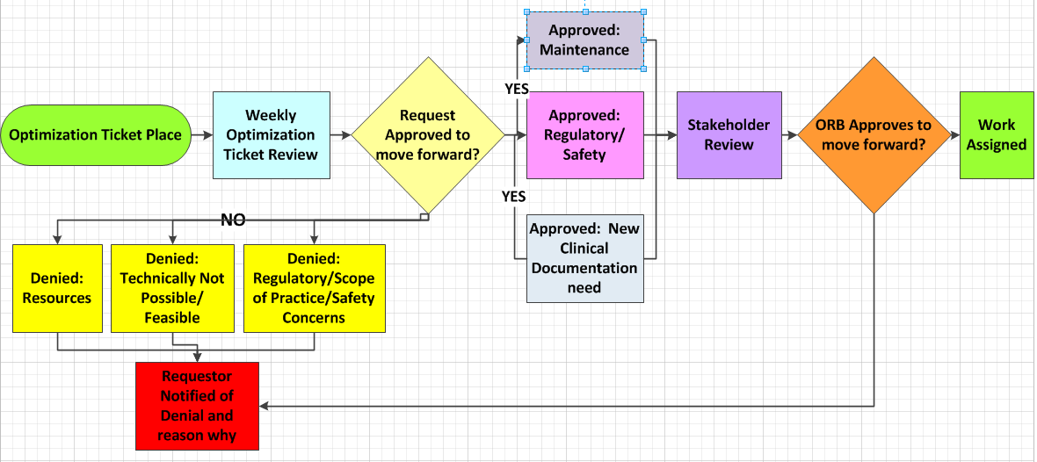
Overview

Slide 7
Overview

Slide 8
Overview
Optimization Review Structure
Comprised of Optimization Team and Nursing Informatics Team
Meets weekly to review ticket submissions
Guest invited as needed to provide insight or details related to requests

Slide 9
Structure
Structure of Optimization Team Work
Tickets submitted via ITS Service Catalog
Tickets review weekly by Optimization/NI Team
Approved tickets move to next step in process
Denied tickets are communicated back to the requestor
Input from Clinical Work Groups, Provider Advisory Councils
Approved tickets either came from or are sent to vested stakeholder group(s) for input and decisions
Improvement suggestions, maintenance requests, regulatory/compliance updates, new care element documentation needed

Slide 10
Overview

Slide 11
Overview

Slide 12
Approved Requests
Patient Safety
Example: Safety concern related to bariatric surgery patients receiving gastric contrast.
In addition to build to support safe care, Optimization Team made sure the stakeholder groups (Nursing, Pharmacy, Radiology, Dietary, Bariatric Coordinator) were part of the process
Included items additional to the request to cover all identified concerns (HOB Elevated, Daily Weight reminders, specific diet orders)

Slide 13
Approved Requests
Maintenance
Example: Behavioral Health Care Plans were not restricted like the rest of Behavioral Health documentation. When this was identified, it was corrected as maintaining the record, not as something new or broken.

Slide 14
Approved Requests
New Clinical Documentation Need
Example: A new Cardiac intravascular device will be used in all facilities providing cardiac surgery. New build to support the new tool and workflows is needed to capture the device settings and clinical data.

Slide 15
Stakeholder Groups
Physicians Ambulatory Practitioner Advisory Council (PAC) Emergency Department PAC Inpatient PAC Anesthesia Forum Mother Baby Clinical Council Heart and Vascular Committee | Nurses Nursing Informatics Council Mother/Baby Clinical Work Group (CWG) Emergency Department CWG Surgical Services CWG Behavioral Health CWG Care Transition Manager CWG Oncology CWG Cath Lab/Interventional Radiology (PRN) Clinical Nurse Leader CWG Other PRN groups (Trauma, Respiratory Therapy)
Ancillary Services Food and Nutrition Services Taskforce Therapy Clinical Workgroup Meds Management Forum

Slide 16
Overview

Slide 17
Structure
Optimization Review Board (ORB)
After an approved request has been vetted with the appropriate stakeholders it goes to the ORB
Run by Optimization Team
Consists of Managers and Directors of ITS Build Teams, Chief Health Informatics Officers, ITS Leadership, Nursing Informatics
Special cases (Regulatory/Compliance)
Fast Track options available
Some flexibility in system yet still adheres to process

Slide 18
Problems The Process Helps Solve
Expending limited build resources wisely
Major ITS projects
Keep The Lights On work
Only so many analysts, only so many hours (83 requests with 1,280 build hours)
Producing a coordinated user friendly build
Balancing new items with old, pruning obsolete build
Reducing documentation burden and cognitive load
Reducing change fatigue
Changes are made for valid, where possible evidence-based reasons

Slide 19
Management Issues
Denying requests for good ideas
Denying requests from physicians
Grouping similar requests into a more cohesive solution
Timing for when to build and deploy requested changes

Slide 20
Evolution of Process
Optimizing the Optimization Process, always looking for ways to evolve
Change management techniques
Track requests and complete follow up

Slide 21
Part of the Greater Whole
Has to be part of the bigger picture with other large organizational goals
Keeps it fair for all and gives users a chance to have input
Depends heavily on the feedback from stakeholder groups

Slide 22
Questions
???

Slide 23
Contact Information
Johnna Moution-Donald
JohnnaMoution@texashealth.org
Joni Padden
jonipadden@texashealth.org

