Slide 1
Smartphones in the Clinical Environment
25 September 2015

Slide 2
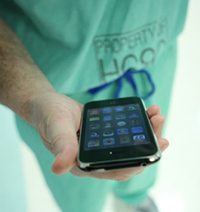
The Reality of Smartphone Usage
Spyglass Consulting Group report found:
67% of hospitals reported that staff nurses are using personal smartphones to support clinical communications
89% of hospitals have policies that do not allow staff nurses to carry and use their personal smartphones during their work shift
91% of hospitals are aware that nurses are using personal smartphones during their work shift
Source: Healthcare Without Bounds – Point of Care Communications for Nursing; Spyglass Consulting Group; 3/14

Slide 3
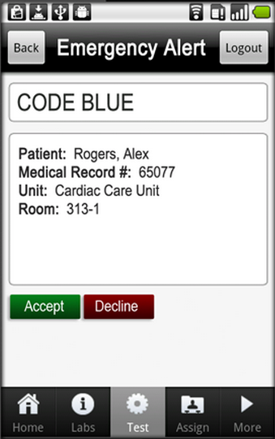
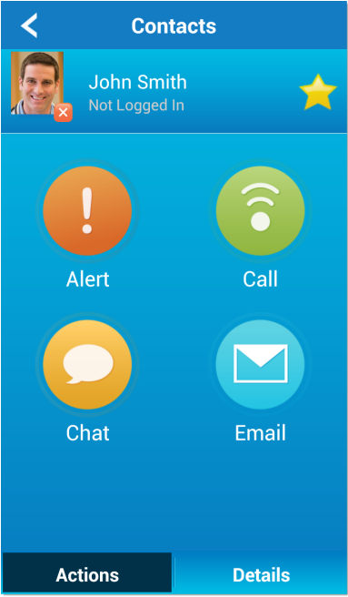
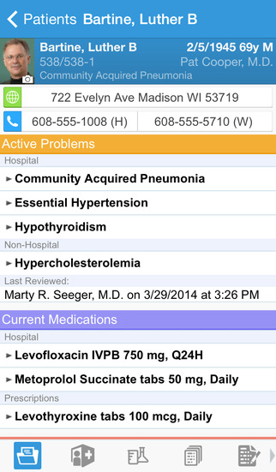
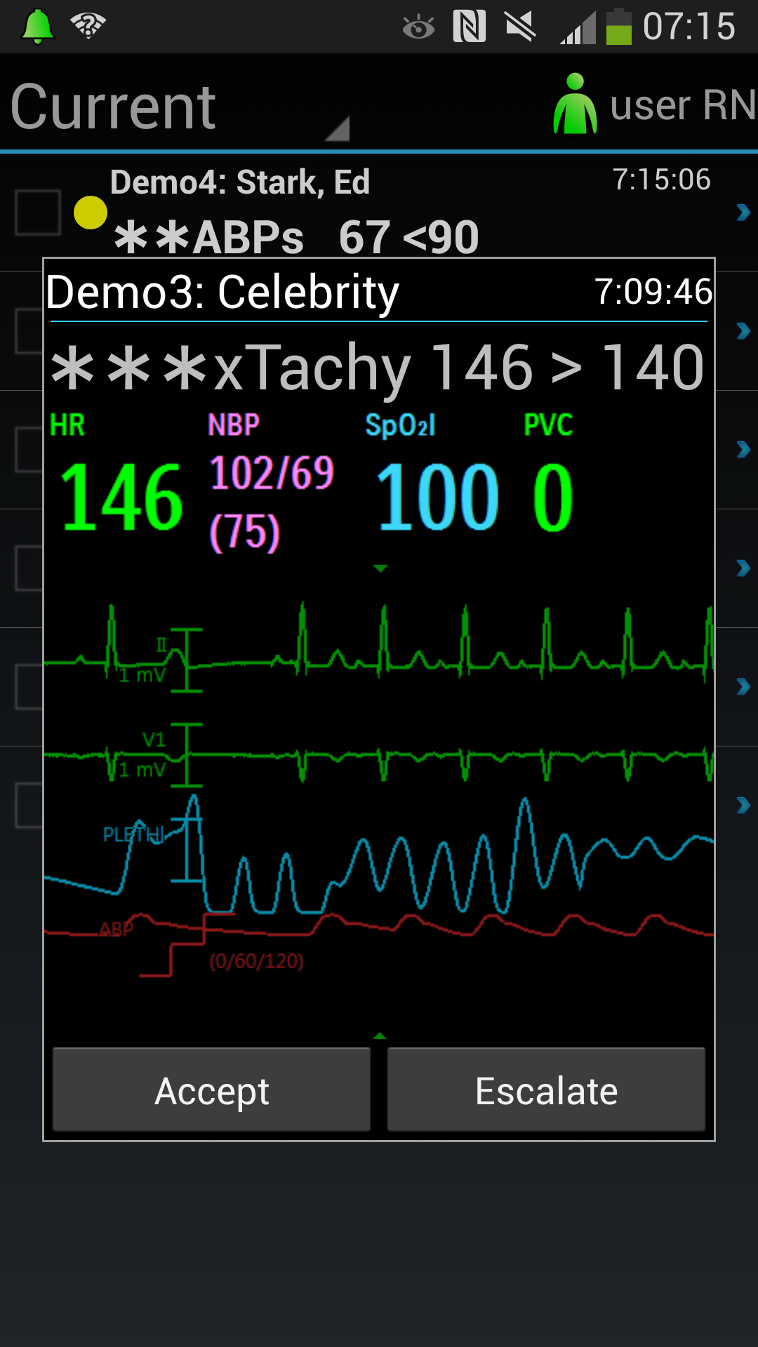
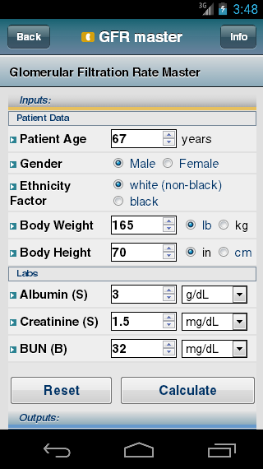
Killer Apps in Clinical Environments
Secure messaging
Alert & alarms
Patient monitoring
Electronic health record (EHR) access
Medical reference
Task management
Email

Slide 4
Mobile Application Integration Issues
Secure communication / messaging
Does it need to work between inside and outside hospital networks?
Does it need to support sharing files and images?
Cloud or on-premises server?
Alert & alarms / patient monitoring
What systems and devices need to be integrated?
How do the right alarms get to the right people?
How do you deal with alarm fatigue?
Electronic health record (EHR) access
What does the EHR vendor provide?
Do devices need scanners, cameras?
Medical reference
Unrestricted internet access or hospital-endorsed sources?
Task management
How does it integrate with other systems – EHR, alerts, messaging?
Email
What are the corporate policies for email access and usage?

Slide 5
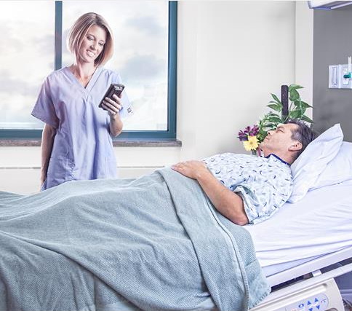
Measuring the ROI
HCAHPS score impact
Nurse, doctor communication
Response time
Quiet environment
Speed of care
Eliminating inefficiencies
Leveraging EHR mobile apps
Staffing requirements
Cost of not solving the problem
Liability

Slide 6
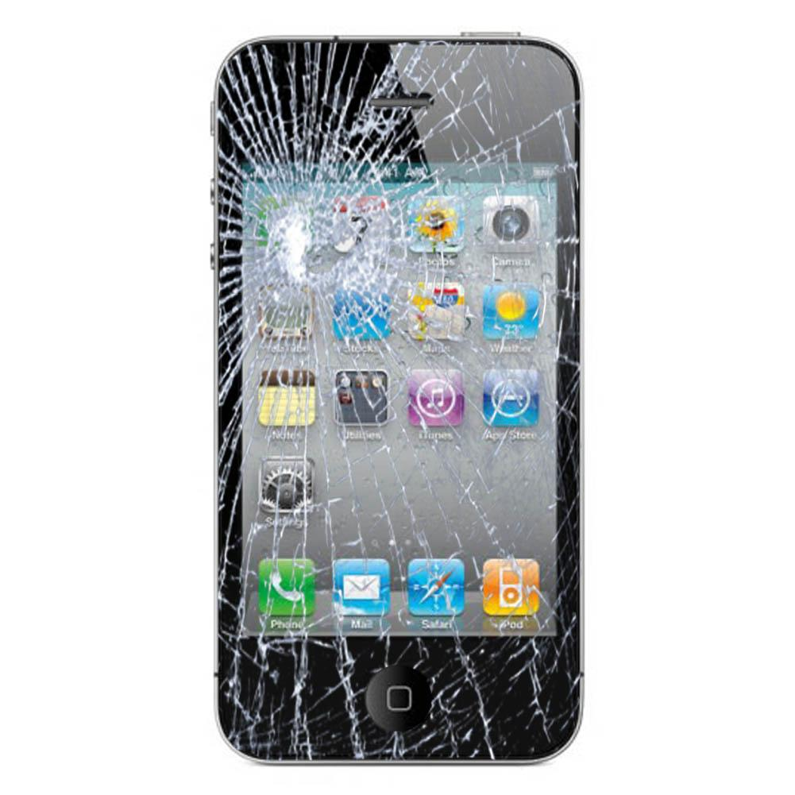
Are consumer smartphones suitable for hospital use?
Durability: 78% of hospitals expressed concerns about the durability of consumer grade smartphone in a hospital-based environment
Sterility: 67% of hospitals expressed concerns about the sterility of consumer grade smartphones in a hospital-based environment
Usability: 50% of hospitals expressed concerns about the usability of a consumer grade smartphone to support nursing workflow due to its screen size
Source: Healthcare Without Bounds – Point of Care Communications for Nursing; Spyglass Consulting Group; 3/14

Slide 7
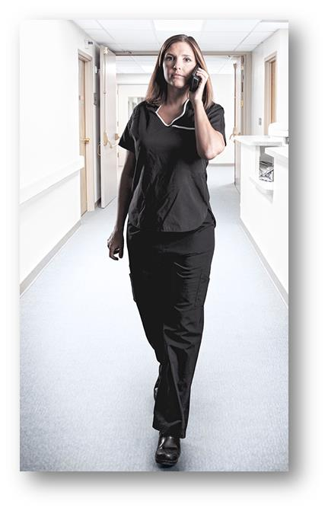
Importance of Voice Quality
Real-time voice communication is a critical requirement for mobile devices
Caregivers need to converse with colleagues, physicians and lab personnel quickly, reliably and securely
Most hospitals already rely on wireless voice solution (Spectralink, Cisco, Vocera, etc)
Consumer smartphone voice limitations
Cellular coverage, network integration
Poor quality over Wi-Fi (QoS, roaming)
Softphone app limitations
Only purpose-built voice-over-Wi-Fi devices can deliver the required level of voice quality

Slide 8
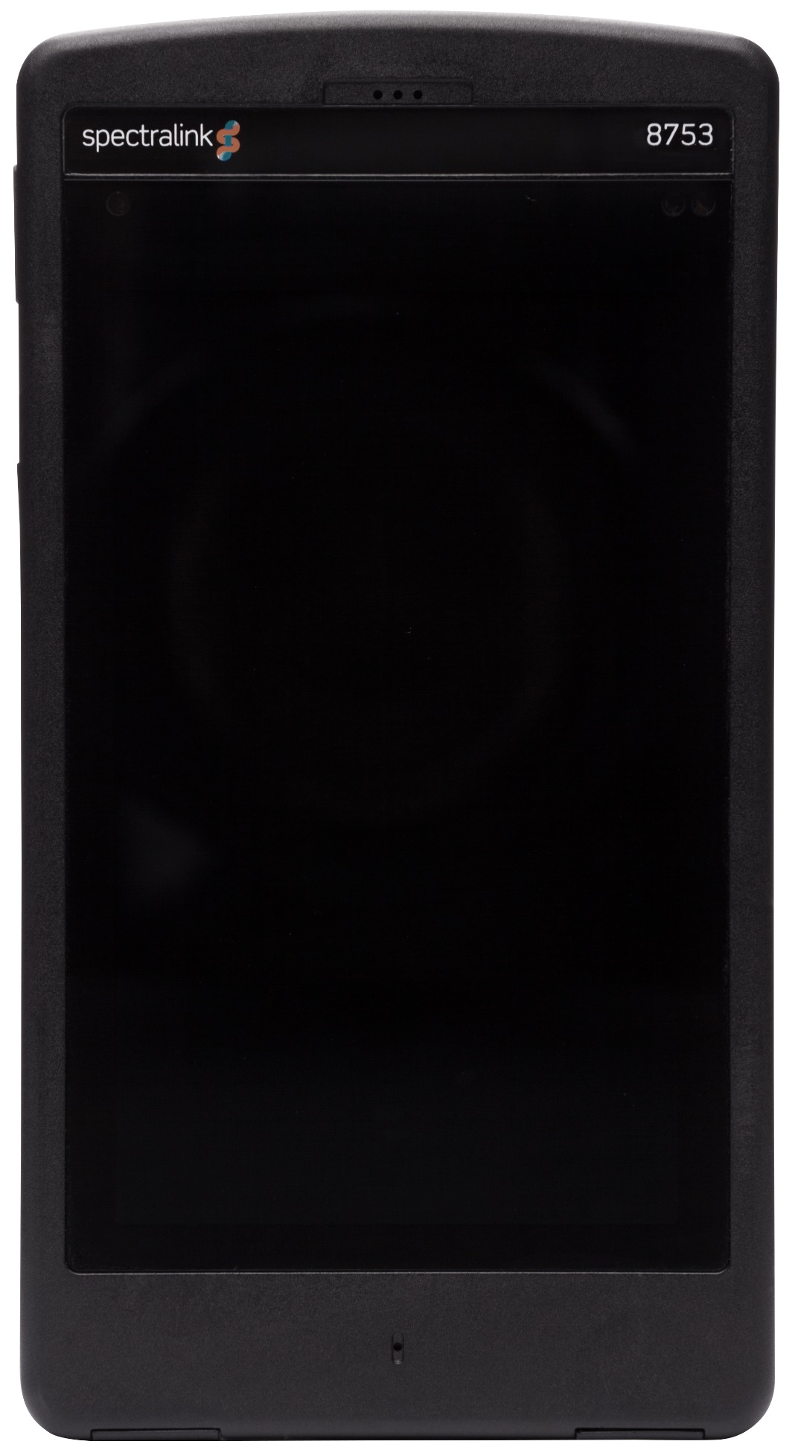
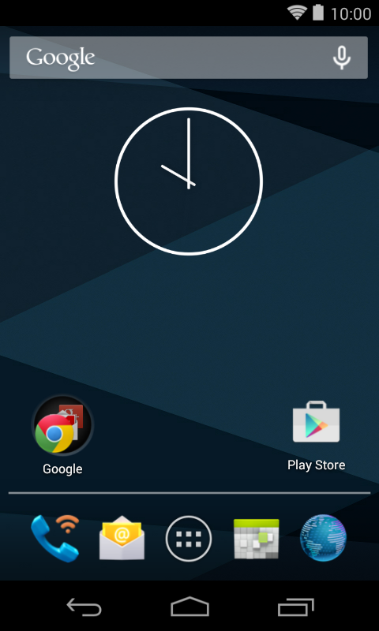
What Makes Ideal for Healthcare?
It’s instantly familiar
Android smartphone features
Enterprise telephone system integration
It’s a mobile application platform
Supports Android and XML applications
Access to web apps and resources
It’s purpose-built
Unrivaled durability, longevity and support
Supports 24x7 usage
Safe for cleaning and disinfecting solutions
It’s dependable
Excellent, consistent voice quality
Built to last with enterprise grade warranty and support
It’s manageable
Supported by industry leading EMM solutions
Enterprise level security and privacy

Slide 9
Today’s Takeaways
What are the needs for mobile solutions in healthcare?
Clinical applications for mobility are critical and in demand
Applications are available but consumer grade devices can’t meet the requirements
Opportunities for delivering comprehensive mobile solutions
What kind of integration is needed and available?
End-to-end solutions are complex with multiple stakeholders, components, and integration points
Opportunities to build best-of-breed solutions
How do you make sure a mobile project succeeds?
Understand the big picture
Don’t let consumer devices jeopardize the project

Slide 10
We’re here to help
(800) 775-5330
info@spectralink.com
Ben Guderian
Director of Business Development
Ben.Guderian@spectralink.com
Jim Abbott
Healthcare Account Executive
Jim.Abbott@spectralink.com

Slide 11
Thank you for attending

