Slide 1
Improving NICU Nurse Efficiency with a Mobile Device
Rachel Jackson BSN RN-BC
Kayla Carey BSN RN NE-BC
November 14, 2019

Slide 2
Acknowledgements
Texas Tech University Health Science Center
Barbara Cherry DNSc MBA RN NEA-BC
Susan McBride PhD RN-BC CPHIMS
Stephanie Hoelscher DNP RN-BC CPHIMS CHISP
Baylor University Medical Center
Penny Quinn MSN RN-BC
NICU Nurses
Notes:
I would like to acknowledge a few people.
From Texas Tech, Barbara Cherry is my advisor for this project. Susan McBride is the program director for the informatics track and Steph Hoelscher is also my instructor this semester.
BUMC is my clinical site and, I would like to thank my preceptor, Penny Quinn, and the nurses in the NICU.

Slide 3
Objectives
Summarize the impact of human factors in the NICU
Describe the impact of physical environment on a clinical workflow
Demonstrate how a mobile device improves the clinical workflow
Outline challenges of mobile device

Slide 4
Problem Statement
Physical layout impacts patient care (Probst et al., 2017)
Problem is amplified in NICU pod design
Computers several feet away from infants
Inefficient Expressed Breast Milk (EBM) workflow
Notes:
The physical layout of the patient care area, including placement of computer terminals in patient rooms, has a direct impact on electronic health record (EHR) documentation and workflow efficiency. The BUMC NICU has a pod design with multiple infants in each room. The computers are positioned several feet away from the infants in isolettes. The expressed breast milk (EBM) workflow requires the nurse to move between the infant and the computer, the result is an inefficient workflow requiring the nurse to repeatedly walk between the infant and the computer for each EBM feeding.

Slide 5
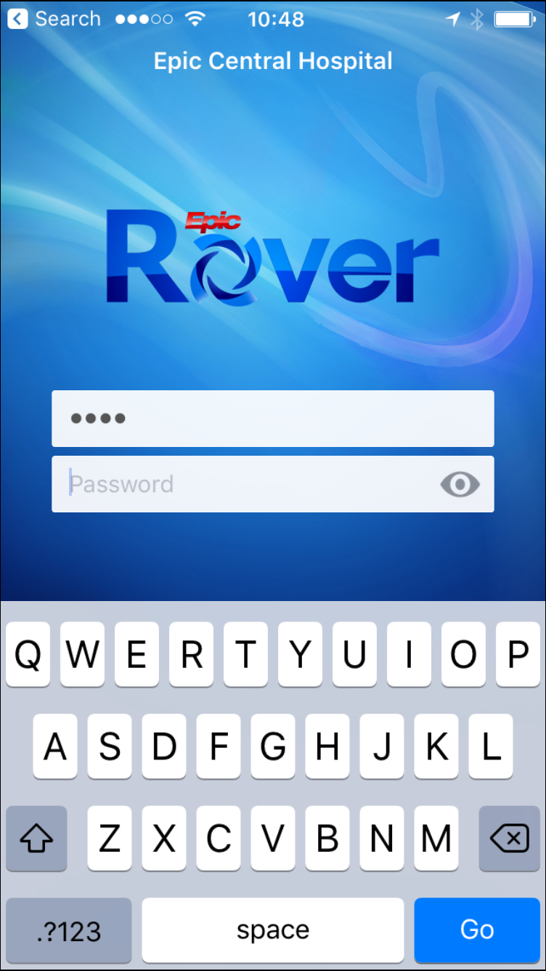
Intervention
Epic implementation
Added Rover mobile application
Barcode med administration (BCMA) workflow redesign
Focus on NICU
Image source: welearning.epic.com
Notes:
Baylor University Medical Center implemented Epic on September 1, and the Rover mobile application on an Android platform was added October 22. Rover allows for barcode scanning and documentation directly on the device. This is in contrast to the previous barcode medication (BCMA) process where scanning is done with a handheld device and documentation is completed in the computer.
Rover has several other functions including a patient summary for review of allergies and medications, some flowsheet documentation including lines/drains/airways, BCMA for meds and blood, the worklost, and secure chat. Finally it is on a smartphone, so you can actually talk to others on it.

Slide 6
Aim Statement
Total scanning time for expressed breast milk feedings will be reduced by 5% within 90 days following the implementation of the revised workflow utilizing a mobile device.

Slide 7
History of EHR at BUMC
1980s: Baylor Communication Online Network (BCON)
~2008: Cerner BCMA implemented with PPID
2011: Allscripts Sunrise Clinical Manager implemented
2013: Converted to Allscripts BCMA
2015: PPID for EBM introduced
2019: Epic Implementation
Notes:
Now for a little history of the EHR at BUMC—or how did we get here. The first system used was an in-house product known as Baylor Communication Online Network, or BCON. It was developed in the 1980s and provided for order entry and manual documentation of medications on an eMAR. Then in 2008, BCMA with positive patient identification (PPID) was implemented with a Cerner product and a fully functioning handheld mobile device. This product was never deployed at other facilities across the system. In 2011, we moved to Allscripts for EHR with electronic documentation, but we continued to use the Cerner handheld BCMA product. In preparation for this implementation, computers were installed in patient rooms to support real time documentation. The decision was made to place the computers on the wall nearest the foot of the bed. In the NICU, they were installed at along one wall of each room. The impact of this decision was not fully realized until we moved to the Allscripts BCMA module in 2013. This introduced a simple handheld scanner that pairs to the computer via Bluetooth and requires the nurse to move between the computer and the patient during med administration. As mentioned before, because the NICU has multiple patients in a room, the challenges of the workflow are intensified. Finally, in September, Epic was implemented, followed by the Rover mobile application in October.

Slide 8
BUMC NICU
Level III
2 halls
Critically ill hall
Feeder/grower hall
Capacity of 80 infants
Average census 40
8 feedings per day x 40 patients = 320 per day
Notes:
Kayla
BUMC has a level 3 NICU designed with 2 hallways—one for the critical babies and the other for the feeders and growers. We have capacity for 80 neonates and an average census of about 40. Most neonates are fed every 3 hours—that’s 8 times a day. With 40 infants, that’s 320 feedings per day.
That’s a lot of breast milk!!

Slide 9
Example NICU Room
Notes:
Kayla
This is a diagram of a typical room in the NICU. It can accommodate up to 10 infants (blue squares), with only 4 computer workstations (green). Breastmilk is stored in a single refrigerator in each room, but each infant has a warmer and feeding pump at bedside. Distances were measured with a tape measure. The shortest distance between baby and computer in this room is about 8 feet, the longest is 14 feet with an average of 10 feet. Nurse patient ratio is typically 1:3 and babies are fed every 3 hours. Within the BCMA workflow, nurse must move from computer to infant and then back to computer, an avg distance of 20 feet.
1 nurse x 3 babies x 4 feedings each x 20 ft = 240 feet of unnecessary movement per nurse, per shift.
How many steps is that? According to google, the average stride is between 2.1 and 2.5 feet. Let’s make the math simple and say 2.4 feet, so 240 feet is about 100 steps.
OR: 320 feedings per day x 20 feet = 6400 feet or 1.2 miles or 2667 steps per day!

Slide 10
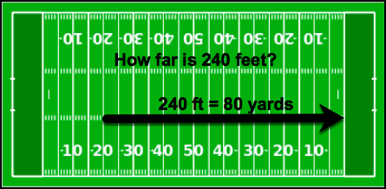
How far is 240 feet?
Notes:
Rachel
Well 240 ft = 80 yards. On a football field, it’s the distance from the 20-yard line to the opposite goal line. This would mean that Dak hands off the ball to Zeke at the 20-yard line and then he runs all the way to the opposite end of the field for a touchdown! Go Cowboys!

Slide 11
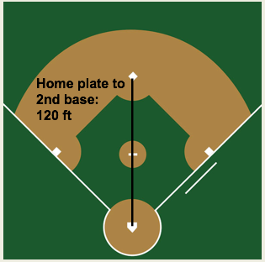
How far is 240 feet?
Notes:
But if you prefer baseball, as I do, here’s how that looks on a major league diamond. 240 feet is the distance from home plate to 2nd base and back again. Think of the greatest catcher to ever play the game, Pudge Rodriguez, throwing out a runner trying to steal 2nd base, and then the 2nd baseman returning the ball.

Slide 12
Evidence
Importance of breast milk established
American Academy of Pediatrics, American College of Obstetrician-Gynecologists, World Health Organization, US Department of Health and Human services as cited in Wight, 2015
BCMA promotes patient safety and efficiency
Steele, Czerwin, and Bixby, 2015; Oza-Frank, et al., 2017
Workflow redesign improves nurse efficiency
Eisenstein and Butler, 2015; Probst et al., 2017
Human factors related to preventable errors
Doerhoff and Garrison, 2015
Notes:
The importance of breast milk for growth and development of neonates is well established by several sources as cited in Wight, 2015. BCMA and PPID are a proven tools for improving patient safety (Steele, Czerwin & Bixby, 2015; Oza-Frank, et al., 2017). Einstein and Butler (2015) and also Probst et al. (2017) demonstrated that nurse efficiency can be improved using a workflow redesign. The Probst study was conducted at BUMC, examining the BCMA process on 2 units, an ICU and a med-surg unit. I was aware of this study and was able to contact the primary author to discuss his process for the time-motion study. Doerhoff and Garrison (2015) explored human factors in the NICU and established that cognitive workload, physical demands, and fatigue can impact patient safety and outcomes. So the reduction of walking by 240 feet per nurse per shift can make a difference.

Slide 13
Model/Framework
Lewin’s Change Theory
Moving
Getting ready for change
Implementing the change
Maintaining the change
Unfreezing
Refreezing
Notes:
Kurt Lewin’s change theory (Lewin, 1951) is based on forces that compete to prevent or promote change. The first stage is unfreezing, when instability is created and the forces promoting change are greater than those preventing change. The second phase, Moving, begins when the decision to change is made. Planning and training occur, then the change is implemented. The final stage is Refreezing. Maintenance begins, the forces preventing change increase, and stability is again achieved.
This process sounds simple and linear, but in practice, healthcare and informatics are in a constant state of change. So instead of a linear process, it can feel like a unending state of chaos and turmoil. In this project, Epic was implemented in September and before the new processes were refrozen and stable, Rover was implemented.

Slide 14
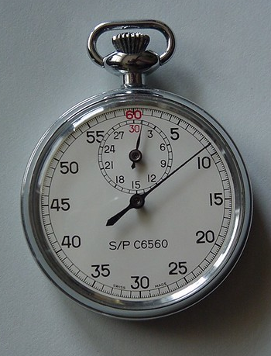
Methodology
Outcome measure: time in seconds
Pre- and post-implementation studies
Timed each step of EBM scanning workflow
Challenges of process
Other measures
Notes:
This is a quality improvement project with a goal of improving nurse efficiency, therefore time is the outcome measure. Pre- and post-implementation times studies by direct observation and a stopwatch were used, measuring time in seconds for each step of the BCMA scanning workflow for EBM.
The challenges I faced were deciding when to start the time and how to identify steps. It required making a few observations without timing to identify and define those steps. I started the timer when the nurse selected the EHR icon. Each subsequent step was determined by either a click or a new screen appearing.
Other metrics being monitored are scanning compliance, or the % of feedings that are scanned. The unit consistently exceeds the facility goal of 95% and wants to maintain that level. Finally, we are also on the lookout for errors as any change can impact errors. The unit has a strong safety record and it has been 2 years since an error was reported.

Slide 15
Feeding Workflow
Legacy system
Login
Select pt and open worklist
Scan dongle
Walk to infant
Scan infant ID band
Scan EBM barcode
Walk back to computer
Submit documentation
Epic Rover
Login
Select patient
Open feedings
Scan infant ID band
Scan EBM barcode
Enter volume
Submit documentation
Notes:
These are the basic steps used for documentation of EBM. One of the challenges of this type of observation is determining when to start the clock. In the first study, I started the clock when the nurse clicked the EHR icon to begin the login process, then started the next step when the program opened to the patient list. In the next step, once you select the patient, you click another icon to open the worklist. This happens in rapid succession and it was difficult to split those steps, so I combined them.
The Rover workflow is different, and some steps are eliminated, but an additional step of entering the volume is added.

Slide 16
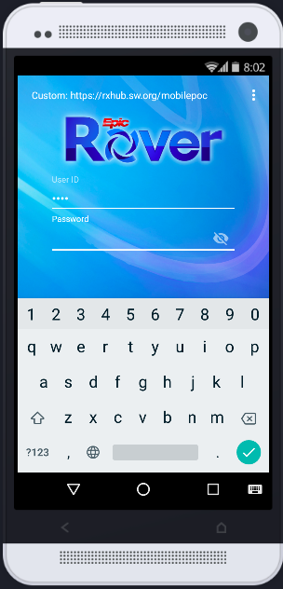
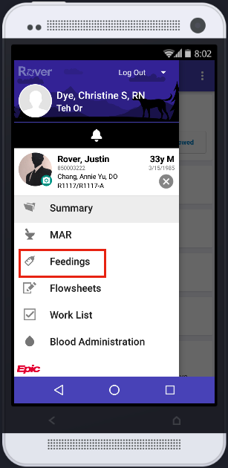
Rover Workflow
Image source: www.epic.com
Notes:
Here are some highlights of the the new workflow. Here you see the login screen, then after selecting a patient, you select the chart activity.

Slide 17
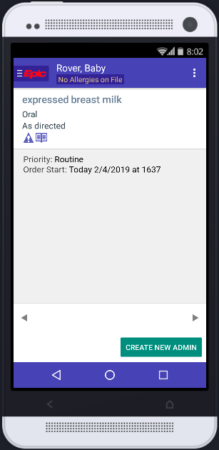
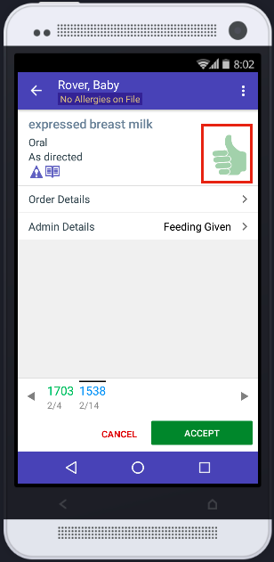
Rover Workflow
Image source: www.epic.com
Notes:
After selecting the desired feeding, scanning is done. The green thumbs up indicates the scans were successful. Then enter the volume and click Accept.

Slide 18
Device Deployment
NICU 26 phones + batteries
26 additional batteries
7 charging stations with 4 slots each
Notes:
Kayla
Prior to this implementation, each nursing unit had handheld phones that are just that—phones. Some areas elected to keep the old phones along with the new Zebra phone, some swapped out 1 for 1 and others turned in most phones but kept a few for the patient care technicians. The NICU elected to keep all of the legacy mobile devices for use by the physicians and NNPs.
The NICU received 26 phones with batteries, 26 extra batteries and charging stations placed in each room. The battery charge is more than 12 hours and the recommendation is to swap the battery at the beginning of the shift.
Training for the devices was provided via eLearning. In classroom deep dive sessions were available for Super Users the day before deployment.

Slide 19
Implementation
Rose Gardens
Sunshine
Notes:
Kayla
Implementation day finally came!
It was all sunshine and rose gardens and unicorns and rainbows.

Slide 20
Implementation Challenges
Interruptions
Dropping calls
Losing network connections
Adding extra flowsheet columns
Resistance to change
Notes:
Kayla
Well……not exactly. There were several challenges encountered.
Interruptions—If the nurse gets a phone call while administering medications, anything scanned and not completed is lost. You get a warning that meds were not documented and you must scan again. It is worth noting that this is an issue with the MAR and the blood administration module, but not flowsheet documentation where the feedings are documented, so it does not impact the EBM workflow. This was a known issue that Epic has been working on. We have recently learned that they have a fix for the problem, but it won’t be available until next year.
Dropping calls—Phone calls randomly drop, especially if moving while talking. This was resolved by re-imaging the phones. The hospital purchased over 400 phones, so this task took a couple of days.
Losing network connections--Nurse starts documenting and loses connection before documentation is completed. This was the result of an issue with the version of the software. Pushing a new version to all phones resolved the issue.
Extra flowsheet columns—This is an issue raised by the nurses. With the prior workflow, the feedings were documented on a worklist with hourly time columns. While the exact time of feeding was recorded, all of the time columns lined up. With the new workflow in the flowsheets, the time column is labeled with the exact time the feeding is given. The nurses don’t like it that the feedings don’t line up exactly on the hour.
Resistance to change—while some nurses have already adapted to the new device, many do not like using it and prefer the old scanners and walking back and forth. The typical complaints are that it’s too many steps and too hard to use.

Slide 21
Results: Pre-Implementation
 | Login | Open WL mgr | Scan dongle | Move to baby | Scan armband | Scan milk | Move to computer | Submit | Total | Projected Post
1 | 26 | 15 | 3 | 12 | 13 | 26 | 14 | 5 | 114 | 85
2 | 21 | 5 | 2 | 16 | 8 | 7 | 13 | 16 | 88 | 57
3 | 34 | 14 | 3 | 14 | 7 | 7 | 14 | 7 | 100 | 69
4 | 15 | 9 | 3 | 9 | 7 | 7 | 7 | 22 | 79 | 60
5 | 34 | 4 | 2 | 10 | 6 | 7 | 11 | 15 | 89 | 66
6 | 18 | 10 | 4 | 7 | 4 | 8 | 9 | 7 | 67 | 47
7 | 28 | 4 | 2 | 7 | 11 | 13 | 6 | 18 | 89 | 74
8 | 42 | 14 | 5 | 7 | 12 | 9 | 9 | 5 | 103 | 82
9 | 16 | 4 | 2 | 8 | 5 | 8 | 7 | 19 | 69 | 52
10 | 15 | 6 | 5 | 6 | 11 | 10 | 8 | 6 | 67 | 48
11 | 52 | 15 | 3 | 10 | 5 | 9 | 5 | 7 | 106 | 88
12 | 16 | 4 | 4 | 11 | 5 | 11 | 7 | 8 | 66 | 44
13 | 15 | 11 | 3 | 7 | 4 | 7 | 7 | 18 | 72 | 55
Avg | 25.54 | 8.85 | 3.15 | 9.54 | 7.54 | 9.92 | 9.00 | 11.77 | 85.31 | 63.62
Notes:
Rachel
These are the results of the initial study that I did. Each column represents a step in the BCMA workflow and each row represents a different feeding. The bottom row is the average time in seconds. The total column is the sum of all of the previous columns, representing total time for scanning a single feeding. The red columns are the steps to be eliminated in the new workflow. The Projected Post column is the sum the total column minus the red columns. In the last 2 columns, you can see that the current workflow takes an average of 85.31 seconds per feeding. In the future workflow, the estimated average time is 63.62 seconds, a savings of 21.69 seconds per feeding.

Slide 22
Results: Post-Implementation
 | Login | Select patient | Select feedings | Scan ID band | Scan EBM feeding | Enter volume | Save/File | Total
1 | 13 | 3 | 3 | 5 | 15 | 28 | 6 | 73
2 | 25 | 9 | 6 | 29 | 3 | 8 | 9 | 89
3 | 8 | 3 | 3 | 6 | 8 | 6 | 9 | 43
4 | 0 | 5 | 8 | 13 | 6 | 18 | 2 | 52
5 | 3 | 6 | 4 | 6 | 5 | 32 | 3 | 59
6 | 6 | 5 | 4 | 7 | 8 | 12 | 8 | 50
7 | 33 | 4 | 4 | 8 | 8 | 12 | 4 | 73
8 | 14 | 2 | 5 | 12 | 14 | 25 | 12 | 84
9 | 0 | 7 | 15 | 11 | 9 | 31 | 3 | 76
10 | 9 | 4 | 4 | 6 | 7 | 11 | 3 | 44
11 | 0 | 4 | 3 | 5 | 6 | 25 | 3 | 46
Avg | 10.09 | 4.73 | 5.36 | 9.82 | 8.09 | 18.91 | 5.64 | 62.64
Notes:
Rachel
As I conducted the second study last week, nurse were quite vocal. They complained that Rover has too many steps and assured me it does not save any time! Since almost all babies are on the same 3 hour feeding schedule, I couldn’t be in 2 places at once. So I would catch a few of them, others would say that they were not using Rover, and a few had mothers who came to breast feed the babies.
But look at this result!!
With the mobile device, the average time for the scanning workflow was 62.64 seconds, which is 22.67 seconds lower than the old workflow. In 24 hours, with an average census of 40 babies fed 8 times each, that is a savings of 7254.4 (6698) seconds or 121 (111)minutes or 1.86 hours of nursing time. That is 28 (26) hours in a 2 week pay-period or 728 (676) hours in a year. (28 days
In the login column, there are 3 zeroes. This is because the nurse was already logged in when starting the workflow. When using shared desktop computers, the nurse had to login every time she started a feeding.
If I eliminate these 3 rows and take the average of the remaining rows including the login time, the average is 64.38 seconds, a reduction of 20.93 seconds.
Additionally, the scanning rate for the first 3 weeks is xxx, and with no errors.

Slide 23
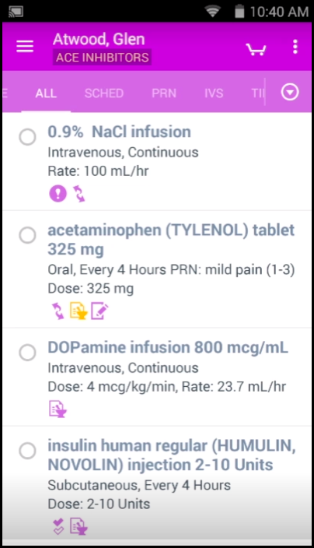
Recommendations/Next Steps
Work with technical team
Continue to monitor metrics
Follow up time study
Explore environmental challenges
Consider barcode inventory system
Image source: welearning.epic.com
Notes:
Continue to work with technical team on network issues.
Monitor the metrics. Another time study will be conducted in January.
Future recommendations include continuing to explore potential environmental changes such as the location of the refrigerators for EBM storage and consider a barcode inventory system for EBM.

Slide 24
Conclusion
Challenges of workflow established
New workflow = new challenges
Preliminary results are promising
change
Notes:
The unique challenges for administration and documentation of EBM feedings in the BUMC NICU have been outlined. The mobile device resolves the issue of walking back and forth between computer and infant. While it is understood that the implementation is a significant workflow change and a new challenge on its own, the preliminary results indicate an improvement in nurse efficiency for the EBM workflow. Eliminating several seconds of unnecessary movement with each feeding can lead to several minutes of nursing time each day that is shifted to direct contact with the infants and their families, improving satisfaction for nurses and families.

Slide 25
References
Doerhoff, R., & Garrison, B. (2015). Human factors in the NICU. Journal of Perinatal & Neonatal Nursing, 29(2), 162–169. https://doi.org/10.1097/JPN.0000000000000105
Lewin, K. C. (1951). Field theory in social science. New York, NY: Harper & Row.
Nelson, R. (2002). Major theories supporting nursing informatics. In S. P. Englebardt & R. Nelson (Eds), Healthcare informatics: An interdisciplinary approach (3-28). St. Louis, MO.: Mosby
Oza-Frank, R., Kachoria, R., Dail, J., Green, J., Walls, K., & McClead, R. E. (2017). A quality improvement project to decrease human milk errors in the NICU. Pediatrics, 139(2), 79. https://doi-org.ezproxy.ttuhsc.edu/10.1542/peds.2015-4451
Probst, C. A., Carter, M., Cadigan, C., Dalcour, C., Cassity, C., Quinn, P., … Xiao, Y. (2017). Utilizing a human factors nursing worksystem improvement framework to increase nurses’ time at the bedside and enhance safety. Journal of Nursing Administration, 47(2), 94–100. https://doi-org.ezproxy.ttuhsc.edu/10.1097/NNA.0000000000000446
Steele, C., Czerwin, A., Bixby, C. (2015). Breast milk bar code scanning results in time savings and staff efficiency. Journal of the Academy of Nutrition and Dietetics 115(1), 23–26. doi: 0.1016/j.jand.2014.06.360
Wight, N. E. (2015). Breastfeeding the NICU Infant: What to Expect. Clinical Obstetrics & Gynecology, 58(4), 840–854. https://doi-org.ezproxy.ttuhsc.edu/10.1097/GRF.0000000000000140
Wojciechowski, E., Pearsall, T., Murphy, P., & French, E. (2016). A case review: integrating Lewin’s theory with Lean’s system approach for change. Online Journal of Issues in Nursing, 21(2), 1. doi: 10.3912/OJIN.Vol21No02Man04

