Slide 1
Partnering for Success: Informatics and
Human Factors Engineers
Donna Montgomery, RN-BC, BSN, MBA
BS&WH System Director of Nursing & Pt. Care Informatics-NTX
Courtney Dalcour, RN, BSN
Informatics Resource Nurse, Baylor University Medical Center
C. Adam Probst, PhD
Senior Human Factors Specialist, BS&WH Office of Patient Safety

Slide 2
Objectives
Describe the role of human factors engineers in healthcare technology
Discuss the partnership of informatics and human factors engineering in
improving the use of technology to improve patient outcomes
Describe methods utilized to quantify baseline workflow metric and
interventions to improve workflow
Describe the skill set & roles utilized to accomplish the workflow
Human Factors @ Baylor Scott&White Health © 2014 2

Slide 3
Background
2012 National Database of Nursing Quality Indicators (NDNQI©) demonstrated a significant decline in nurse satisfaction, despite steady nurse to patient ratios of 5:1 for med/surg units and 2:1 for ICUs
In particular, nurses’ ratings fell significantly on:
Job enjoyment
Staffing
Perceptions of the environment
Indicated that nurses felt more burdened than in previous years.
Human factors was asked to assemble and lead a multidisciplinary team, utilizing a systems engineering framework, to identify solutions
Two pilot units at Baylor University Medical Center (BUMC) were selected
Goal was to win back time and reduce nurses’ workload in order to allow more time for direct patient care activities with minimal threats to patient safety
Human Factors @ Baylor Scott&White Health © 2014 3

Slide 4
Project Overview
1 Med/Surg unit & 1 ICU were selected as pilot sites to:
Map nurse medication administration workflow
Quantify baseline nurse workflow & workload via observation
Identify barriers to nursing efficiency & contributors to workload via a human factors and systems engineering framework
Implement targeted interventions following PDCA rapid cycle improvement methodology
Assess efficiency gains & workload reductions via observation
Interventions focused on:
Optimizing medication preparation workflow
Improving supply management & work efficiencies
Reducing interruptions and distractions for nurses
Human Factors @ Baylor Scott&White Health © 2014 4

Slide 5
Methodology
Methods utilized & taught to team members
Contextual Inquiry
Ethnographic Observation
Weekday & Weekend
0630 – 0930 & 1830 - 2130
Semi-Structured Interviews
Surveys
Baseline
12 observations (36hrs total)
Med/Surg: 6 observations (3 @ 0630 & 3 @ 1830)
ICU: 6 observations (all @ 0630)
Improvement Assessment
10 observations (30hrs total)
Med/Surg: 4 observations completed (2 @ 0630 & 2 @ 1830)
ICU: 6 observations completed (4 @ 0630 & 2 @1830)
Human Factors @ Baylor Scott&White Health © 2014 5

Slide 6
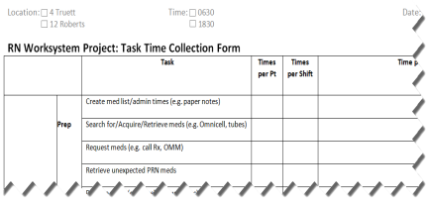
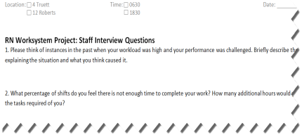
A standardized data collection form was created & utilized to identify primary contributors to nursing inefficiency & workload to prioritize interventions
Identified tasks were timed via direct observation (bottom left)
Semi-structured interview questions guided interaction with frontline staff (bottom right)
Tasks that occurred the most frequently, occupied the most time each shift and were identified as pain points via semi-structured interviews were targeted for improvement.
Standardized time sheet (printed front/back)
Semi-structured interview questions
Human Factors @ Baylor Scott&White Health © 2014 6

Slide 7
Measures
Process Measures
Tasks identified via observation & interviews as bottlenecks to efficiency for:
Medication preparation / administration
Supply Management
Interruptions / distractions
Time that nurses spend to complete tasks collected via direct observation
Outcome Measures
Calculated number of times per shift nurses complete the timed tasks
Calculated mean time spent on each task per nurse per shift
Difference in time spent on tasks before – after interventions to assess improvement
Balancing Measures
Comparison of nurses’ subjective ratings on the occurrences of interruptions before – after interventions (survey)
Human Factors @ Baylor Scott&White Health © 2014 7

Slide 8
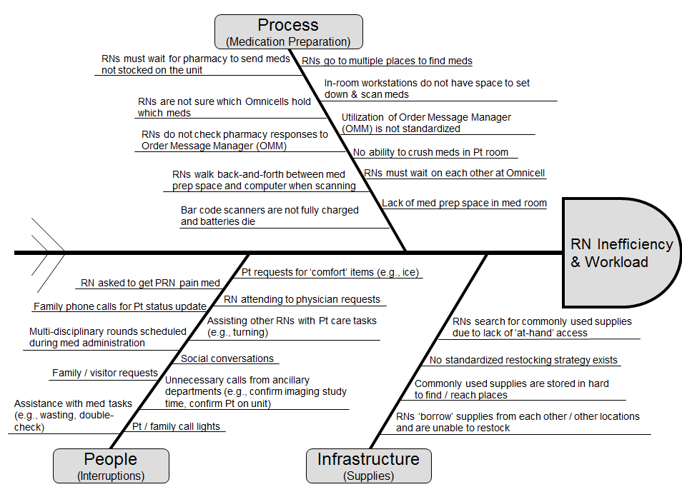
Identified Issues
Human Factors @ Baylor Scott&White Health © 2014 8

Slide 9
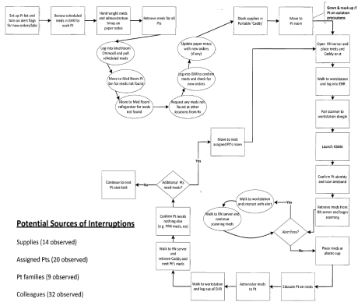
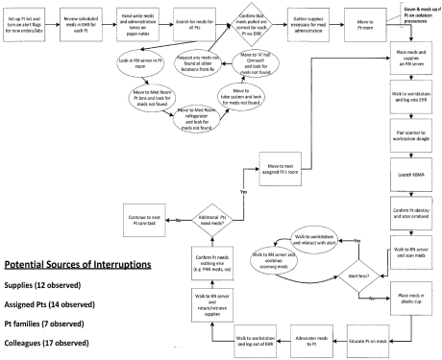
Medication Administration Workflow Mapping
Med/Surg
ICU
Human Factors @ Baylor Scott&White Health © 2014 9

Slide 10
Med/Surg Efficiency Barriers
RNs spend almost 3.5 hours per shift dealing with: supply & medication issues, interruptions, infrastructure issues, and pt / visitor requests
Supplies
RNs spend 1:08 on average per shift on supply issues
Preparing caddys
Searching for meds
Searching for routine supplies
Waiting on meds not stocked
Waiting on access to meds / supplies
Assigned pts
RNs spend 2:06 on average per shift on interruptions from assigned pts
Checking for new orders
PRN meds
Hourly pain meds
Pt care activities (e.g. vitals, toileting, etc)
Colleague, pt family, and outside interruptions
RNs spend :54 on average per shift on interruptions from other sources
Requests for information
Requests for MDs
Requests for conveniences (e.g. water, linens)
Assist other RNs with pt care tasks
Rounding MDs
Social
Assistance with pt care tasks
Assistance with meds (e.g. wasting)
Waiting
*estimated totals derived from observation data and assume a 5:1 Pt to RN ratio
Human Factors @ Baylor Scott&White Health © 2014 10

Slide 11
ICU Efficiency Barriers
RNs spend almost 7 hours per shift dealing with: supply & medication issues, interruptions, infrastructure issues, and pt / visitor requests
Supplies
RNs spend 1:15 on average per shift on supply issues
Searching for meds in 4 locations
Searching for routine supplies
Waiting on meds not stocked
Waiting on access to meds / supplies
Assigned pts
RNs spend 2:00 on average per shift on interruptions from assigned pt
Checking for new orders
PRN meds
Hourly pain meds
Pt care activities (e.g. vitals, toileting, etc)
Colleague, pt family, and outside interruptions
RNs spend 3:58 on average per shift on interruptions from other sources
Requests for information
Requests for MDs
Requests for conveniences (e.g. water, linens)
Assist other RNs with pt care tasks
Rounding MDs
Social
Assistance with pt care tasks
Assistance with meds (e.g. wasting)
Waiting on colleagues
*estimated totals derived from observation data and assume a 2:1 Pt to RN ratio
Human Factors @ Baylor Scott&White Health © 2014 11

Slide 12
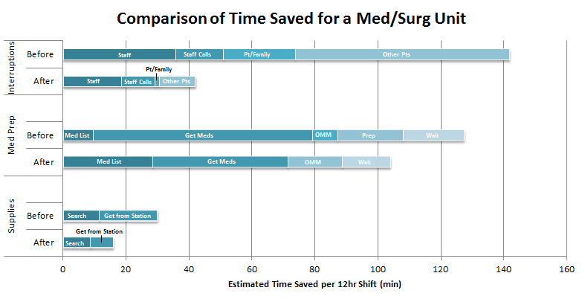
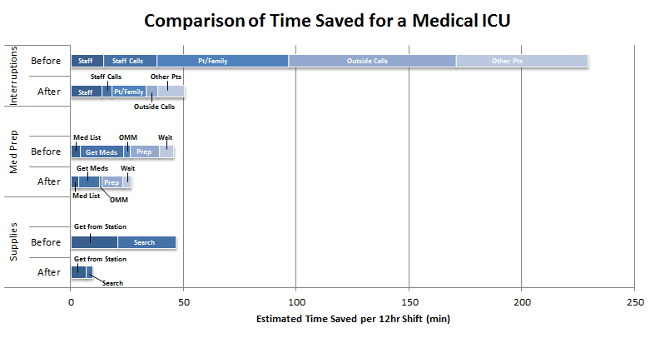
Impact of Improving Nursing Time in BUMC Pilot
Tools to Reduce Interruptions
Unit secretary probing questions & checklist
PCT checklist
Ancillary departments education packet
Pt Safety Zone: protected time during med admin
Tools for Meds Prep
Pharmacy collaboration checklist
Tip sheet for Order Message Manager (OMM) to track frequency of missing meds
Tools for Supply Management
Checklist for supply retrieval disruptions (e.g., glove boxes, syringes)
Tip sheet work efficiency (e.g., using a portable caddy for supplies)
Human Factors @ Baylor Scott&White Health © 2014 12

Slide 13
Summary RN Efficiency Improvement
Med/Surg Total Estimated Time Saved
Total Time Saved (min) | 159.82
% of Time Saved (per shift) | 22.20%
Summary Chart | Time Saved | % of Total Savings
Med Prep | 34.50 | 21.59%
Supply Management | 13.03 | 8.78%
Shift Change | 12.45 | 7.79%
Interruptions | 99.84 | 62.47%
Computer Issues | N/A | N/A
Combined Estimated Total Savings
Time
408.50min
ICU Total Estimated Time Saved
Total Time Saved (min) | 248.68
% of Time Saved (per shift) | 34.54%
Summary Chart | Time Saved | % of Total Savings
Med Prep | 16.76 | 7.60%
Supply Management | 37 | 14.88%
Shift Change | 14.08 | 5.66%
Interruptions | 178.7 | 71.86%
Computer Issues | N/A | N/A
*Estimates based on one RN for one 12hr shift
Human Factors @ Baylor Scott&White Health © 2014 13

Slide 14
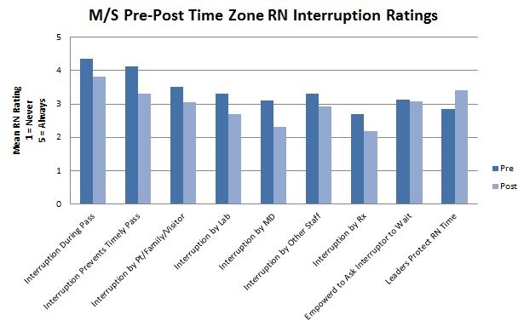
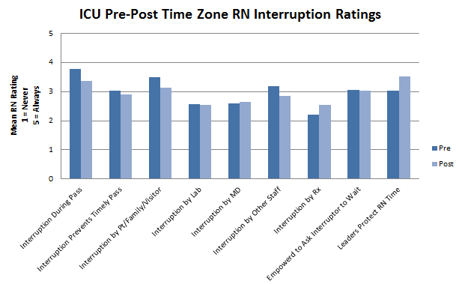
Nurses’ Subjective Ratings of Interruptions
Nurses surveyed were not found to have a dramatic shift in their ratings of the occurrence of interruptions
Time won back was back-filled with tasks required to care for their patients
Prevented acknowledgment of the reduction in interruptions
Human Factors @ Baylor Scott&White Health © 2014 14

Slide 15
Summary of Pilot Accomplishments
Improvement to
RN efficiency
Medication retrieval & administration
Searching for supplies
Interruptions
Infrastructure
ICU medication room
Supply management
Project team education on human factors principles & approaches to safety
Engagement of multiple stakeholders for collaboration on improvement strategies
Human Factors @ Baylor Scott&White Health© 2014 15

Slide 16
Implications to the Enterprise
Detailed mapping of multiple RN workflows
Medication administration with KBMA
Initial documentation strategies
Supply needs
Quantitative, objective measurement of current RN workflows
Estimates of RN time spent on tasks each shift & associated salary costs
Improved understanding of RN workflow challenges
Comprehensive understanding of KBMA & anticipated barriers
Insights into efficiency barriers
Assessment of interruptions & distractions on workflow
Input on intervention strategies
Identification of RN efficiency barriers
Interruptions & distractions
Infrastructure
Supply management
EHR design & usability
Creation of an easy to use Toolkit
Human Factors @ Baylor Scott&White Health© 2014 16

Slide 17
Spread
In order to facilitate spread to other units and facilities, the interventions that achieved marked improvements were packaged into a usable toolkit:
Allows units to pick and choose which interventions will work on their unit & ensures the implementation of interventions is possible via tools (e.g., checklists)
Toolkit spread throughout BUMC via presentation to the Nurse Managers Meeting
Enterprise meeting presentations (e.g., Patient Safety Committee)
Abstract submitted to the 2014 American Medical Informatics Association Annual Conference in Washington, D.C.
Toolkit shared with:
Additional units within BUMC
Facilities throughout the enterprise: Baylor All Saints, Baylor Carrolton & Baylor Heart and Vascular Hospital
Human Factors @ Baylor Scott&White Health© 2014 17

Slide 18
Human Factors Enterprise Vision of Nursing Efficiency: Four Areas of Focus
Value of RN Work
Policy & guidelines for standardization of EHR nursing documentation
Policy & guidelines for RN workload management (e.g. supporting CPOE, teamwork, non direct care activities, etc)
Technology
Analytics to assess RN workload
Mobile access to information, medication scanning and EHR documentation
EHR optimization via user-centric design principles
Infrastructure support of IT & EHR system performance
RN Efficiency
Workflow
Reduction of RN interruptions during medication administration, documentation & supply needs
Improvement of workflow via better ‘tools’
Creating the ideal inpatient / medication rooms and units to support improved RN workflow
Competence
EHR skill development and strategies
Human factors of efficiency at all levels of leadership
Best practices of construction/acquisition to increase efficiency
Problem solving to enhance nursing worksystem
Human Factors @ Baylor Scott&White Health© 2014 18

Slide 19
Project Team
System Leadership
Rosemary Luquire
Don Kennerly
Jan Compton
Donna Montgomery
BUMC Leadership
Claudia Wilder
Rita Fowler
Lynn Randolph
Toni Johnson-Akers
Nursing
Caton Cadigan
IRNs
Cortney Dalcour
Abigail Cartagena
Sandra Squires
Tiana Williams
Jason Jeffers
Ruby Relos
Rachel Jackson
Shameka Butler
Unit Managers:
12R: Penny Quinn
4T: Carol Crenshaw
Patient Safety
Cindy Cassity
Richard Gilder
Adam Probst
Yan Xiao
Ancillary Departments
Pharmacy: Kirk Starr & Angela Straza
IV Services: Melinda Belcher & Kelly Crayton
Radiology: Curt Bush & Melinda Hirshouer
Unit educators
4T: Jessica Strasen
12R: Loan Do
Informatics
Cindy Wohlgemuth
BIS
Chris Matta
Human Factors @ Baylor Scott&White Health© 2014 19

Slide 20
Problems we are trying to solve
Nursing has multiple workflows that require different devices; the desire is consolidation to one device.
Barcode medication administration
Breast milk scanning
Specimen labeling
Blood Administration scanning
Communications-texting, phone calls, reminders and alerts
Unintended consequences have been experienced at BUMC since the replacement of the legacy BCMA to Allscripts.
Purposeful planning and implementation science strategies utilized
Workflow study estimates 26 minutes has been added to each shift per nurse.
KBMA video
Notes:
BCMA is shown to provide a safety net for our patients and the clinicians administering medications, particularly in a closed loop environment, which because of CPOE we now have for most inpatients. In addition, BCMA is the method that Allscripts has certified for our EHR for MU, Stage 2. The KBMA project is was approved as a FY14 IT project. We have learned at BUMC that the physical environment and lack of a mobile device has added approximately 26 minutes to each nurses shift. On the 2 units where workflow was observed and measured that equates to nurses not being able to complete other important care for our patients (efficiency). The Discovery phase was approved by this group to help explore and discover if there was a best mobile solution for implementation of BCMA. Next I would like to show you a video to help you understand the limitations of nurses workspace and how a mobile solution can assist them in a more efficient and streamlined workflow. Discuss the mitigation strategies to get the most optimal workflow possible….

Slide 21
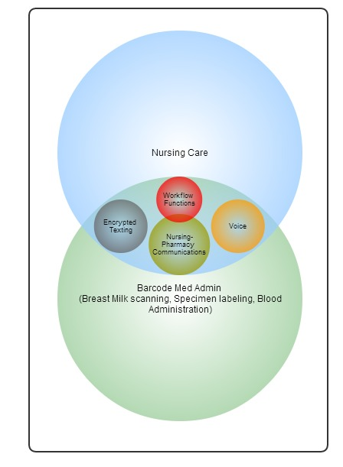
Objectives for Discovery
To consolidate the number of devices used by nursing to one
To provide nursing with a tool to increase efficiencies in workflow
Meet Meaningful Stage 2 Standards (10/1/14)-use of technology to support med administration
Notes:
The Discovery was very helpful in determining the maturity of healthcare technology available for Nursing Mobility. What we found is there is not solution that answers all the wants, needs and desires of our end user community. I will be taking you through a high level review of our findings and then making recommendations for you to consider. They will require additional resources and capacity from IS as well as the organization at large.

Slide 22
Solution Comparison see Appendix***
 | PSS | Allscripts | Motorola | Epic | Spectralink
Medication Administration | ✔ | ✔ P1 of 3 available 4/1/14 | X Future | ✔ Epic Customer Only | X Scanner only
PPID Blood Admin Specimen Collection Breast Milk Scanning | ✔ ✔ ✔ | X | X | ✔ ✔ | X
Secured Communications Text Msg Voice Integration with Nurse Call *Recommended by Telecom | ✔ ✔ X middleware part of application | ✔ ✔ X middleware not part of application | *✔ ✔ X X Future | X Future | *✔ *✔ *✔
Other Clinical Documentation Task List (reminders) | ✔ | X Future | X | X Future | X
Notes:
We evaluated 6 vendors and networked across the country to find out what other health systems and other EHR vendors are doing to support the Nursing workflows-BCMA included. We explored both the iPhone and Android device platforms. The most complete solution, ready for implementation now is PSS, as you can see from the slides (Positive Pt. ID for multiple future modules) Not reliable for Telecom perspective (call dropping). Additional discussion with Children’s in Dallas, using Epic module Rover. Currently enabling Med Admin to eMAR (limited on IV documentation) and other basic documentation (Ht. Wt. and VS), breast milk scanning (utilized Pharmacy module) and lab specimen (foreign lab system) checking. Device is currently Honeywell 7800, bringing forward smartphone capabilities for voice, text and integration with flowsheets, IV smartpumps, etc). ***Additional Information is not shown on this slide and can be reviewed in the Appendix

Slide 23
Recommendations
BCMA deployments using Code (scanner-only) at remaining hospitals and re-evaluate market progression at each Wave.
The purchase of devices-laptops, carts and other handheld devices are
not currently budgeted in some sites (utilize MU dollars to support).
Approval of Nursing Mobility Project (IS, Telecom, Infrastructure, Informatics Resources needed). Additional exploration needed to understand potential pilots.
Consider using Motorola or SpectraLink device as part of Wave 2 & 3
Consider piloting Allscripts mobility solution in Wave 3.
In a separate project, pilot Patient Safe Solutions at BUMC.
Capital dollars need to be spent on investment of infrastructure (mobile carts, re-config of environment).
Purchase Motorola or SpectraLink device, use them as a communication device and scanner in pilot phase.
Notes:
The rollout of KBMA is critical for us to attest for MU Stage 2. The team is recommending a waved approach (slide 5) based on the environmental and workflow assessments done at the facilities in conjunction with Adam Probst/Office of Pt. Safety. The team is also recommending a parallel approach of KBMA rollout and pilots. I am here today to ask for recommendations for how to continue the investigation of solutions for nursing mobility to enable a more efficient workflow for nursing and other clinicians.

Slide 24
Proposed Timeline
Group | Facility | Proposed Date
1 | McKinney | May 24
1 | Carrollton | May 24
1 | Irving | May 24
2 | Denton | June 28
2 | Waxahachie | June 28
2 | AllSaints | June 28
3 | Baylor Plano | August 9
3 | Plano Heart | August 9
3 | Grapevine | August 9
4 | BHVH | September 20
4 | BSH | September 20
4 | OCH | September 20
Considerations:
Using current vendor or dumb scanner
Kickoff meeting for first wave occurs on 2/10
Final deployment will depend on the following elements:
Technical Assessment
Nursing Assessment
Pharmacy Assessment
Facility Deliverables
Geographical Locations
Approval of Nursing Mobility Project (Capacity Issues)
Notes:
Reducing the Critical Path (Hardware Purchase) for Wave 1 only effects Wave 1. All subsequent implementation are dependent on the conclusion of the Planning Phase, not Execution .
Notes:
Targeted facilities are confirming timelines with other important deliverables (Joint Commission Survey, Magnet Accreditations, etc.)

Slide 25
Appendix: Partnering for Success

Slide 27
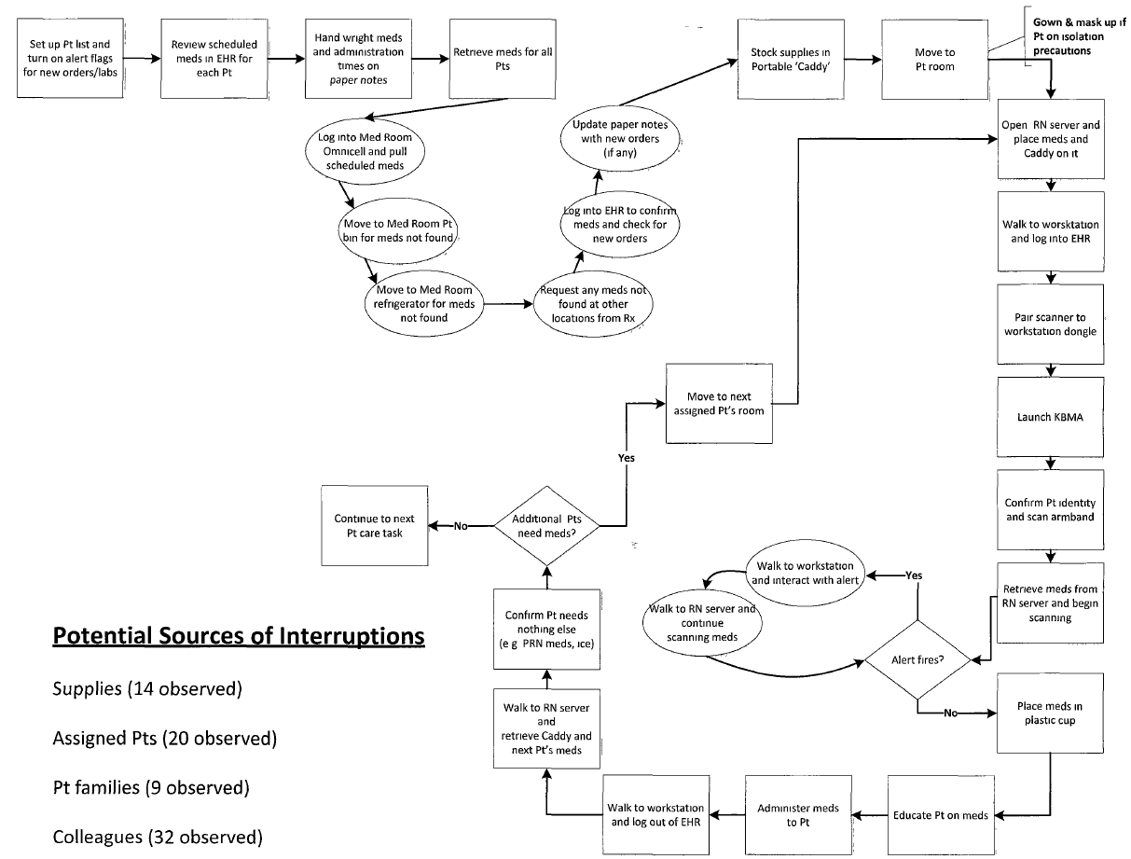
Appendix A: Med/Surg Med Admin Workflow & Interruptions
Human Factors @ BHCS © 2013
Human Factors @ Baylor Scott&White Health© 2014 27

Slide 28
Appendix B: ICU Med Admin Workflow & Interruptions
Human Factors @ BHCS © 2013
Human Factors @ Baylor Scott&White Health© 2014 28

Slide 29
Appendix C: Human Factors Learning Points
DRAFT for Discussion
Importance of observing
Observe, not assume barriers to RN workflow efficiency
Objectively measure current RN workload
Evaluate interventions and impact to RN workload
Interruption and memory burden to address work arounds
RNs make use of paper processes to address memory burden
Utilization of paper as an artifact from
Cumbersome processes
Sub-optimal tools (e.g. EHR)
Interruptions / distractions while completing work
Human Factors @ Baylor Health Care System © 2013 29

Slide 30
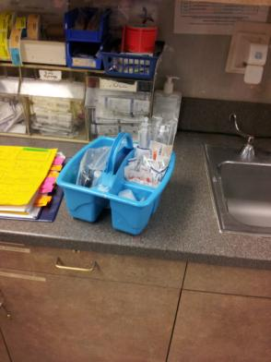
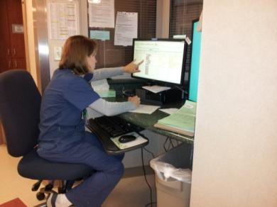
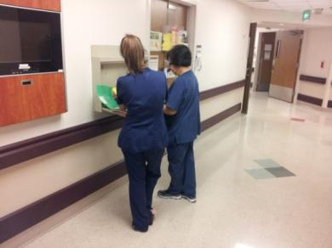
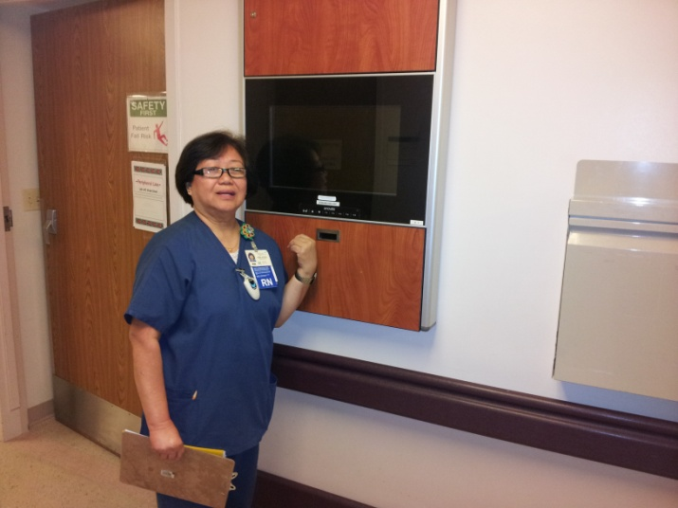
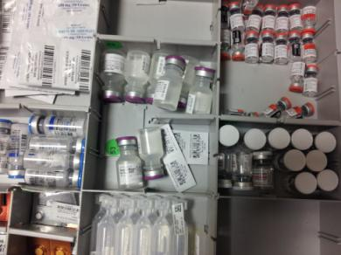
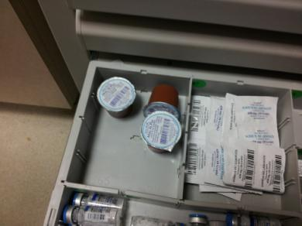
Appendix D: Exampled Inefficient Work System
RNs hand write med admin schedules from EHR (4T)
RNs perform report on hallway RN servers due to lack of space in room (12R)
RNs create their own ‘Caddy’ to keep needed supplies at hand (12R)
RNs avoid hallway mounted workstations due to ergonomics issues (12R)
Omnicell issues: broken bins and missing labels are not fixed due to RN’s lack of free time (4T)
Human Factors @ BHCS © 2013
Human Factors @ Baylor Health Care System © 2013 30

Slide 31
Appendix E: Interventions Literature Summary
Implementation of an ‘Interruption-Free Zone’
Identify a time period where RNs cannot be interrupted unless emergent^{1,4}
Charge RN to cover calls via routing of phones¹
Identify a set time where pt families can call for updates⁴
Night shift RNs to call designated pt family member to update overnight status
Unit secretary to address pt & visitor requests (e.g. call lights)^{1,4}
Interdisciplinary team to design and implement initiatives^{4,5}
Increase safety of med administration
Allow for first round of documentation to be completed (e.g. first shift assessment)
Education of interruptions and medication errors, the motivation for the intervention, and the time period / protocols to:
Frontline staff (e.g. RNs, MD, RT)^{1,2,3,4}
Ancillary staff (e.g. lab, radiology)⁴
pts and visitors (e.g. family, friends)⁴
Utilize signage to inform pts and visitors of intervention^{1,5}
Guidelines for reducing unit and pt room noise levels^{4,5}
Human Factors @ BHCS © 2013
Human Factors @ Baylor Health Care System © 2013 31

Slide 32
Appendix F: Interventions Literature Summary
Supply Interventions
Medications:
Techs round prior to scheduled morning admin time to place all meds in a single location (4T RN server and 12R med room bins)¹
Ensure the medications requested most frequently from each unit are stocked regularly¹
Standardize Omnicell stocking⁵
Supply Stocking strategies:
4 Truett night shift techs to fully stock RN servers in a standardized process with:
Medication administration supplies (e.g. pill crusher, paper cups, syringes, etc)¹
Routine supplies (gloves, linens, tubing, alcohol swabs, gauze, etc)¹
12 Roberts night shift techs to fully stock RN caddys in a standardized process¹
KBMA & Infrastructure Interventions
Select one room on 4 Truett and relocate the wall-mounted workstation next to the RN server to improve interactions with computer³
Human Factors @ BHCS © 2013
Human Factors @ Baylor Health Care System © 2013 32

Slide 33
References
Relihan, E., O’Brien, V., O’Hara, S., & Silke, B. (2010). The impact of a set of interventions to reduce interruptions and distractions to nurses during medication administration. Quality and Safety in Healthcare, 19, e52.
2. Bennet, J. (2010). Effects of interruptions to nurses during medication administration. Nursing Management, 16(9), 22-23.
3. Koppel, R., Wetterneck, T., Telles, J.L., & Karsh, B. (2008). Workarounds to barcode medication administration systems: their occurrences, causes, and threats to patient safety. Journal of the American Medical Informatics Association, 15(4), 408-423.
4. Hall, L.M., Ferguson-Pare, M., Peter, E., et al., (2010). Going blank: factors contributing to interruptions to nurses’ work and related outcomes. Journal of Nursing Management, 18, 1040-1047.
5. Pape, T. M., Guerra, D.M., Muzquiz, M., et al., (2005). Innovative approaches to reducing nurses’ distractions during medication administration. The Journal of Continuing Education in Nursing, 36(3), 108-116.
Human Factors @ Baylor Health Care System © 2013 33

