Slide 1
Supporting Clinical Decision-Making Through Technology
A Sepsis Story

Slide 2
Conflict of Interest Disclosure
Tanna Nelson, MSN, RN-BC, CPHIMS
&
Joni Padden, DNP, APRN, BC
has no real or apparent
conflicts of interest to report.

Slide 3
Session Objectives
Discuss how to use data to support changes to processes
Demonstrate how rule based data mining can improve the accuracy of clinical response
Discuss importance of giving clinicians information at the correct place in their workflow supports better practice

Slide 4
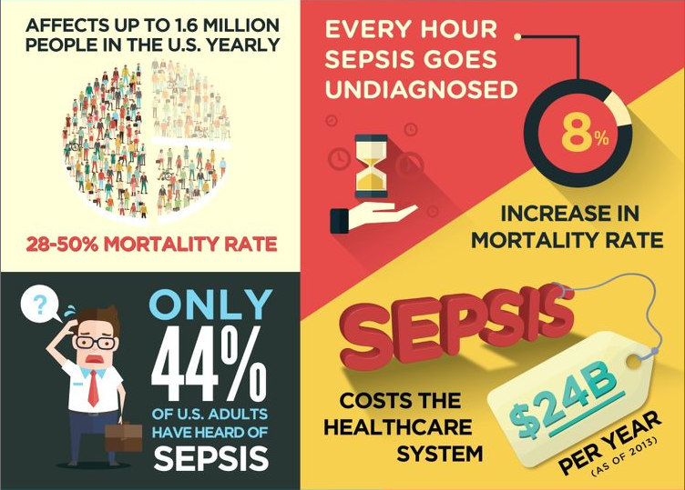
Why Sepsis?
https://learn.premierinc.com/ebooks/sepsis-infographic
Notes:
Nation wide 80% of sepsis patients come through the ED with Present on admission. At Texas Health it’s 92% of patients.

Slide 6
Notes:
VERY BRIEFLY do RCB overview with short focus on Clinical Specs. How the design team insisted on using the paper tool workflow.

Slide 7
Sepsis Screen
Based on a paper tool
Screened 100% of ED patients
Expected the nurse to answer question based on limited information
Does not utilize functionality that would facilitate accurate documentation and timely patient care
Notes:
Joni
conversion of a paper tool to an electronic tool did not translate well
Set up the nurse for failure

Slide 8
Sepsis Mortality Rates & Initial Documentation of Suspected Infection
With some exceptions hospitals have higher mortality rates when suspected infection was answered ‘No’ during screening
Notes:
41% of Sepsis patients were not suspected to have an infection

Slide 9
TOP THREE
Shortness of Breath
Abdominal Pain
Altered Mental Status
Notes:
May want to add a text box to prevent the eye-test slide syndrome

Slide 11
Time to Get Real
Data and outcomes showed intended process was not followed
Even when screening was done correctly we were missing sepsis patients
Eliminate the nurse’s decision whether the patient has an infection
Needed a better way to inform the clinician of the individual patient’s risks/evidence of infection
Put the right information in the right place, at the right time, in the right way, to the right person
Notes:
Joni must provide screenshots and new process info.

Slide 12
Identification of At-Risk Patients in the ED
Goal:
Identify risks for infection accompanied by early indicators of organ dysfunction
Ease the cognitive burden on clinicians
Objective for identification of those at:
Leverage existing research and guidelines
Utilize known characteristics of infection/septic patients
Avoid complex scoring/weighting of attributes
Aggregate information found in numerous locations for succinct viewing
Notify clinicians when simple criteria is met
Notes:
by clearly and succinctly bringing forth pertinent information for informed decision-making

Slide 13
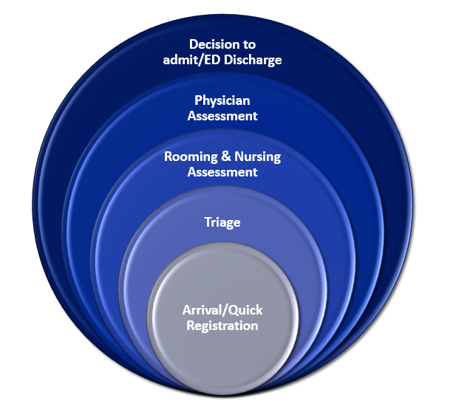
Phases of an ED visit
Documentation and data availability increases as the patient moves through the phases of an ED visit
Each phase contains evidence of suspected infection AND physiological changes when used in the right context

Slide 14
Using What We Know
Who is at risk for infection
Recent hospitalization
Immunocompromised
Recent surgeries, invasive lines, visits for infection, antibiotic therapies
Elderly at higher risk, especially living in a healthcare facility
What is an abnormal functioning body system?
Assessment findings can identify potential problems before it is actually diagnosed
Baseline function of body systems must be accounted for (i.e. renal failure)

Slide 15
Identification Begins Before ED Visit Begins
Patient Arrival
Recent Treatment for Infection
Antibiotics
Recent Procedures
Surgery
Dialysis treatment
Cultures
Isolation
Diagnosis
Chronic Health Conditions
Airways
Wounds/ Incisions
Invasive lines
Implanted device/ports
Immuno-compromise
Extended Contact with Healthcare Institution
Recent Admission
Lives in a nursing home or institution
Cancer
HIV/AIDS
Asplenia
Registration
Arrival Complaint
Triage
Chief Complaint
Vital Signs
Home Meds
Patient History
Living Arrangements
Roomed
Nursing Assessment
Treatment
Orders-Infection- related
Lab results

Slide 16
Notes:
Briefly point out how the 6th step in the RCB process proved our screening process was not working.

Slide 17
Simple Criteria
Risk or Evidence of Infection
2 Body System Abnormalities
THINK SEPSIS

Slide 18
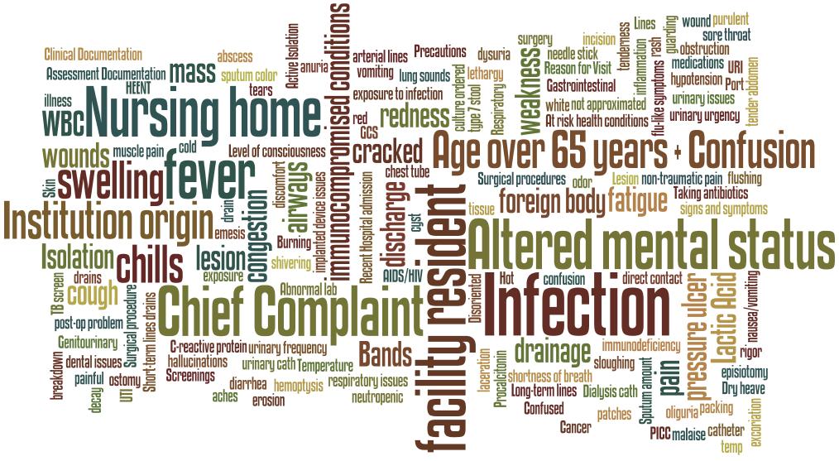
Risk For Infection

Slide 19
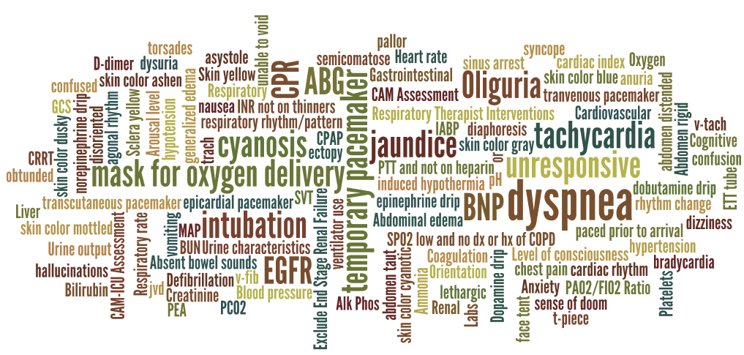
Abnormal Body System Function

Slide 20
From Just Triggers to Real Change

Slide 21
Design Teams
Iterative design team looked at the THINK SEPSIS infection risk identification tool and where to best place it in the ED workflow
Everyone was still thinking of this as a classic ‘screening’ tool, something done during assessment
Physicians requested the new tool to fire for them instead of following the previous workflow of the nurse notifying the physician of a positive sepsis screen
Be very careful what you ask for
Notes:
Joni must provide screenshots and new process info.

Slide 22
Infection Identification
Population: ED patients with Infection (ED physician diagnosis or Coded as POA)

Slide 23
Human Factors
Easy to forget this is NOT a sepsis identification tool, it is a risk of infection identification tool
Risk of infection is so common it is easy to be desensitized
Flu season = the whole world has an infection
Over-firing versus including ‘infection’ in clinical thinking more often
Identifying infection means different work efforts
Timing is everything
Information needs to be highlighted when the clinician can reasonably act on it

Slide 24
Sepsis Identification
Population: ED patients with Sepsis (ED physician diagnosis or Coded as POA) who roomed in the ED 30 minutes or more

Slide 25
You don’t know what you don’t know
Nurse designers and Physician designers
Approved the new workflow using the trigger tool and clinical decision support tools
Triggers in wrong spot
Even after the trigger tool was adjusted to fire less, the alerts were still not in the best place in the workflow for clinicians to act upon
Just because the trigger is met does not mean that is the best time to tell the clinician.
Good intention of instant alert when criteria was met had bad outcome of delaying action to the alert

Slide 26
Flexibility and Rapid Cycle Change
Knew this new process would have unique issues associated
Intense data scrutiny by team to identify issues early
Kept open lines of communication with front line clinicians
Made several ‘tweaks’ to the process immediately
Adjusted triggers to appropriately reduce firing
Knowing what you know now
Listened to clinicians struggles with when alert was firing
Listened to struggles with how to use clinical decision support tools (BPA buttons, order sets)
Rapidly changed tools to meet the needs of front line staff

Slide 27
THINK SEPSIS TRIGGER PERCENTAGE
Change #2:
BPA alerts at Sign Orders
Removal of chief complaints related to trauma (cont.)
Nursing home patients changed from stand-along inclusion criteria to a risk factor
THINK SEPSIS Go-live
Change #1:
remove traumatic ‘risk of infection’ Chief Complaints
Remove chief complaints from physiological abnormalities (except Confusion)
Mean 20.0%
Mean 18.9%
Mean 17.9%
Mean 15.3%

Slide 28
Sepsis POA – Time to Alert
Though the Post Go-Live sample is small we see an improvement of > 2.5 hours in alerting the clinicians
Minutes to 1st BPA*
 | n | Mean | Median | (Min-Max)SD
Pre Go-Live (Jan-Dec 2016) | 6376 | 193.2 | 168 | (0-1981) 202.8
Post Go-Live (Sep 20-Oct 8 2017) | 163 | 50.6 | 11 | (0–1511) 134.9
*ED total time in minutes used for patients who had no alert

Slide 29
Sepsis POA – Time to First Intervention
Though the post Go-Live sample is small, we see an improvement of 17 minutes to first intervention
Minutes to 1st Intervention*
 | n | Mean | Min Max SD | Median Time
Pre Go-Live (Jan-Dec 2016) | 6376 | 75.49 | (-19 to 2438) SD180.8 | 25
Post Go-Live (Sep 20-Oct 8 2017) | 223 | 57.2 | (2-549) SD 82.4 | 27
*ED total time in minutes used for patients who had no interventions

Slide 30
Contact Information
Tanna Nelson, MSN, RN-BC, CPHIMS
Nursing Informatics Specialist
Texas Health Resources
TannaNelson@TexasHealth.org
Joni Padden, DNP, APRN, RN-BC, CPHIMS
Nursing Informatics Specialist
Texas Health Resources
JoniPadden@TexasHealth.org

