Slide 1
A Collaborative Approach to Improving IV Charge Capture
Penny Quinn, MSN, RN, NE-BC
Ericka Boykin, MSN, RN

Slide 2
Conflict of Interest Disclosure
Penny Quinn, MSN, RN, NE-BC
and
Ericka Boykin, MSN, RN
have no real or apparent
conflicts of interest to report

Slide 3
Session Objectives
Summarize the collaborative approach in determining the best solution to capture Intravenous (IV) stop times
Describe the process in outlining which medications should be included in the workflow
Review financial impact of implemented changes
Notes:
Our session objectives include summarizing the collaborative approach we took to improve IV charge capture, describing the process we used in defining medications to be included, and reviewing the financial impact we realized from the changes made.

Slide 4
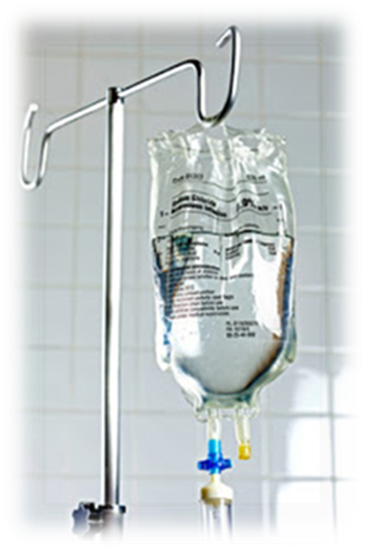
Problem
Loss of revenue due to the lack of consistent documentation of IV stop times
Notes:
The problem we were having was NTX losing revenue because of documentation issues, informatics decided to dig deep into the potential options and see what we could come up with for a solution.
We also knew that if we could “solve” this problem there was potential financial impact in other areas that we could avoid loss in too such as our sepsis patients. We will discuss this later in the presentation.

Slide 5
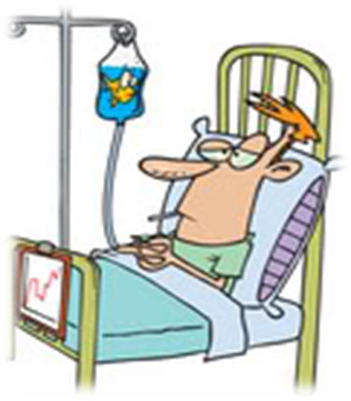
Background
Documentation of infusion stop times are required to capture revenue for visits billed hourly
Previously attempted electronic solutions were not optimal
Created a problematic workflow for nursing
Inconsistent processes
Current state did not have a dedicated field for documentation
Organizational lack of awareness of revenue loss
Poor feedback of opportunities
Revenue cycle regarding charge capture
Nursing
Notes:
Documentation of the stop time for IV infusions is required on visit types that are billed hourly and stop times are also required for IV chemotherapy drugs in order to capture revenue for certain account types. On several occasions informatics was asked to come up with a solution to fix this issue.
The issue we recognized behind why we were missing these charges was that clinicians were lacking a dedicated field or visual reminder/cues to document the needed stop times.
Prior to this project, clinicians were manually documenting in comments field on IV task the stop time. Of course this was when they remembered to do so. This workflow created issues when an IV start/stop crossed a shift. When we began to look at some data around IV stop time documentation we were surprised at the revenue loss figures. It was determined that there was an overall organizational lack of awareness of this revenue loss due to lack of documentation. It was also discovered that there had not been any feedback given previously around the opportunities in this area-no ownership.

Slide 6
Baseline Data Analysis/Trends
Avg I&I* Pmt Per Obs Day (Jan-June 2016) | Annualized Projected I&I Reimbursement (Jan-June 2016) | Total I&I Reimbursement (Jan-June 2016)
$22.88 | $1,696,497 | $538,898
*I&I=Injection and Infusion
Notes:
Here was the baseline data that was collected to begin to have discussions with the CNO’s about the need of this project.
Prior attempts to implement a new process with the electronic health record were not well received largely due to workflow implications for clinicians.
However, when this data was seen and shared it became evident this was a significant problem that we needed to get a handle on.
As you can see for this baseline data capture period of Jan-June 2106, NTX as a whole was only seeing about a $500,000 total reimbursement for IV and injection medications on the select subset of patients in specific visit types.

Slide 7
Goal
75% increase in charge capture from baseline by:
Implementing the IV Stop Task in the Electronic Health Record
Educating clinical staff
Simplifying revenue cycle capture and reporting processes
Notes:
We pulled a group together and developed our AIM statement.
We were a little anxious about our ambition to increase charge capture by 75% but really felt we needed to make a serious go at it.
We looked to accomplish this goal by implementing the IV stop task in the electronic health record, by providing education to clinicians, and by simplifying revenue charge capture and reporting processes for HIM.

Slide 8
Collaboration Plan
Bedside leader
Identify workflow issues
Suggest ideas for improvement
Health Information Management (HIM)/Revenue Cycle
Financial opportunities
Nursing leaders
Awareness of problem
Medication Management Team
Collaborate for potential solutions
Reports Team
Evaluate reporting tool
Notes:
We knew we had to collaborate with a lot of people. The first group we needed to collaborate with included bedside leaders. We needed to determine what the workflow issues were exactly and get suggested ideas for improvement. We knew we needed to involve HIM since they were involved with the charging process. We needed nursing leaders to be aware of the problem. The medication management team was involved to help up determine potential electronic solutions. Then we knew we needed to have a report to capture this documentation in order to have quick assessments and follow up when documentation not completed. We brainstormed and determined we had options to alleviate some of the workflow concerns.

Slide 9
Implementation Plan
Reduce 800 medications down to 400 medications that require documentation task
Implement documentation task
Educate and demonstrate to bedside leaders
Live demonstration of the new workflow/process
Utilize monthly EHR communications
Modify reporting tool for HIM
Webinar education on the use of
Create additional report for nurse managers
Notes:
We could not implement the solution for only those patients with hourly billed accounts so we knew we had to look at the medications themselves to address workflow concern. In prior attempts the visual reminder was on all medications with a route of IV which was greater than 800 medications.
In order to have success with this project, we knew we had to get that list down. So we took the list of 800+ IV medications and really thought through the ones we had potential to gain charges on and narrowed the list down to just over 400. As an example: We knew we didn’t need the Amiodorone drip IV medication on the list as this is given in ICU and those patients will never be in an account that is billed hourly.
We implemented the follow up tasks to trigger as a visual reminder to nurses only for certain IV fluids and piggybacks (that list of just over 400 medications). We knew we had to have a robust, multifactorial communication and education plan.
Our communication and education plan included live demonstrations of the workflow/process at multiple committee meetings for nurses.
We utilized our standard monthly electronic health record communication pathways such as emails with EHR update and some handouts.
We had a report to help us monitor documentation and we used that report to see how we needed to modify it to make it more useful.
Then we worked on this report to improve the capture of documentation of IV stop date and time to have it be more reliable and easily understood.
We hosted webinars with HIM to educate/communicate with them on the use of the new and revised reporting tool. We also worked with the nurse managers to ensure their report was used and understood.

Slide 10
Evaluation Plan
Daily monitoring of report
Reinforce/reeducate as needed when deficits noted
Notes:
Our monitoring and evaluation plan to ensure buy in on the new workflow/process including having units review data from the report on missed documentation opportunities daily at huddles.
We found this truly was the best avenue to reinforce or reeducate if needed when deficits in documentation were noted.

Slide 11
Project Outcomes
Easier documentation
Efficiency for HIM to capture charges
Charge capture improved 550% from the baseline
Annualized reimbursement projection improved by $6.5 million
Notes:
With the implementation of the stop time task to IV fluids and piggybacks, nurses now have a standard, easier way to document when fluids have stopped.
The new workflow/process brought efficiency to HIM to capture charges for patients in select visit status’.
We had a charge capture improvement of 550% from the baseline and includes an annualized reimbursement projection improvement of $6.5 million.

Slide 12
So How Did We Do?......
Notes:
This is our data during the implementation phase of where we were and some key points of activities done.

Slide 13
So How Did We Do?......
Notes:
This graph shows monthly reimbursement totals through February.

Slide 14
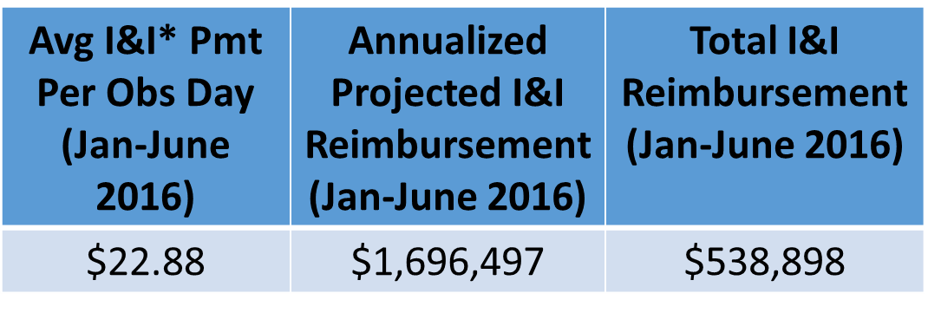
Financial Analysis
Baseline
Avg I&I Pmt Per Obs Day (Oct ‘16-Jan’17) | Annualized Projected I&I Reimbursement | Improvement from Baseline
$145.80 | $8,191,708 | $6,495,211
Notes:
Remember the baseline was $500,00 for 11 hospitals. This graph shows data for post implementation time frame of October 2016-January 2017.
As you can see the NTX total of improvement from baseline for reimbursement projections was about $6.5 million.
Also compared to baseline data, the average payment for charges per observation day (first column) increased from $22.88 to $145.80 and the annualized projected reimbursement went from $1.7 million to $8.1 million, hence the almost $6.5 million difference.

Slide 15
Sustainability
Nursing leaders proactively use the reporting tool
Peer accountability
HIM reporting out on discharge cases
Notes:
In order to sustain this improvement, nursing leaders are continuing to use the reporting tool to monitor compliance.
They are also looking at visual cues in the electronic health record to ensure compliance with documentation especially at key times such as shift change.
HIM at multiple facilities continue to report out on discharged cases when we had missed opportunities with documentation.
HIM is tying this to actual dollar amounts as we found this really makes a bigger impact to get buy in.

Slide 16
Next Steps
Expand IV Stop Task functionality use for clinical decision support (i.e Insulin drip transition, Sepsis bolus stop times for value-based purchasing measures)
Evaluate possibilities of using the process in procedural areas to ensure appropriate charge capture in those areas
Explore IV documentation/charge capture opportunities in the emergency department electronic information system
Promote following the process for all visit types
Notes:
So for our next steps we want to expand IV stop time task functionality to be used in clinical decision support. This includes our transitioning from insulin drip to SQ insulin and sepsis boluses. We are evaluating the possibilities of using this process in procedural areas to ensure appropriate charge capture.

Slide 17
Lessons Learned
Involve other teams earlier
Sharing information at huddles
Native electronic functionality adoption
Notes:
Along the project journey, we did learn some things.
First we learned that we needed to involve some other teams or people earlier in the process improvement activities to solicit feedback and recommendations. When we didn’t have all the right people involved there was some confusion and delays in moving forward.
Next we learned that utilizing the appropriate avenues of communication provided faster turn around for the process improvement. Therefore, sharing data daily in huddles to frontline staff and leaders was most beneficial. Lastly, explore the impact of not adopting native functionality in electronic solutions.

Slide 18
Lessons Learned
Notes:
Lastly and most importantly we learned that being transparent about the financial impact with real dollar figures especially with losses allowed for us to progress with the suggested change.

Slide 19
Questions

Slide 20
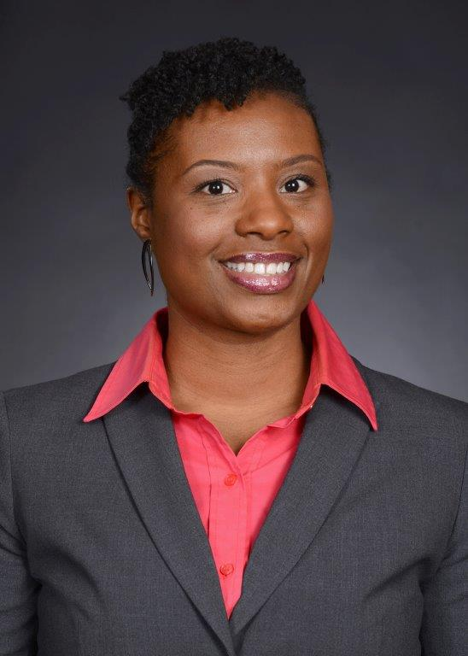
Contact Information
Penny Quinn, MSN, RN, NE-BC
Director, Clinical Informatics
Baylor University Medical Center, Dallas
Penny.Quinn@BSWHealth.org
Ericka Boykin, MSN, RN
Manager, Clinical Informatics
Baylor Scott & White Medical Center Carrollton
Ericka.Boykin@BSWHealth.org

