Slide 1
Interprofessional Practice Structure: Building Strong Foundations and Better Informatics Bridges
2019 Annual DFW ANIA Conference

Slide 2
Agenda Day One
Sponsor Passport
Keynote Speaker
Legislative Update
Executive Leadership Panel
Lunch
Afternoon sessions
Evening Social

Slide 3
Agenda Day Two
Welcome and Sponsor Passport Activity
Patient Safety and Clinical Informatics
Building Screening Tools Based on Informatics Science
Break
Optimizing Practices: Building a Sustainable Structure
EHR Downtime Drills: A Study of Downtime Procedures
Sponsor Passport Activity
Applying the 5 Rights of CDS in the Real World: It’s Messy
Leading Though Change
Closing and Raffle

Slide 4
Join DFW ANIA Today!!
Information about membership can be found at the Registration Desk

Slide 5
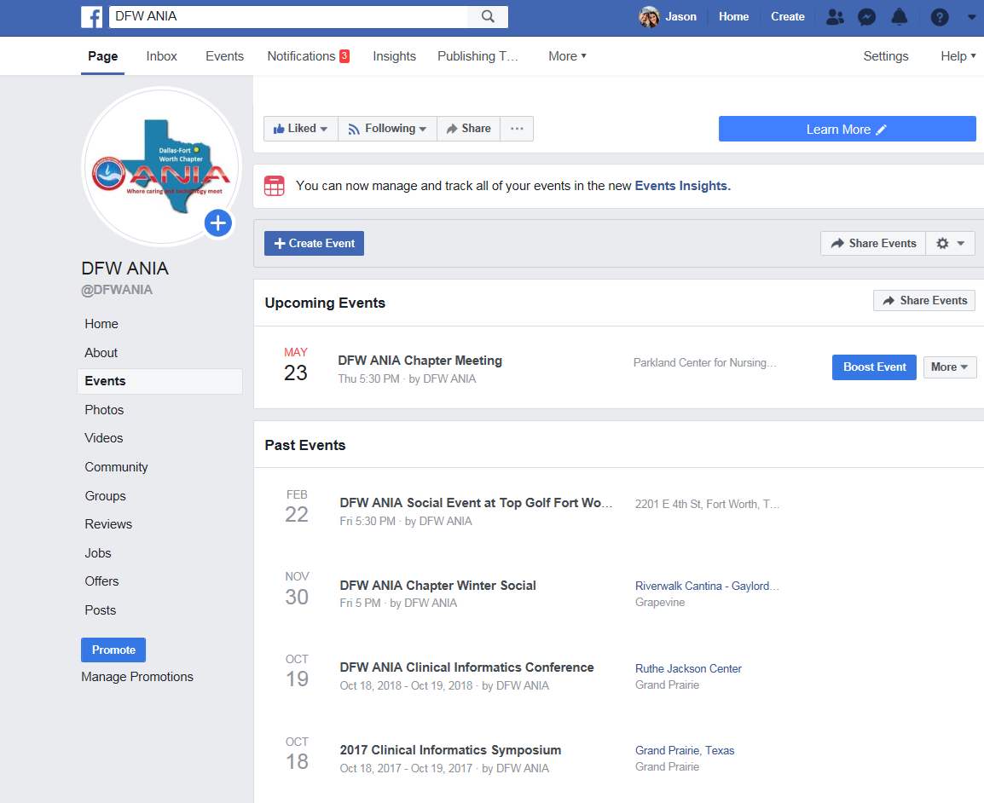
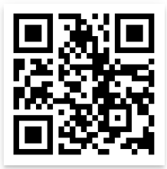
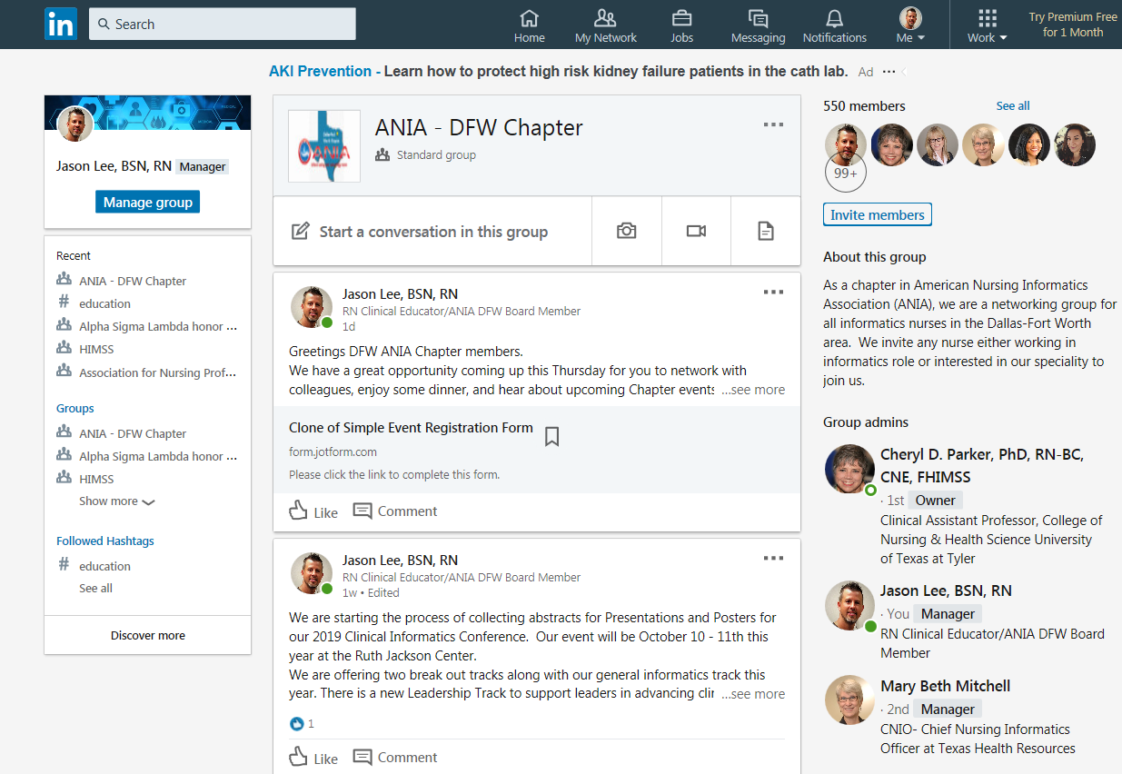
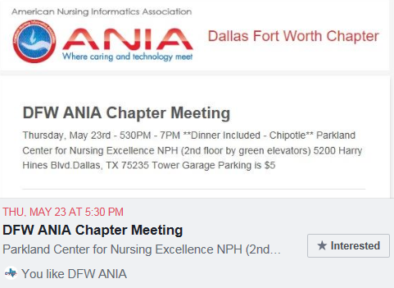
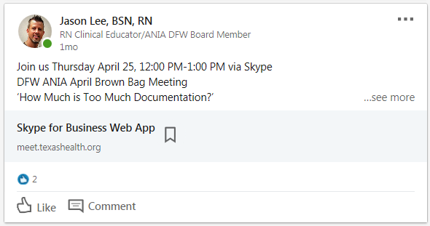
Stay Connected:
Follow Us: QR Codes Located at Registration Desk
Facebook
LinkedIn
Scan the QR code or use the following URL link below:
https://qrgo.page.link/rBDs6

Slide 6
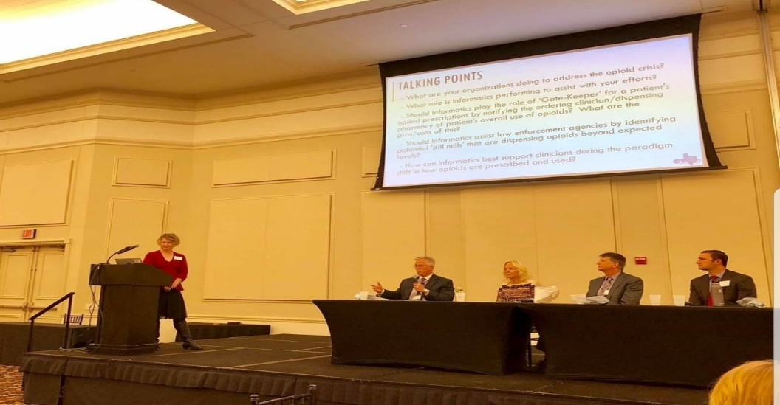
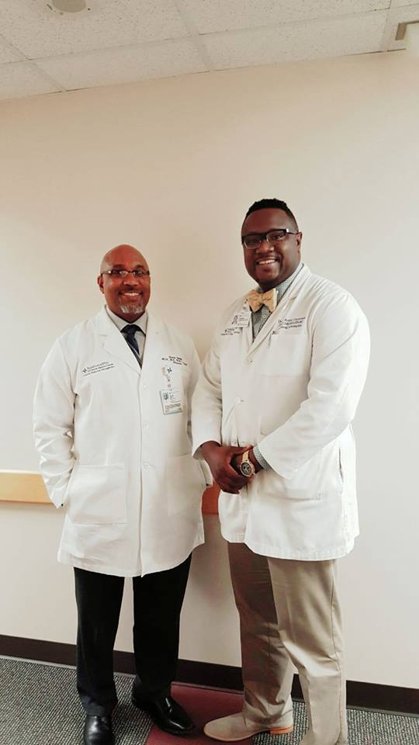
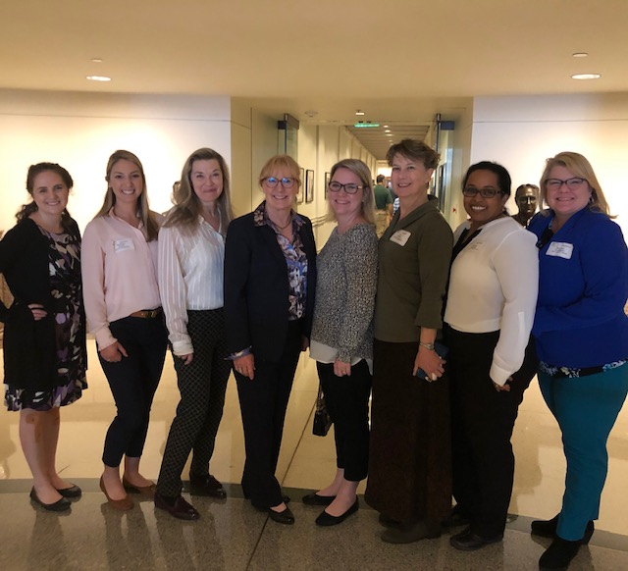
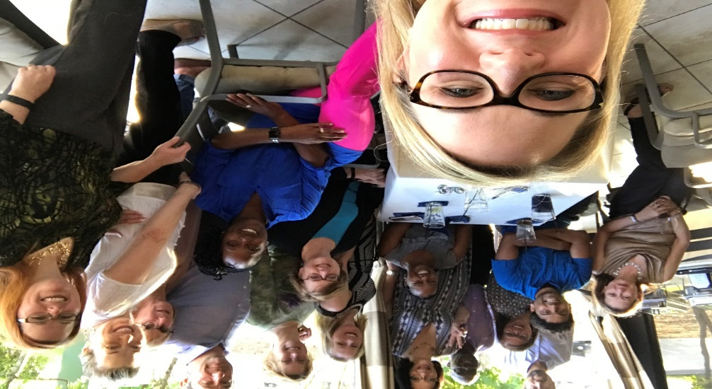
Community Engagement
Continuing Education and Networking
Mentorship
Social Events

Slide 7
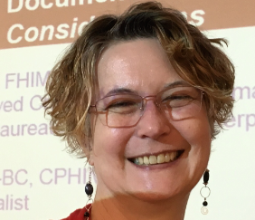
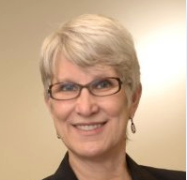
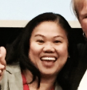
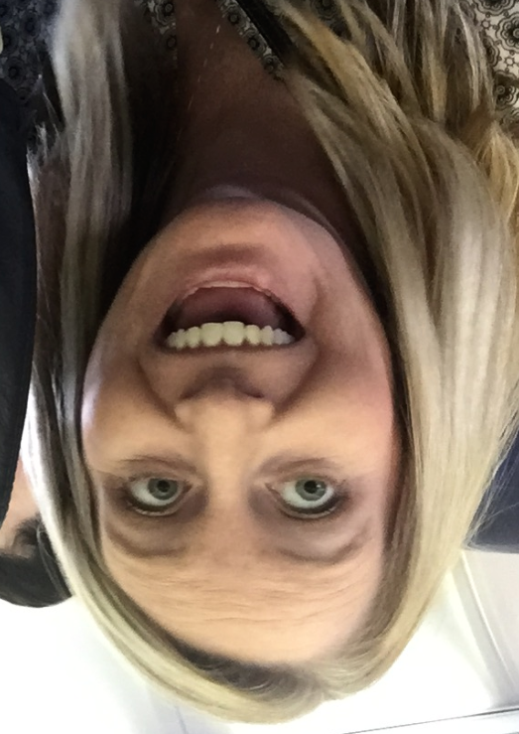
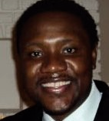
Social Networking Events
We Ate!
We Played!
We Bowled!

Slide 8
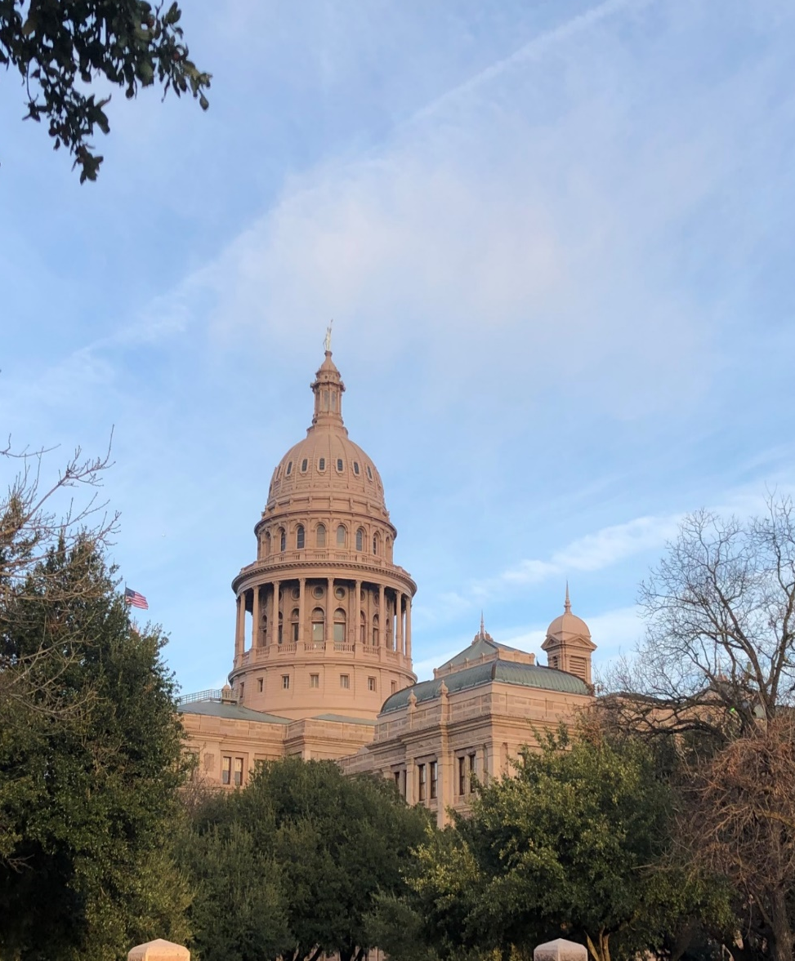
2019 Highlight: Health IT Day in Austin Get Involved!!!

Slide 9
Our Sponsors are Our Partners!
This Years Sponsors:

Slide 10
Get Your Passport Stamped!
Visit the Sponsor Exhibit Hall
Learn from Technology Experts
Get your passport stamped
Completed passport: Enter drawing for **Valuable Prizes**

Slide 11
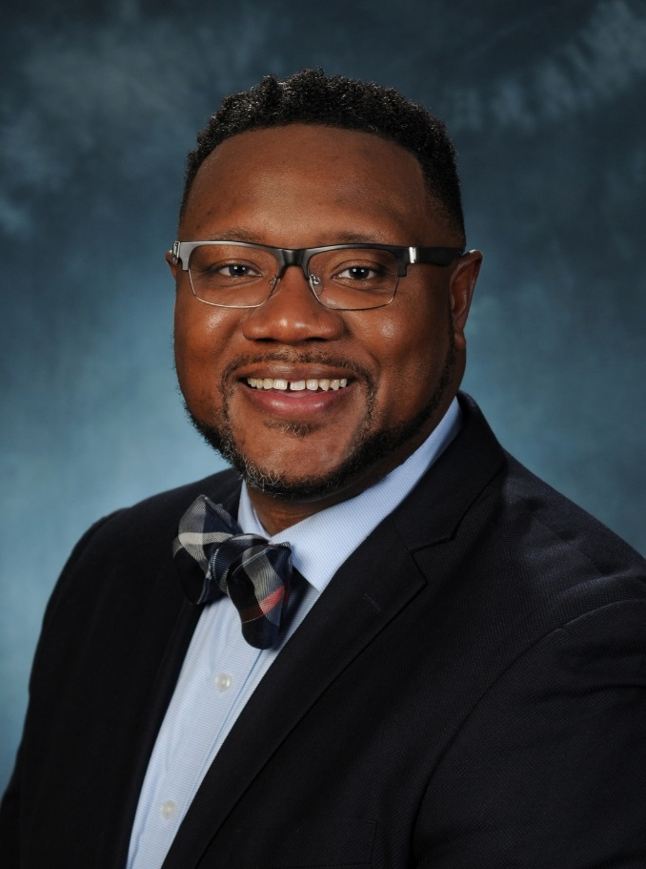
Board Member Updates
Erin Dickerman
Secretary
New Role: Manager, Enterprise Systems
Children’s Health
Dr. D’Andre Carpenter
Chapter President
New Role: Senior Vice President, Enterprise CNIO
Thomas Jefferson University Hospitals

Slide 12
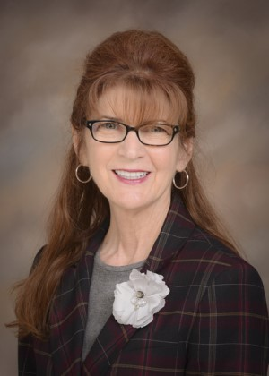
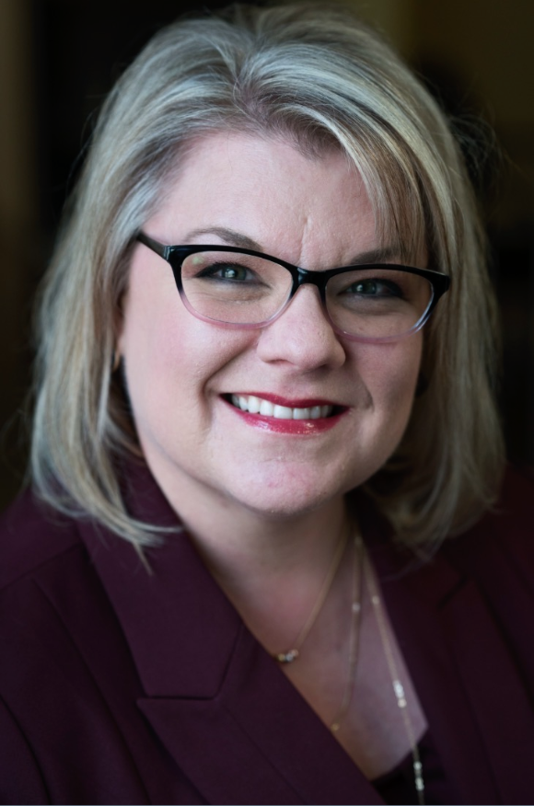
Board Member Updates
Dr. Mari Tietze
Education Liaison
Inducted as: Fellow in the American Academy of Nursing
Dr. Tietze joined as an Expert on Informatics & Technology
Heahter Scrioggins
Treasurer
2019 Employee of the Year, Community Service Award
DFW Hospital Council

Slide 13
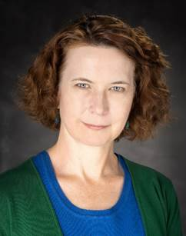
Board Member Updates
Dr. Joni Padden
Your 2020 DFW ANIA Chapter President!!!
Texas Health Resources

Slide 14
Interested in becoming a Board Member?

Slide 15
Board Nomination Process
Either submit your application through the DFW ANIA Chapter section of the ANIA website
OR
Speak/email/call/IM/carrier pigeon with one of the Board members

Slide 16
Board Role Information
Voting and Non-voting Board members
Expanding the Board in 2020
NEED professionals interested in supporting their peers through involvement
IT’S SUPER FUN!! Really.
DFW is an incredibly active chapter and needs YOU to keep the dream alive

