Slide 1
2015 Clinical
Informatics Academy:
Real-Time Locating
Systems (RTLS)
September 25, 2015

Slide 3
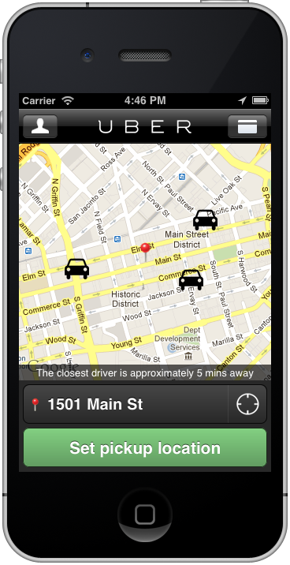
Customer Satisfaction
Provider Satisfaction
Profit

Slide 4
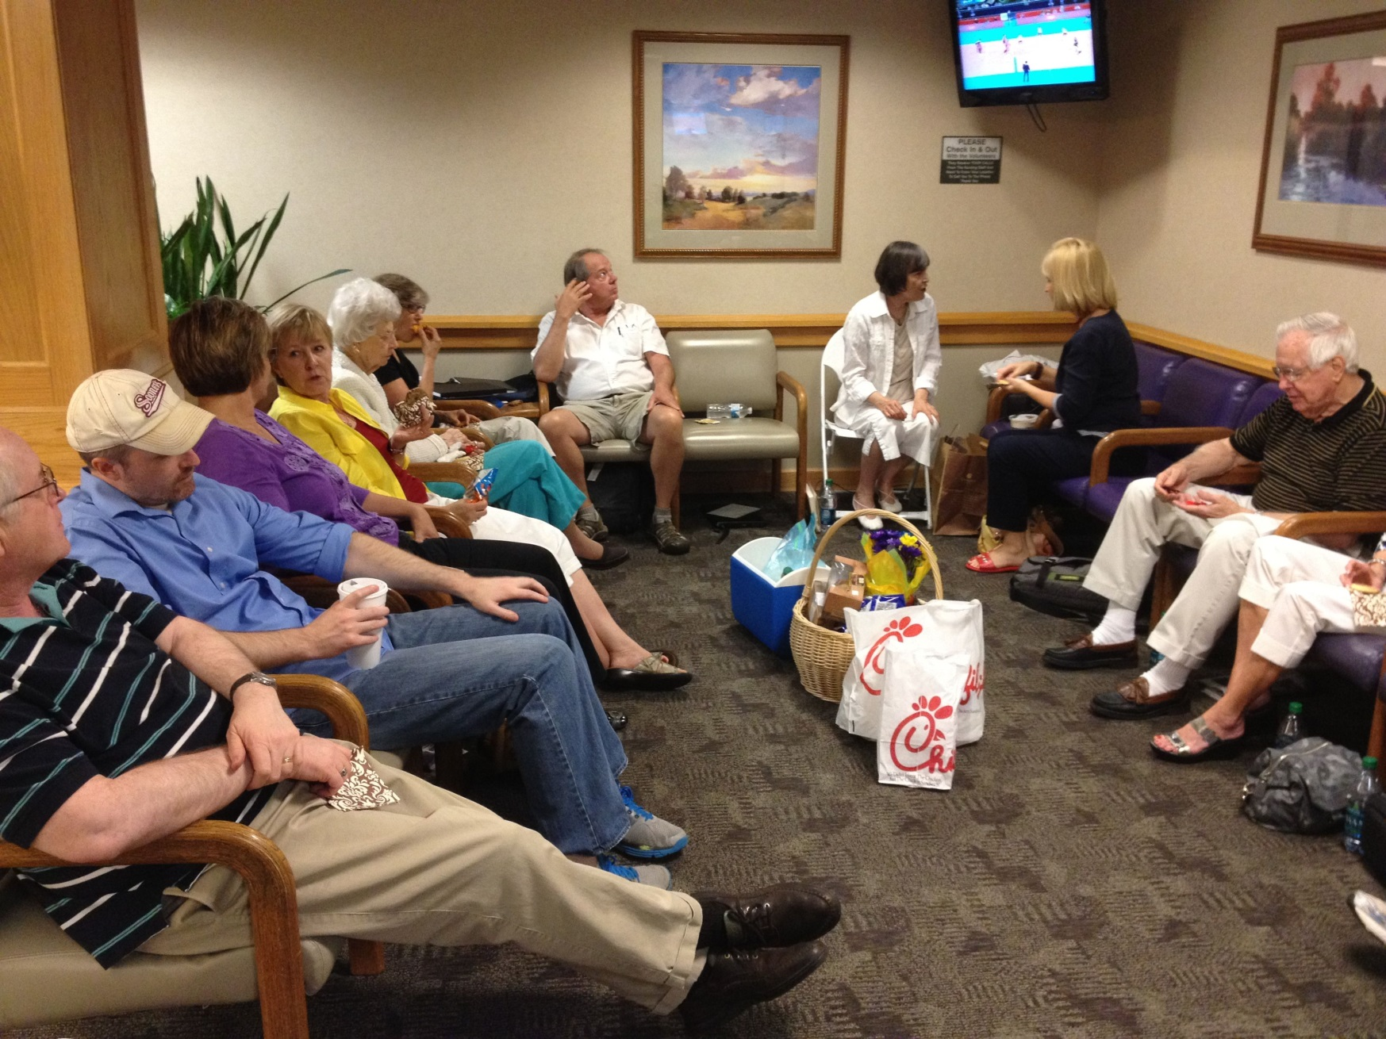

Slide 5
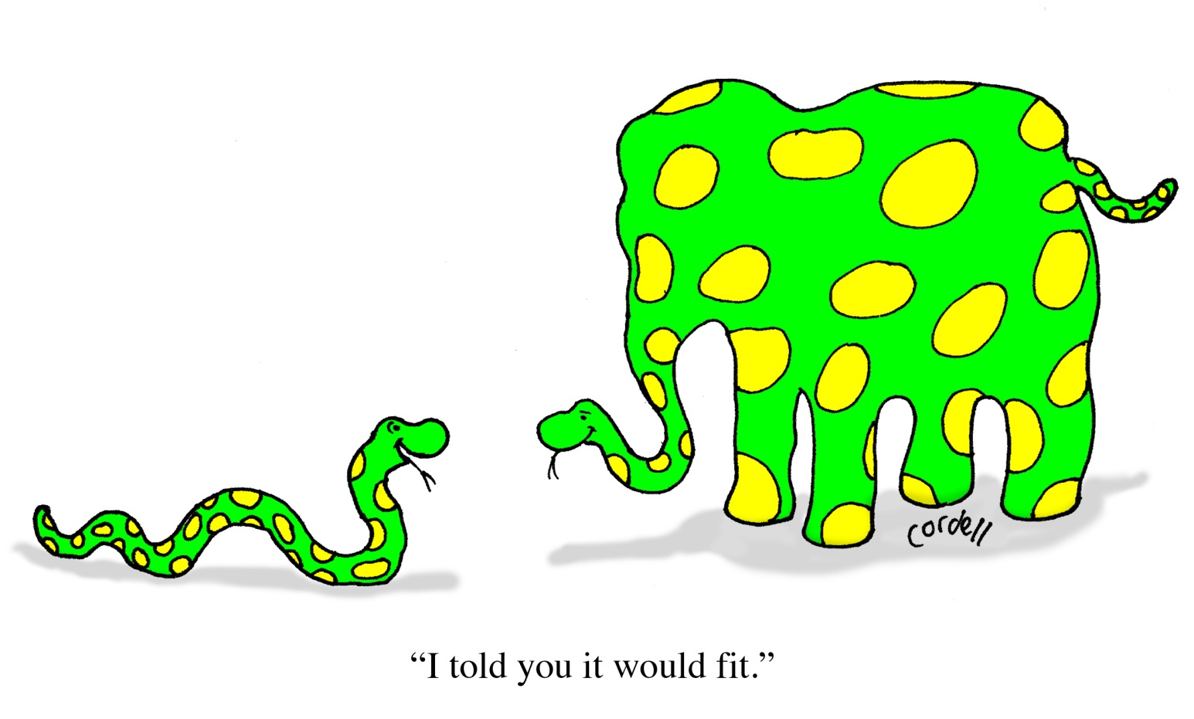
Implement EHR
Increase Revenues
Stabilize Staffing
Maintain/Increase HCAHPS
Increase ED & Clinical Throughput
Reduce Capital Expenditures/Maximize ROI
Improve Patient Care
Reduce Nursing Workload
Consequences of HAIs
Fierce Competition
Increase the Number of Surgeries
Notes:
Key point: U.S. wastes $130 billion per year from inefficiently delivered services. Service delivery is probably the one item on this list that hospitals can actively control.

Slide 6
$750 BILLION
WASTED
EVERY YEAR
http://www.iom.edu/Reports/2012/Best-Care-at-Lower-Cost-The-Path-to-Continuously-Learning-Health-Care-in-America.aspx

Slide 7
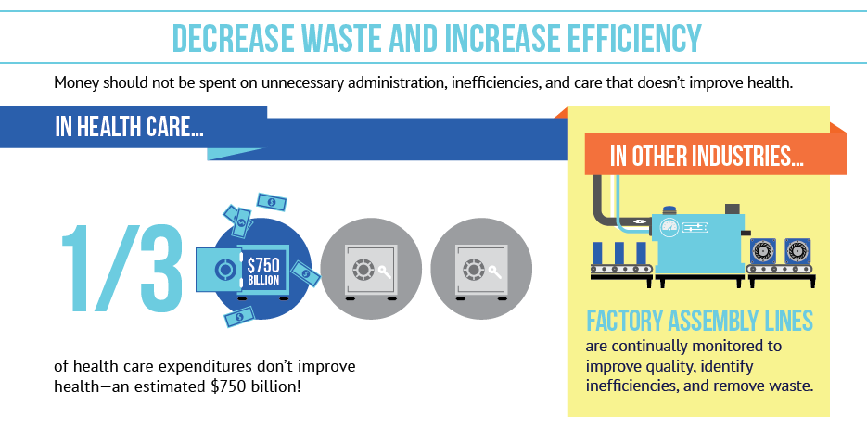
http://www.iom.edu/Reports/2012/Best-Care-at-Lower-Cost-The-Path-to-Continuously-Learning-Health-Care-in-America.aspx
Notes:
Key point: U.S. wastes $130 billion per year from inefficiently delivered services. Service delivery is probably the one item on this list that hospitals can actively control.

Slide 8
Innovation

Slide 9
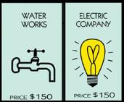
CENTRAK APPROACH
Philosophy – Location should be a utility
Location-enabling the applications healthcare already owns

Slide 10
Notes:
Open, universal infrastructure also integrates easily with your existing IT investments.

Slide 11
A New Paradigm, A New Standard
Notes:
Key point: U.S. wastes $130 billion per year from inefficiently delivered services. Service delivery is probably the one item on this list that hospitals can actively control.

Slide 12
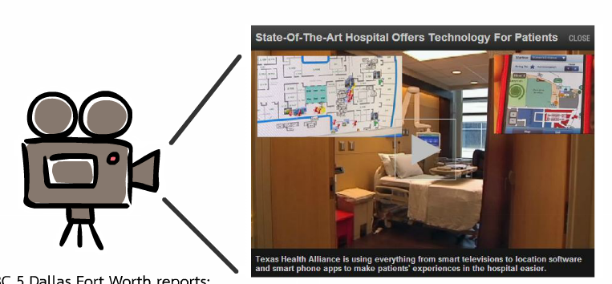
A New Paradigm, A New Standard
Texas Health Alliance Debuting 'Smart' Hospital
RTLS “to make your experience an easier one”.
Notes:
Key point: U.S. wastes $130 billion per year from inefficiently delivered services. Service delivery is probably the one item on this list that hospitals can actively control.

Slide 13
Best Comprehensive
Integration Award
Successfully implemented more than 50 use cases leveraging RTLS
More than $8M in value in 34 months
Temperature Monitoring: $970K/yr
Asset Management: $2M/yr
Redundant Systems Cost Avoidance: $3.5M
Staff Productivity: $2M+/yr
Ability to justify the effort and cost based upon the ROI
Notes:
Use cases: Asset management, temperature monitoring, wait-time management, infection control, patient/staff locating, milestones of care, and many more.

Slide 14
Thank you!
Vince Prosperi
CenTrak, Inc.
125 Pheasant Run, Newtown, PA 18940
Phone: 215.860.2928
vprosperi@Centrak.com

