Slide 1
Managing Post Go Live Depression
Joni Padden, DNP, APRN, BC, CPHIMS

Slide 2
Conflict of Interest
Joni Padden has no conflict of interest to disclose.

Slide 3
Learning Objectives
Understand the psychology behind event related depression
Prepare strategies to combat event related depression
Understand the power of positive thinking and gratitude can be used to improve situations

Slide 4
Post ‘Name Your Event Here’ Blues
Common themes
Big build up to a single event
Lots of work involved to be prepped for ‘the day’
Great expectations of memorable event

Slide 5
Big Events
This Photo by Unknown Author is licensed under CC BY-NC-ND
This Photo by Unknown Author is licensed under CC BY
This Photo by Unknown Author is licensed under CC BY-ND
This Photo by Unknown Author is licensed under CC BY-NC

Slide 6
Notes:
Perspective is important on birthdays. One of my favorite sayings is ‘Beats the heck out of the alternative’. Are birthdays for you a joyous event of celebration of the achievement of still being alive? Or is it a hollow day where you lament your lost youth/vigor/beauty/memory/vision

Slide 7
This Photo by Unknown Author is licensed under CC BY-SA-NC

Slide 8
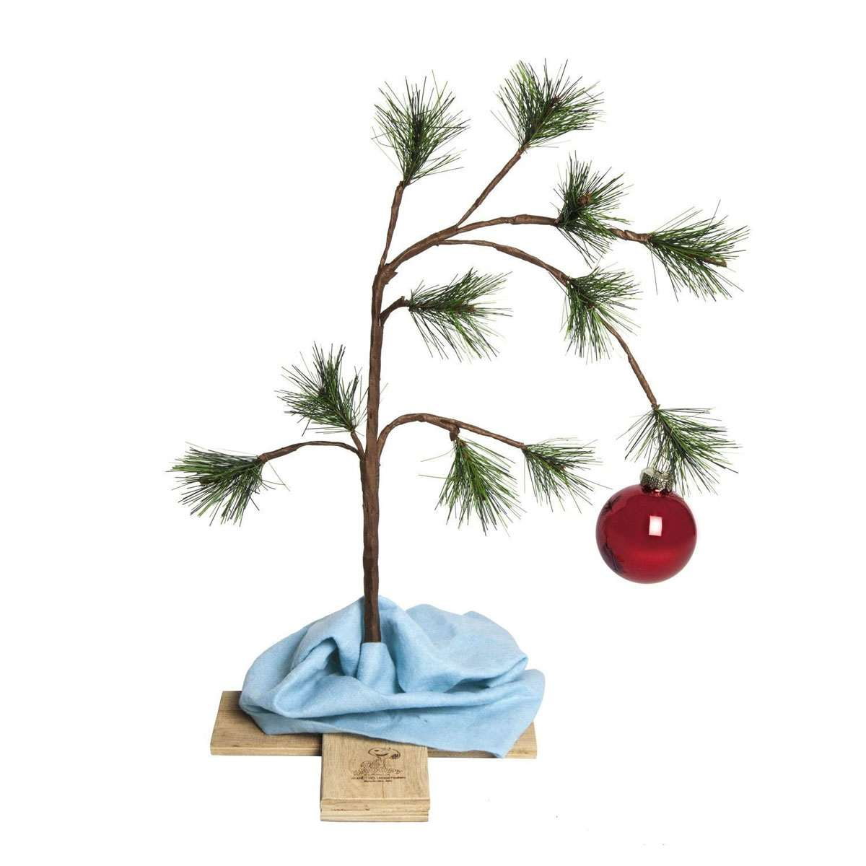
This Photo by Unknown Author is licensed under CC BY-SA-NC

Slide 9
This Photo by Unknown Author is licensed under CC BY-SA-NC

Slide 10
Using Elf-isms to manage go live issues
Four Main Food Groups
Smiling is my favorite
There is room for everyone on the nice list
Get a full 40 minutes of sleep
The best way to spread cheer is to sing out loud for all to hear

Slide 11
Four Main Food Groups
Candy, Candy Canes, Candy Corn, Syrup
Chocolate – Treatment for Dementor-like effects
Stressed is desserts spelled backward, not a coincidence
Licking the icing off of a cupcake makes it a muffin, and muffins are healthy
Salad is not a comfort food

Slide 12
Smiling is My Favorite
Attitude
Be the UP in Upgrade and the LIVE in Go Live
Attitude is EVERYTHING
Gratitude
Know what a bad day really looks like and that you are not having one
Self awareness of happiness
Allow yourself to be happy!

Slide 13
There is room for everyone on the Nice List
Dealing with toxic people
Patronus postulate: A strong happy memory has magic that can protect you from others negativity
See also – Tinkerbell theory – the only way to fly is with a happy thought (and a little Pixie-dust)
Extra credit – Ruby slippers effect – you have the power in you all along
Allowing for personal and professional growth
Everyone has their less than happy day

Slide 14
Full 40 Minutes
Self care
Sleep is vital to good health
If you do not make time for your wellness you will be forced to make time for your illness
Importance of rest
Cleans the brain!
Allows the body to heal as well as the mind

Slide 15
Best Way to Spread Christmas Cheer
Is to sing out for all to hear
To the tune of ‘The 12 Days of Christmas’
On the (first, second, third, etc) day of Go Live, the Help Desk sent to me:
Notes:
First day – Ticket related to security
Second day -

Slide 16
On the _____ day of Go Live, the Help Desk sent to me:
A ticket related to Security
Two transfer issues
Three vendor meetings
Four workflow problems
Five Super User calls
Six system updates
Seven surgeons screaming
Nine Nursing Tip Sheets
Ten Label Misprints
Eleven Printers offline
Twelve doctors fuming
Notes:
First day – Ticket related to security
Second day -

Slide 17
It’s a Wonderful Life
Take away message
Your life/actions touch others in ways you will never know
Your positivity, your upbeat attitude, your ability to reveal the silver lining, may be the tipping point for how others respond/cope
Give yourself permission to be happy and to find the good
Notes:
- story of guy who agreed to play Santa at Scout Christmas, and how he realized that for the kids, he WAS Santa, and how that experience fundamentally changed how he approached being Santa, all from the light in one little girl’s eyes
-

Slide 18
Post Go Live
Will forever be dealing with installation of something
When you cannot see the sunshine, BE the sunshine
No shame in mental health issues
Ask for support from friends/co-workers
Know you are not alone

Slide 19
Questions
???

Slide 20
Contact Information
Joni Padden
jonipadden@texashealth.org

