Slide 1
Politics, Policies and the Clinical Informaticist
Liz Johnson, MS, FAAN, LCHIME, FCHIME, FHIMSS, CHCIO, RN-BC
Retired Chief Innovation Officer, Tenet Health Care

Slide 2
Agenda
Discuss key themes, players and policies for clinical informaticist to consider
Understand both short-term and long-term policy outlook for health IT
Identify key policies and methods for participants to gain access to knowledge and influence

Slide 3
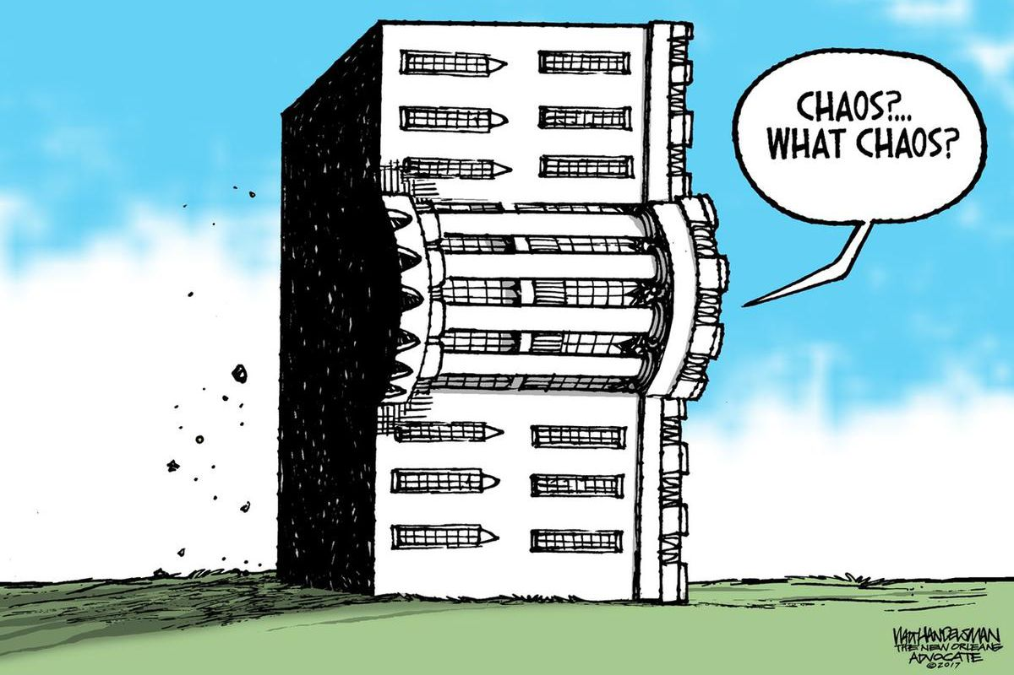

Slide 4
What is our role?
For a very long time Washington has mandated the use of clinical information…..
Now, with the advancements in informatics, the tables are turned and informatics is helping Washington prioritize what to mandate and how.

Slide 5
CMS Administrator Verma’s Personal Story
“We spent almost a week at the hospital and so when my husband was discharged, I asked the hospital for his medical records so I could make sure that his Indiana doctors had all of the information they would need. The doctors looked a little uncomfortable, and they said they would get back to me. After some time, they returned and handed me five sheets of paper, which was essentially just the discharge summary, and a CD-ROM.
I’m going to let that set in for a second. After the federal government has spent more than $30 billion on EHRs . . . I left with paper and a CD-ROM.”
Notes:
Why am I sharing this with you? Because she is on a war path… CMS released the draft Patient Access and Interoperability rule earlier this year, which we’ll dive into shortly, she tells this story just about every time she has the opportunity. This goes hand-in-hand with the ongoing work of the Office of American Innovation which is of course led by the President’s son-in-law, Jared Kushner.
The Administration wants interoperability and is employing a “take no prisoners” approach.

Slide 6
Health IT Policy Trends
Interoperability
Patient Access
Telemedicine
Cybersecurity
Value-based Care & Quality Improvement

Slide 7
Level Setting on Administration Activity Two Critical Agencies
CMS
Willing to use the hammer to move industry
Personal commitment from leadership
ADT requirement
Less stress on Promoting Interoperability Program
Medicaid Reform
ONC
Fighting for funding
Narrowing scope
Future of CEHRT Program
Burden Reduction
Here come the payers
Notes:
Use of Conditions of Participation
Interest coming from the top of the food chain
Interoperability, Certified EHR requirements in CMS payment programs

Slide 8
A Brief History of Health IT Policy
HIPAA
Modernized the flow of healthcare information, stipulate how personal Information maintained by the healthcare entities should be protected and secured.
ONC Established
HITECH
EHR Incentive Program and accompanying certification program to facilitate adoption of EHRs nationally. Results in $35B toward adoption and use of EHRs.
MACRA
Appropriations Act of 2015
JASON Report “A Robust Health Data Infrastructure”
21st Century Cures
Required ONC to produce a report within 90 days of enactment on the extent of health information blocking and a comprehensive strategy to address it.
Report :lack of an architecture supporting standardized APIs, EHR vendor technology and business practices. structural impediments to achieving interoperability
President George W. Bush signs Executive Order to establish National Coordinator for Health IT position.
Required ONC to create a strategy by July 2016 Assess whether interoperability has been achieved by Dec. 2018, If the goal has not reached Report to Congress barriers by December 2019. Rolled MU for doctors into MIPS program.
Addressed provider burden from health IT, information blocking, conditions of certification, HIE network of networks and requests report on patient matching.
REBOOT: Re-examining the Strategies Needed to Successfully Adopt Health IT
Five Senators outlined concerns with current federal health IT policy, including increased health care costs, lack of momentum toward interoperability.
2008
2013
2015
1996
2004
2014
2016

Slide 9
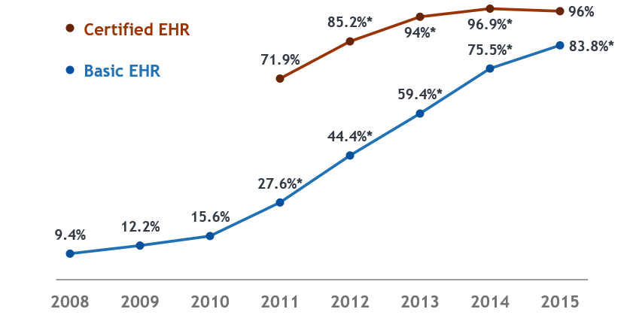
A Look Back at 2009 - HITECH
CMS establishes an incentive program to encourage adoption and “meaningful use” of EHRs
ONC establishes a certification program for EHRs used to participate in MU

Slide 10
21st Century Cures Act
21st Century Cures Act of 2016 passed both the House (392-26) and Senate (94-5) December 7, 2016
President Obama signed Public Law No: 114-255 Dec 13, 2016
Interoperability, Trusted Exchange, Improved Usability

Slide 11
Health IT and Cures
Cures Act = Roughly a dozen major health IT provisions
Address provider burden
Strategy, Certification for specialties and sites of service, provider directory
Improve Conditions & Maintenance of Certification
Real-world testing, EHR Reporting Program (Usability, Interoperability, Security, Communications), Information Blocking, APIs
Ensure Trusted Exchange / Common Agreement
Discourage Information Blocking

Slide 12
Cures Definition of Information Blocking
IN GENERAL.—In this section, the term ‘information blocking’ means a practice that—
‘‘(A) is likely to interfere with, prevent, or materially discourage access, exchange, or use of electronic health information; and
‘‘(B)(i) should know, that such practice is likely to interfere with, prevent, or materially discourage the access, exchange, or use of electronic health information; or
(ii) knows that such practice is unreasonable and is likely to interfere with, prevent, or materially discourage access, exchange, or use of electronic health information.

Slide 13
Cures Definition of Interoperability
Cures defines interoperability in the context of health IT that:
(1) enables the secure exchange and use of electronic health information without special effort on the part of the user
(2) allows for complete access, exchange, and use of all electronically accessible health information for authorized use under applicable State or Federal law; and
(3) does not constitute information blocking
Defined in Section 4003 of the Cures Act

Slide 14
Putting it Simply
Open APIs
Exchange and use of electronic health information “without special effort”
Complete access, exchange, use of all electronic health information
Information blocking is bad

Slide 15
Looking Ahead to 2020
ONC:
Information Blocking Rule
Trusted Exchange Framework and Common Agreement (TEFCA)
Health IT Burden Reduction Report
CMS:
Patient Access and Interoperability Rule
Physician Fee Schedule
Stark Law
OCR:
HIPAA Proposed Rule
FCC
Connected Care Pilot
Broadband Access
NIST:
CSF
Privacy Framework
FDA:
Medical Device Cybersecurity Final Guidance
CDS Guidance
OIG:
Anti-kickback Statute
Provider Info Blocking Penalties
Green = Imminent
Yellow = Open for comment/ Comment Period Closed Recently

Slide 16
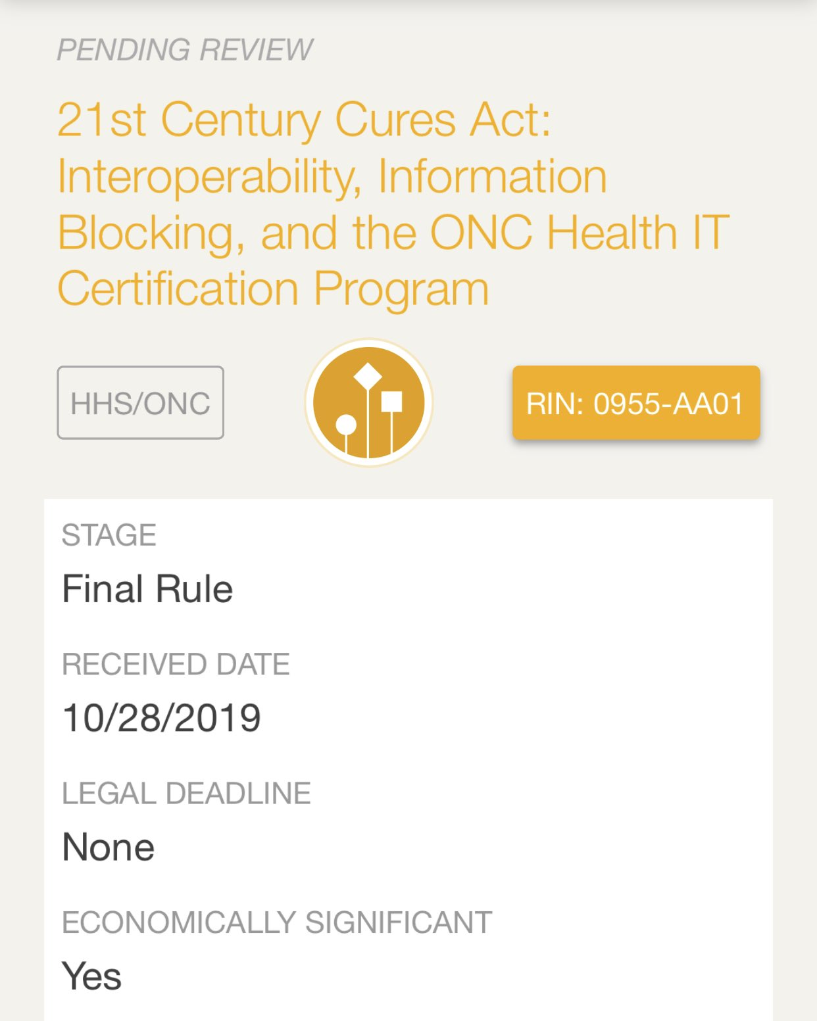
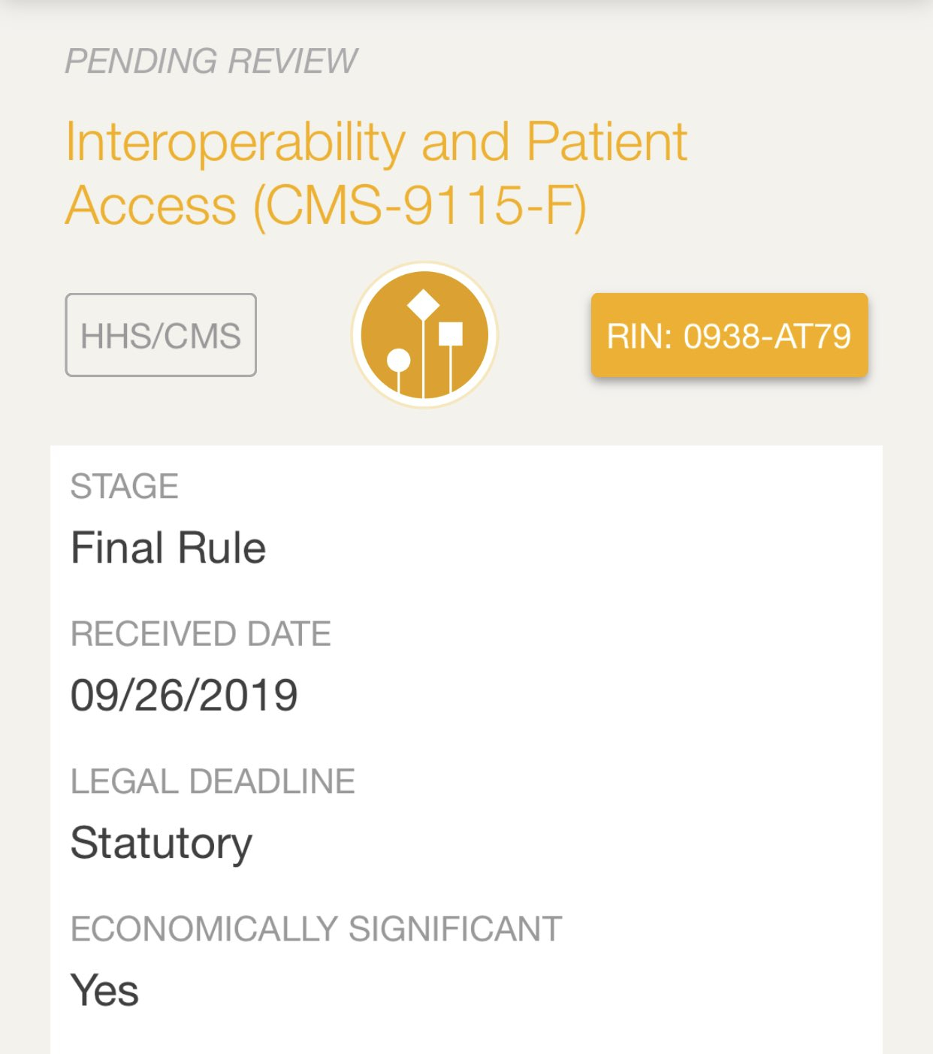

Slide 17
A Look Back at the Proposed Rule
742-page rule released Feb. 11
Three main sections of interest
New functional requirements for Certified EHR Technology (CEHRT)
New standards and specifications (incl. for APIs)
New Conditions & Maintenance of Certification
7 New Requirements
New “safe harbors” for Information Blocking
Notes:
ONC

Slide 18
Keep 2015 Edition
Or
Create a new version.

Slide 19
Open APIs w/o Special Effort

Slide 20
APIs: Open & Without Special Effort
Open & Without Special Effort will be accomplished through:
Standardization
Technical standards and constraining implementation guides
USCDI version 1
Transparency
Business and technical documentation necessary to interact with the APIs in production freely and publicly accessible
Pro-competitiveness
Business practices that promote the efficient access, exchange, and use of EHI to support a competitive marketplace
Certification
Criterion
Certification Conditions

Slide 21
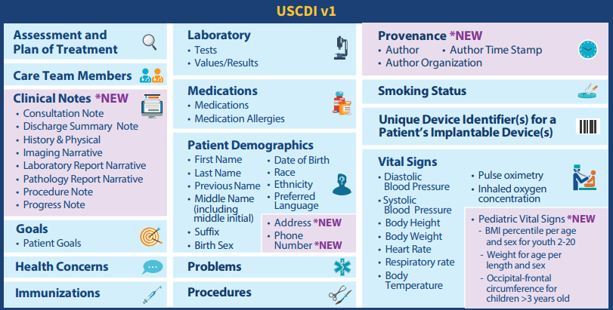
USCDI Version 1
USCDI v1 includes 15 data classes and 50+ data elements
C-CDA 2.1
FHIR R2
Regular cadence of updates expected, but timeline is unclear
Notes:
US Core Data for Interoperability
ONC believes that all of these data classes and elements can be supported by FHIR standards, but it specifies that 6 certification criteria will need to use C-CDA Release 2.1 and an accompanying C-CDA Companion Guide.
“transitions of care” (§ 170.315(b)(1));
• “clinical information reconciliation and incorporation” (§ 170.315(b)(2));
• “care plan” (§ 170.315(b)(9));
• “view, download, and transmit to 3rd party” (§ 170.315(e)(1));
• “consolidated CDA creation performance” (§ 170.315(g)(6)); and
• “application access – all data request” (§ 170.315(g)(9)).

Slide 22
Access to all data

Slide 23
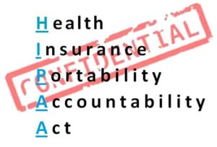
Complete access, exchange, and use of all electronic health information
Meant to support export of a single patient’s data and all of the patients’ data
vs

Slide 24
Scope of EHI
All data health IT system produces and electronically manages for a patient or group of patients.
Health IT’s entire database, including but not limited to clinical, administrative, and claims/billing data.
Any data that may be stored in separate data warehouses that the system has access to, can produce, and electronically manages.

Slide 25
Information Blocking

Slide 26
Information Blocking
One in six (17%) healthcare executives are “completely unaware” of new legislation that requires greater patient access to healthcare records and sharing of such records—with two-thirds (65%) only “somewhat” or “vaguely” familiar, a new Accenture survey finds.

Slide 27
Information Blocking
“Our presumption is you are sharing…Let me repeat that: Our presumption is that you are sharing”
Impacts: Health Care Providers, Health IT Developers, Health Information Exchanges, Health Information Networks
Broadly applicable to all EHI
Seven exceptions outlined in ONC rule
Multiple provisions must be met under the auspice of each exception

Slide 28
Information Blocking Exceptions
Preventing Harm
Promoting the Privacy of EHI
Promoting the Security of EHI
Recovering Costs Reasonably Incurred
Responding to Requests that are Infeasible
Licensing of Interoperability Elements on Reasonable and Non-discriminatory Terms
Maintaining and Improving Health IT Performance

Slide 29
EHR Vendors Under Scrutiny

Slide 30
Patient Access

Slide 31
CMS Interoperability & Patient Access NPRM
Expansion of Blue Button 2.0
APIs required for all federal plans
Requirements to share patient data across payers for care coordination
New Condition of Participation in Medicare change
Hospitals must send electronic notifications when a patient is admitted, discharged, or transferred

Slide 32
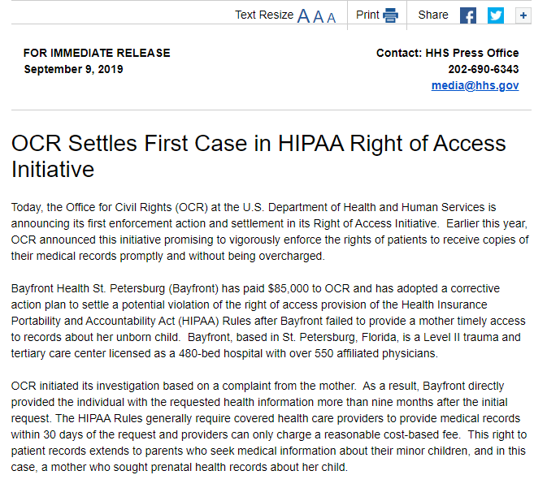
Are you doing enough to share data with your patients?

Slide 33
Telemedicine

Slide 34
The Curse of 1834(m)
CMS expanding telehealth opportunities with help from Congress
SUD Treatment
Medicare Advantage Populations
ESRD
Telestroke
“Virtual Care” and “Digital Communications” offer small, but new reimbursement opportunities
Notes:
Several conditions must be met for Medicare to make payments for telehealth services under the Physician Fee Schedule (PFS) rule, as outlined in Section 1834(m) of the Social Security Act. 1. The service must be furnished via an interactive telecommunications system. CMS’ interpretation of the requirement that the services be performed using an interactive telecommunications system is that this must be a two-way, real-time interactive communication using audio and video equipment between the patient and distant site provider; 2. The service must be furnished by a physician or other authorized practitioner; 3. The service must be furnished to an eligible telehealth individual; and 4. The individual receiving the service must be located in a telehealth originating site (mostly rural). While the law allows CMS to annually add to the list of services which may be performed via telehealth under the above outlined conditions, the statute does not permit the agency to waive the aforementioned conditions.

Slide 35
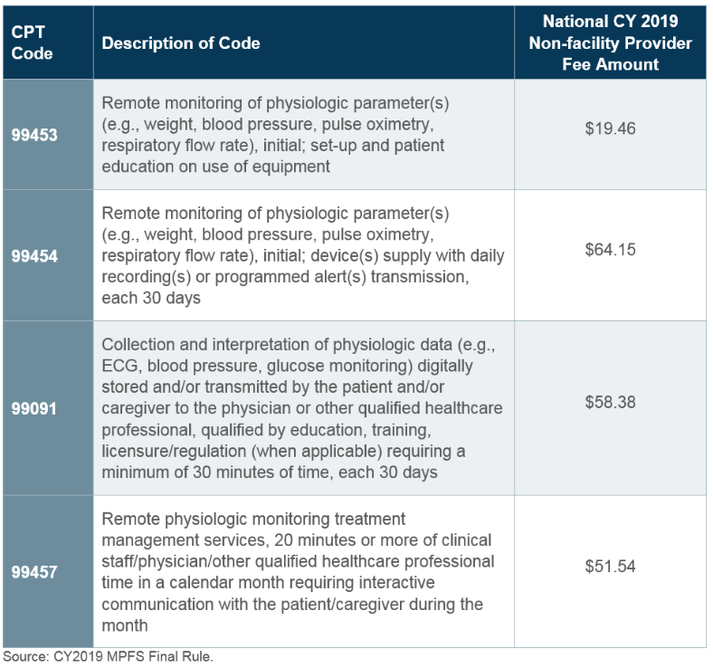
Virtual and Digital Communication Services Reimbursement Changes at CMS
Notes:
Administrator Verma’s stated priority to expand technology-enabled healthcare makes it likely that Medicare reimbursement of virtual health services will expand further in the future. Additionally, the American Medical Association (AMA) has identified CPT codes that could be performed remotely, which CMS may leverage for further expansion of reimbursement of remote services.

Slide 36
Cybersecurity

Slide 37
Still an Afterthought for Most in the Administration
Proposed Stark and Anti-kickback Rules enable donation of cybersecurity services
Forthcoming medical device cybersecurity final guidance from FDA
405(d) work progresses
CMS, ONC doing VERY little
Who “owns” cybersecurity at HHS?

Slide 38
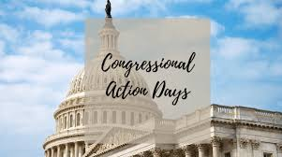
Congressional Action

Slide 39
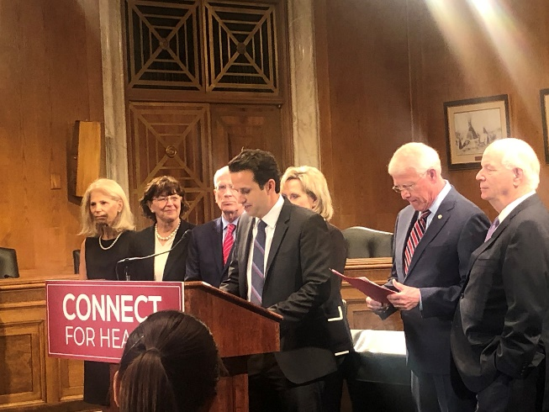
Telehealth
Providing telehealth services across state lines
Telemedicine Across State Lines Act
Overhaul Medicare reimbursement for telehealth
CONNECT for Health Act
Improving coordination of telehealth policies across federal government
E-Consults
MAT via telehealth
Piecemeal Approach vs. Comprehensive Change

Slide 40
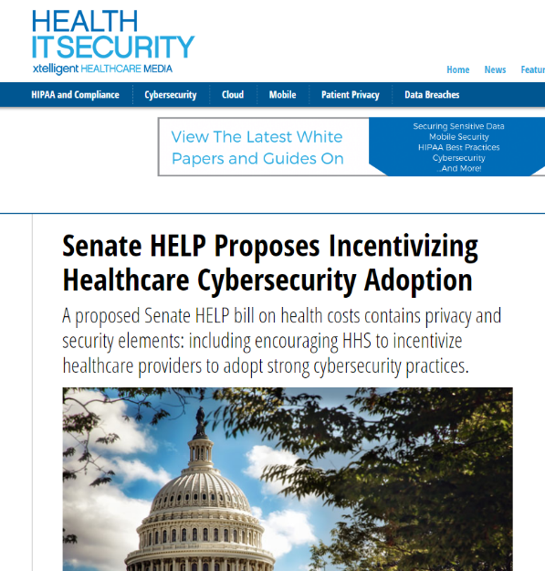
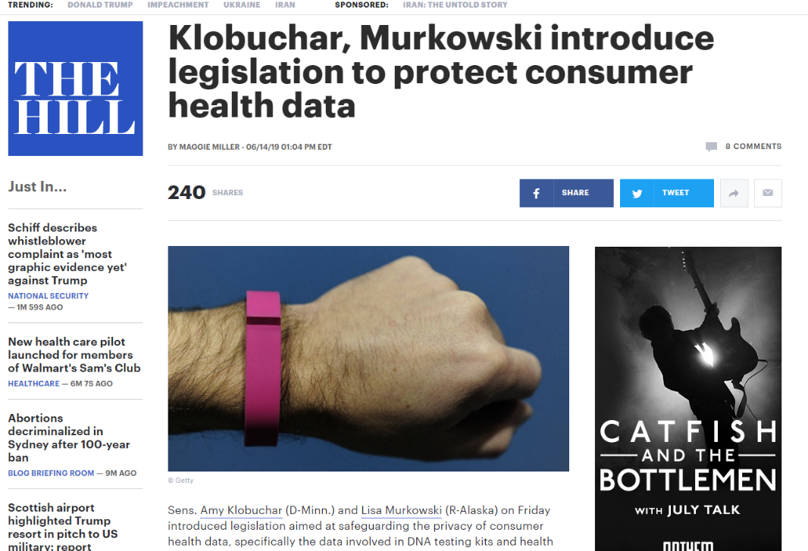
Cybersecurity
Lots of attention… we need action.
Notes:
Congress may be distracted by other non-healthcare priorities, but they have still had plenty of time to dig into some healthcare security and privacy issues. We need to continue educating, advocating and

Slide 41
Cures Oversight & Cures 2.0
Building on forthcoming interoperability rules
Address patient empowerment & access

Slide 42
Consumer Privacy
Call to overhaul national data privacy policies
State law preemption
Private right of access
Use of data by third-parties
Where does health data fit into the conversation?

Slide 43
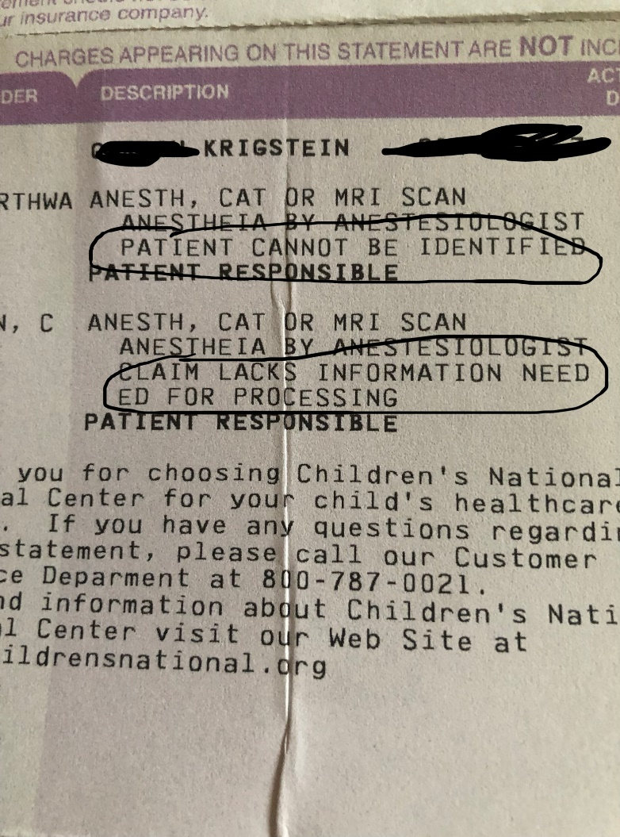
Patient ID Use Case
Scenario: A patient in cardiac arrest was mistakenly not resuscitated because the care team pulled the wrong patient’s record and adhered to a do-not resuscitate order.
Scenario: A cardiac clearance for surgery meant for a different patient was given to a patient who previously had an abnormal electrocardiogram. The patient underwent surgery and was found unresponsive in his hospital room the next day.
Scenario: The wrong meal tray was given to a patient with a nasogastric tube who was not to receive any food or fluids orally. The patient attempted to eat the food and choked.
Scenario: The wrong patient was marked as deceased in the doctor’s office EHR. All of her outstanding appointments were automatically cancelled.
Scenario: Two patients with the same first name were scheduled for cataract surgery. The wrong patient was brought into the operating room and received the lens implant intended for the other patient.

Slide 44
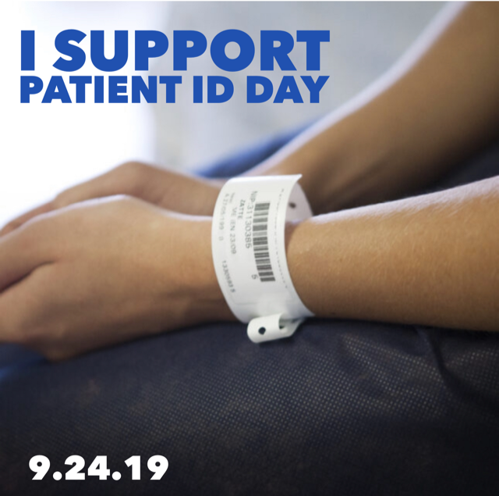
Action with a Purpose

Slide 47
And personally, from me to you…. Go for it!
“I have an almost complete disregard of precedent, and a faith in the possibility of something better. It irritates me to be told how things have always been done. I defy the tyranny of precedent. I go for anything new that might improve the past”.
Clara Barton (1888)
UTA Commencement May, 2017

Slide 48
Questions
Contact Information:
Liz Johnson
l.o.johnson@verizon.net

Slide 49
Additional Information

Slide 50
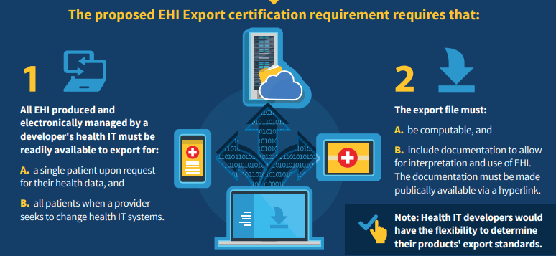
EHI

Slide 51
ONC’s Definition of EHI
EHI is not specifically defined in the Cures Act, HITECH Act, or other relevant statutes. ONC proposes to define EHI to mean:
(i) electronic protected health information (ePHI); and
(ii) any other information that –
is transmitted by or maintained in electronic media, as defined in 45 CFR§160.103;
identifies the individual, or with respect to which there is a reasonable basis to believe the information can be used to identify the individual;
relates to the past, present, or future health or condition of an individual; the provision of health care to an individual; or the past, present, or future payment for the provision of health care to an individual.
ONC Definition of EHI: VIII.C.3 (pg. 344 of pub_inspec.)
Notes:
In particular, unlike ePHI and health information, EHI is not limited to information that is created or received by a health care provider, health plan, health care clearinghouse, public health authority, employer, life insurer, school, or university. EHI may be provided, directly from an individual, or from technology that the individual has elected to use, to an actor covered by the information blocking provisions (around page 344 of public inspection desk version of the NPRM).

Slide 52
Lessons Learned from DoD-VA
One record per patient is the goal
Single method to identify patients
Collaboration at clinical level
Who will “win”
Leadership struggles
Political headwinds

Slide 53
Non-Government Players in Policy Arena
Sequoia Project
eHealth Exchange
Carequality
CommonWell Health Alliance
DirectTrust
HL7
CARIN Alliance

Slide 54
CMS Payment Policy
Inpatient Prospective Payment System (IPPS)
MU aka the Promoting Interoperability Program (PI Program)
Physician Fee Schedule (PFS)
Merit-based Incentive Payment System, Alternative Payment Models, CPT Codes and E&M Guidelines
CMS Innovation Center (CMMI)

Slide 55
Value-based Care & Quality Initiatives

Slide 56
Value-based Care Update
The Health Care Payment Learning & Action Network (LAN) APM Measurement Effort revealed the following for 2018 payments:
39.1% of health care dollars in Category 1 (e.g., traditional fee-for-service or other legacy payments not linked to quality)
25.1% of health care dollars in Category 2 (e.g., pay-for-performance or care coordination fees)
35.8% of health care dollars in a composite of Categories 3 & 4 (e.g., shared savings, shared risk, bundled payment, population-based payments, integrated finance and delivery system payments)

Slide 57
Federal Reimbursement Goals for 2025
New goals outline the percentage of health care payments that are tied to shared accountability APMs:
Medicare Advantage & Traditional Medicare
30% by 2020
50% by 2022
100% by 2025
Medicaid
15% by 2020
25% by 2022
50% by 2025
Commercial
15% by 2020
25% by 2022
50% by 2025

Slide 58
Nursing Informatics
Data has become information…
Information has become knowledge…
Knowledge has become wisdom…
Wisdom – real time wisdom is saving patients’ lives

