Slide 1
Onenote Overview and Use Case
Ona Bonsell & Jessica Camp Englund
Adventist Information Technology

Slide 2
OneNote
Basics to Driving One Informatics Team
Ona Bonsell and Jessica Camp England

Slide 3
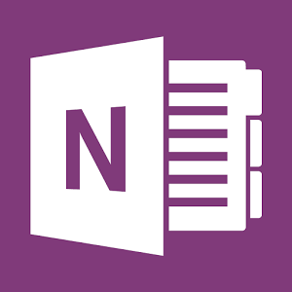
What is OneNote?
OneNote is a Microsoft Office application used for free-form information gathering and note taking.

Slide 4
What is the “cloud”?
Storing and accessing data over the Internet instead of your computer's hard drive.

Slide 5
What is Office 365?
Office 365 is a “Cloud Service” with access to a suite of Microsoft applications such as calendar, email, online storage and collaboration, web conferencing, and much more.

Slide 6
Let’s Explore OneNote

Slide 7
Informatics Notebook Examples
Notes:
In this example I keep track of the change requests I have submitted. This is an Excel Spreadsheet. If I need to make changes I choose edit, make my changes and save. OneNote automatically updates.

Slide 8
Informatics Team Notebook
Provider Checklist
Ensures all important points are addressed
Notes:
This is an example of our provider training checklists. We all cover different areas, but occasionally a need arises for someone to train a provider outside of their normal comfort zone. We have these checklists to make sure that all important training points are addressed. We print this out and the provider signs at the completion of training

Slide 9
Great to use in place of spreadsheet on X drive
Notes:
This is an example of our spreadsheet for provider training. When we receive our new provider list from Med Staff we load that information in and all are able to access to note when training is scheduled and with whom. Unlike a spreadsheet on the X drive, this can be accessed by multiple people at a time.

Slide 10
Another Live Example

Slide 11
Smart room tour
Thank you for joining!

